Slide 1
2018 NSF SMART AND CONNECTED COMMUNITIES PI MEETING
PG: SCC-Planning: Coordinated Autonomous Operation of UAVs in Urban First Responder Scenarios
NSF Award 1737496
Christian Poellabauer¹, Jane Cleland-Huang¹, Vijay Gupta¹, Greg Madey¹, Steve Cox², Andrew Wiand³
¹University of Notre Dame, ²South Bend Fire Department, ³enFocus, Inc.
http://sarec.nd.edu/pages/projects_uav.html
Notes:
BRIEFLY INTRODUCE YOURSELF AND YOUR INVESTIGATORS (10 sec slide)

Slide 2
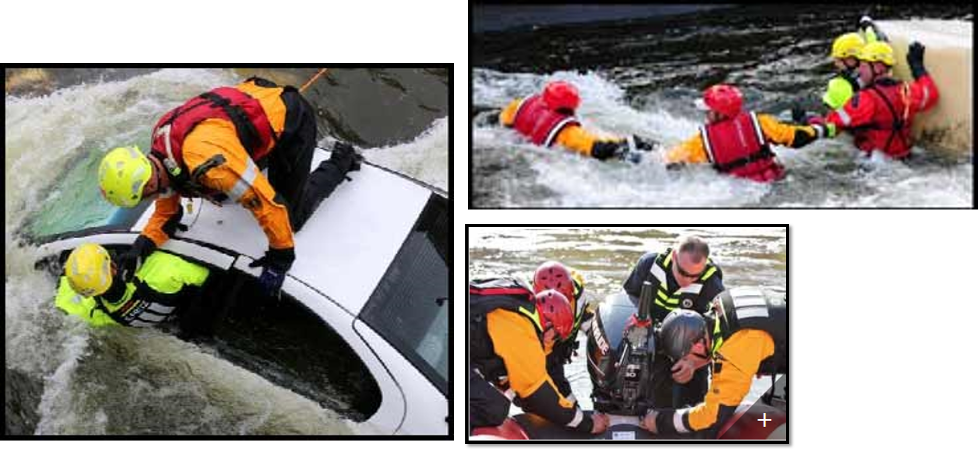
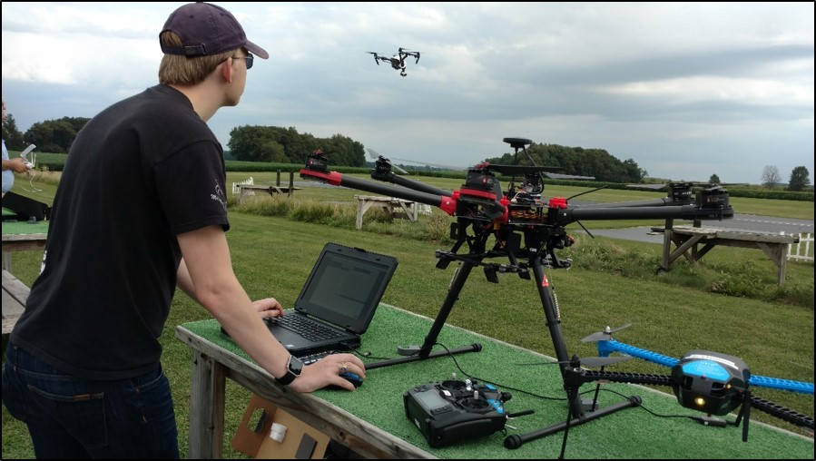
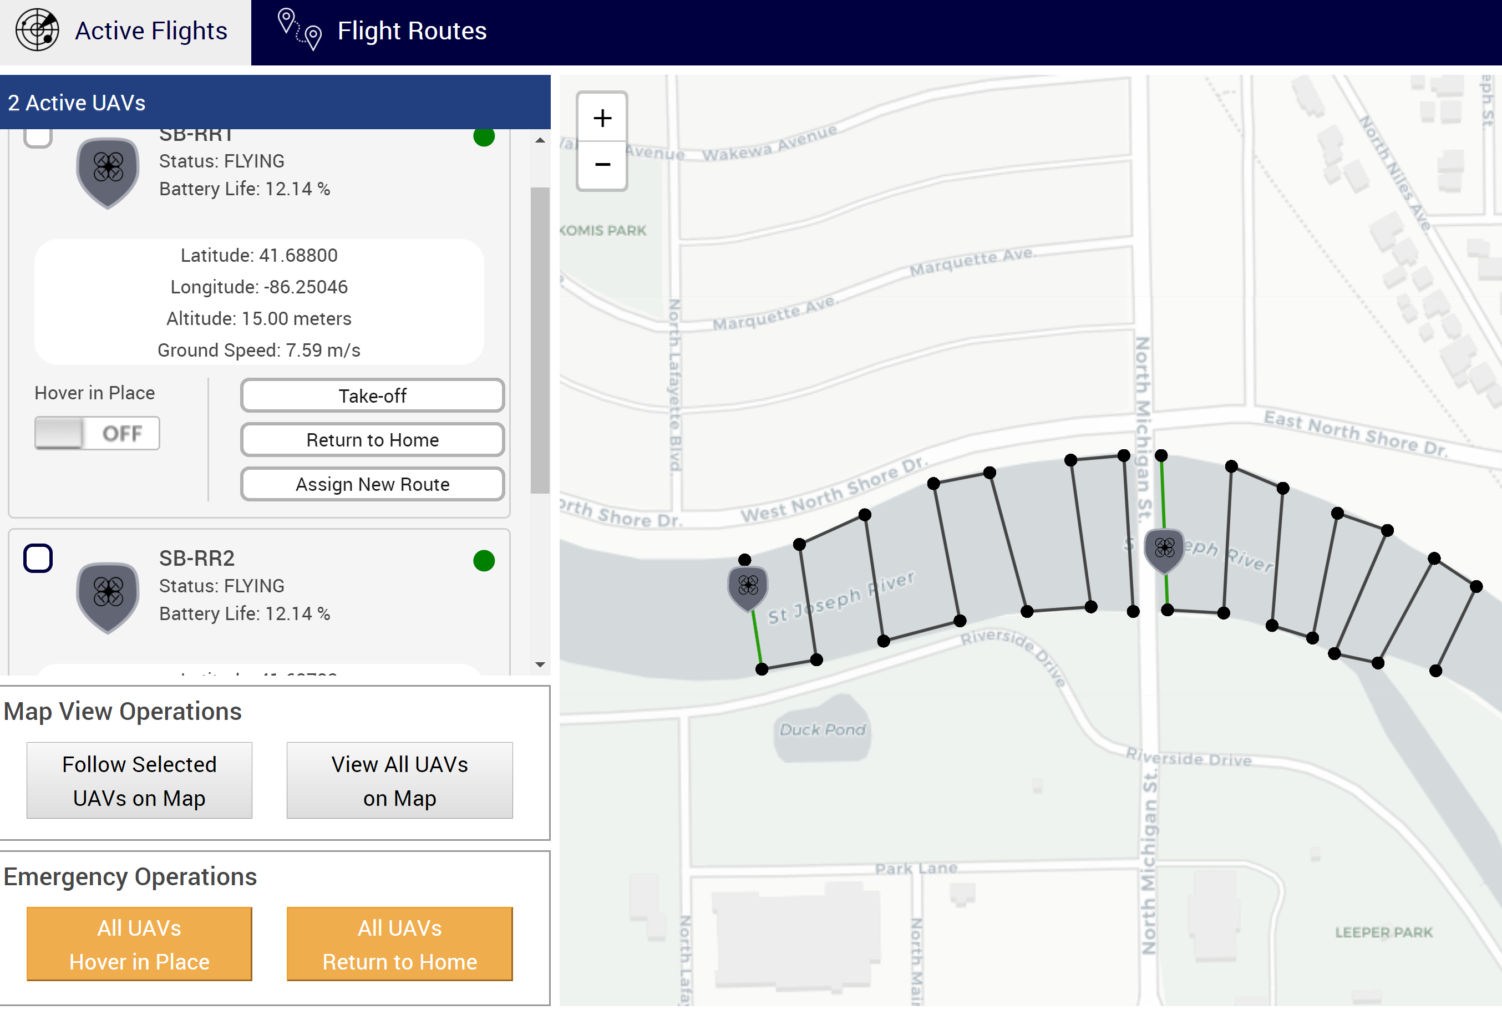
Project Aims
Provide infrastructure, supporting tools, and training needed to enable safe and effective deployments of UAVs in urban settings (with focus on first responder scenarios).
Community partners are South Bend Fire Department (SBFD) and enFocus, Inc.
Initial emergency situation is river rescue.
We provide SBFD with technology, expertise, and training for use of multiple UAVs for video-based observation supporting search and rescue. enFocus, Inc. assists with outreach to community partners and stakeholders.
Notes:
A brief background: Please describe the problem you are addressing and why it is important (20sec slide)

Slide 3
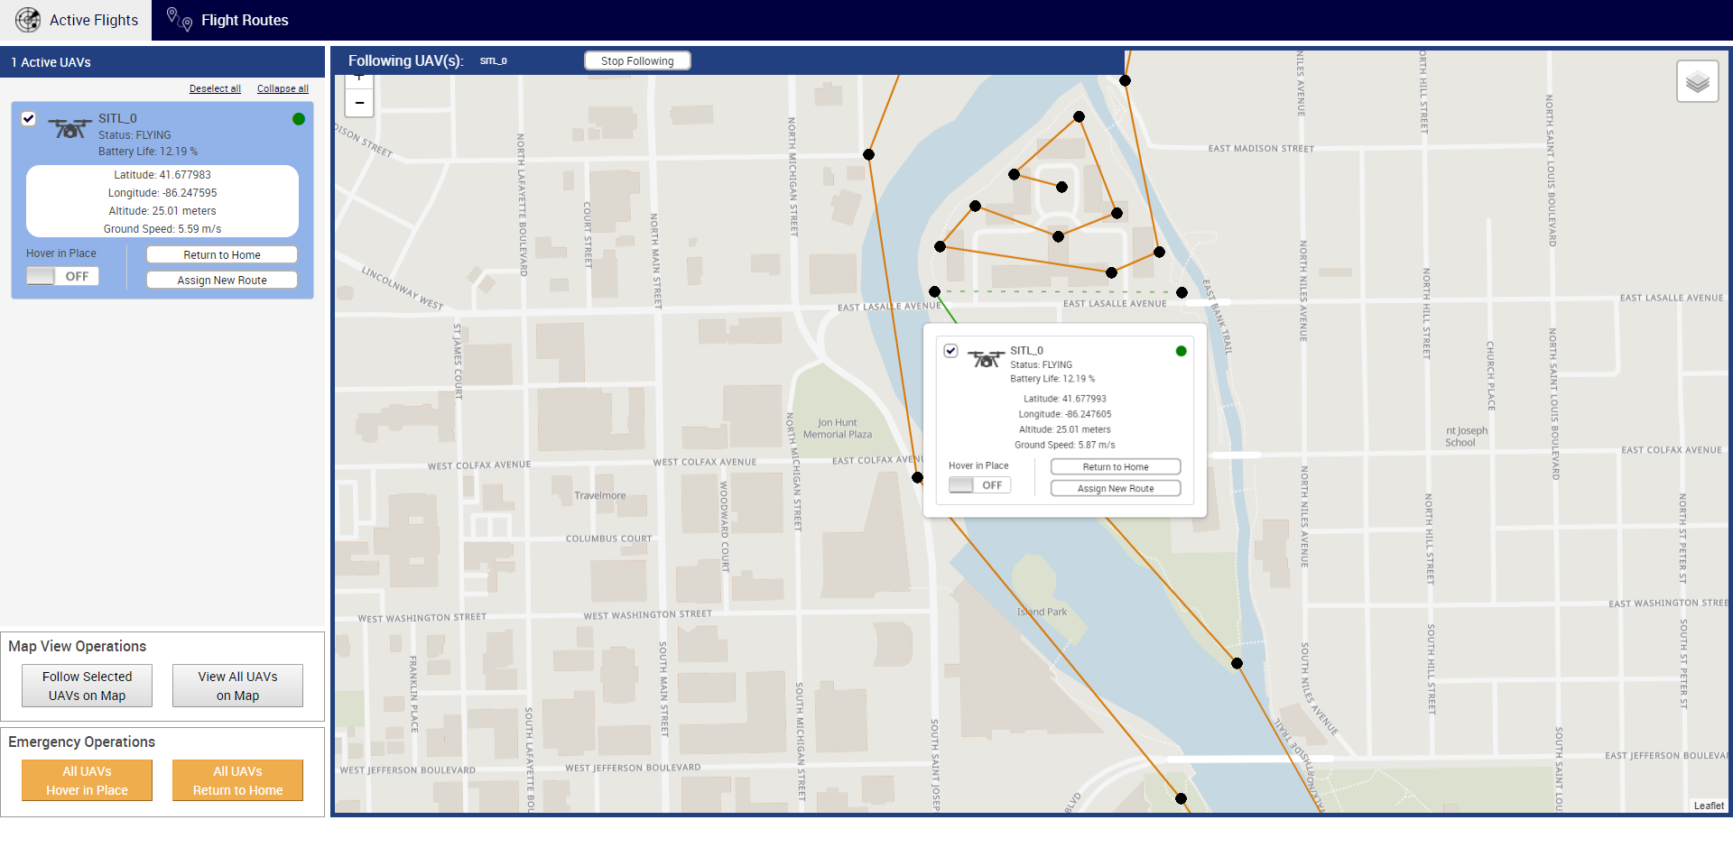
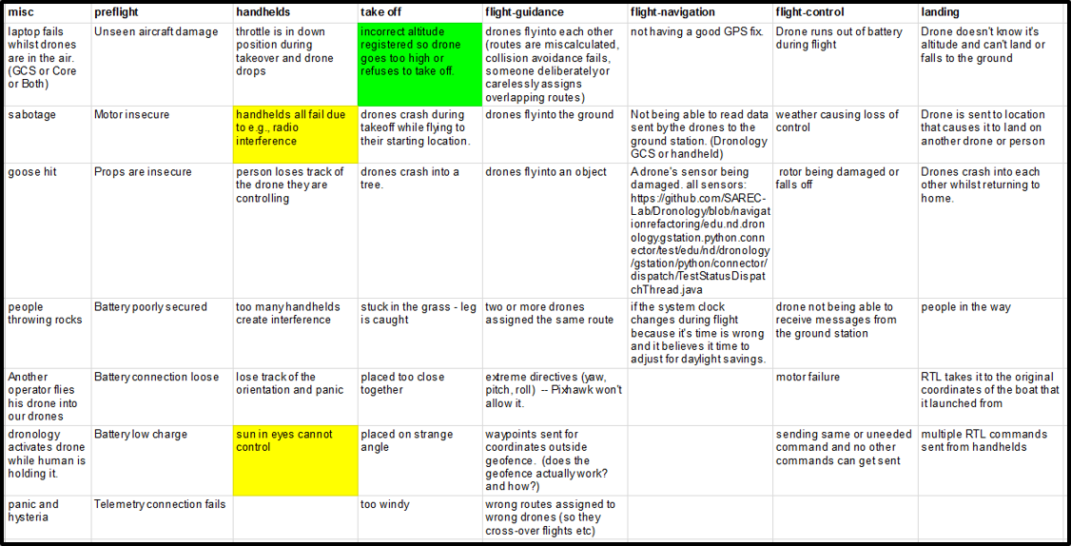
Status of the Project
Development of web-based drone management tool that combines simulated and actual drone operation.
Ongoing planning of first simulated river rescue scenario at Saint Joseph River in South Bend, Indiana, in mid April.
Analysis of safety considerations for river rescue scenario.
Obtained FAA and university permissions to fly UAVs on campus and urban areas.
Notes:
A brief background: Please describe the problem you are addressing and why it is important (20sec slide)

Slide 4
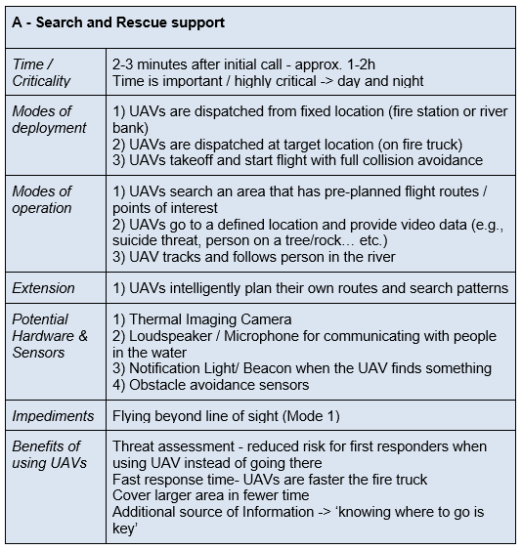
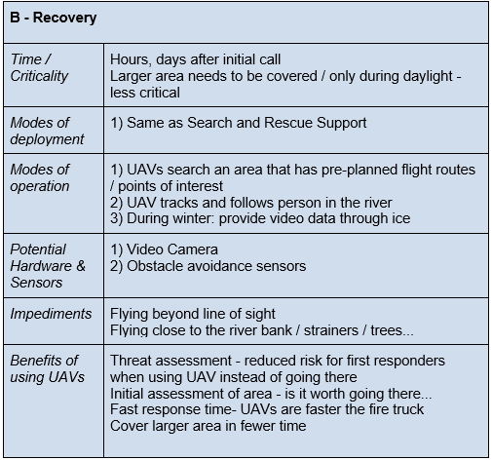
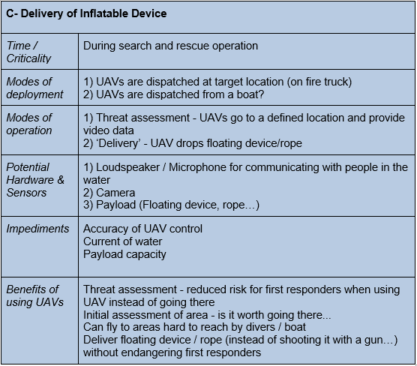
Planned Outcomes
Identification of collaborators and stakeholders in academia, community, and industry.
Requirements elicitation and analysis.
Joint student and first responder training.
Identification of available research and community resources.
Establishment of safe UAV operation protocols and software prototypes.
Notes:
A brief background: Please describe the problem you are addressing and why it is important (20sec slide)

