Slide 1
2018 NSF SMART AND CONNECTED COMMUNITIES PI MEETING
PG:SCC-Planning: Promoting Smart Technologies in
Public Safety and Transportation to Improve Social and Economic Outcomes in a US EDA-Designated Critical Manufacturing Region , NSF Award [1737557]
PI: Seung-Jong Park and Co-PI: Cecile Guin, Chester Wilmot, Kisung Lee, Jagannathan Ramanujam,
Community Partners: Baton Rouge Mayor’s office, District Attorney, BRPD, LA-DOTD, CPEX, Walls Project,
Louisiana State University
http://Smartcity.lsu.edu
Notes:
My name is S.J. Park from Louisiana State University working for Planning Grant. Promoting Smart Technologies in Public Safety and Transportation.

Slide 2
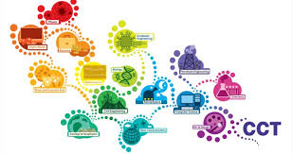
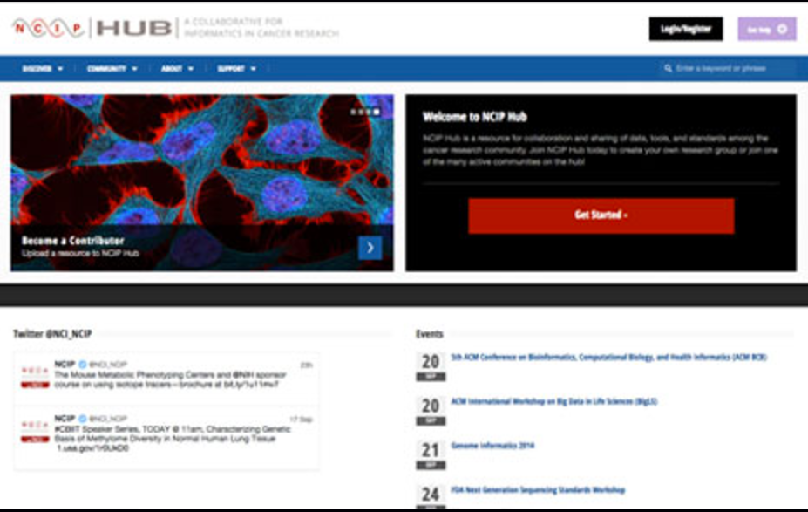
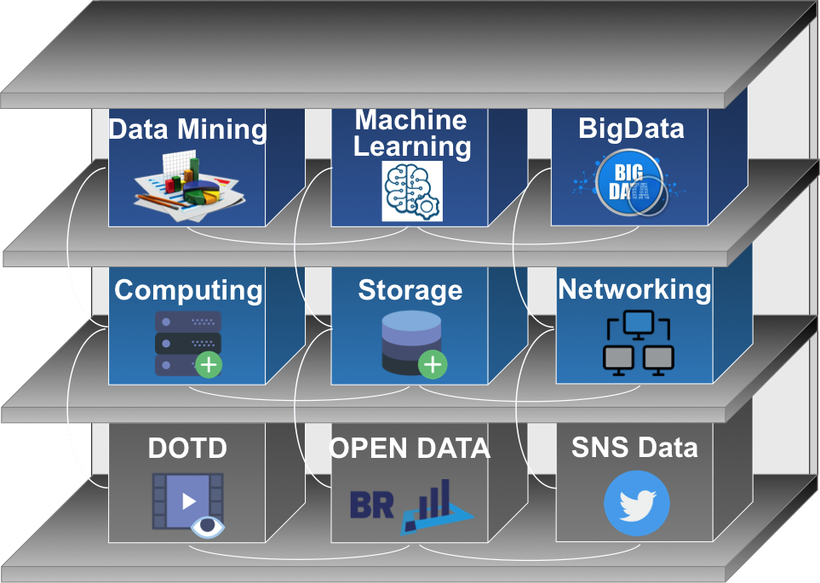
Project Aims
Challenge:
Social Challenges: Transportation issues on overburdened Interstate-10 and High levels of crime
Technical Challenges: Utilization of Open datasets related with Baton Rouge and social network data (Twitter, Waze, etc.)
CCT
Gov.
Electrical
Eng.
SmartCity Hub
DOTD
Social
Science
BRPD
Integrative Research:
Build a community from LSU research groups, Baton Rouge public offices, NGOs through a web-portal (http://smartcity.lsu.edu/)
Develop a research concept : Appling Big Data technologies to collect and manage heterogeneous data using HPC cyberinfrastructure at LSU.
Analyze the Big Data to discover knowledge using Deep Learning technologies for collaborative analyses and predictions.
Comp.
Science
DA
Civil
Eng.
Cyberinfrastructure
NGO
Coastal.
Environ.
BR
Foundation
Impact:
Developed research themes will support the Baton Rouge Smart City Committee’s the strategic plans
Produced technical outcomes will address public safety and transportation.
Community Engagement:
East Baton Rouge (EBR) Parish, EBR Mayor Office, EBR District Attorney, EBR Police Department, LA Department of Transportation (LA-DOTD), BR Foundation, Center for Planning Excellence (CPEX)
Notes:
The project proposed to build a research team consisting of researchers from computer science, Social science, civil engineering and community stakeholders at Baton Rouge Mayor office, District Attorney, Police Department, NGO. The team defined research themes on public safety and traffic using big data and deep learning technologies

Slide 3
Status of the Project
Built a research team from CS, ECE, Social, Civil, Art & Design
Partnering with community stakeholders, DOTD, BRDA, BRPD, NGO, etc.
Developed research topics on crime & transportation (e.g., classifying cars and suspicious behaviors from video streams with deep learning, Linking criminal networks to violent incidents, etc.)
Notes:
To develop research themes, we have meetings, workshops and town hall meetings. Then the team built a cyberinfrastructure consisting of a project web-portal and a small computing cluster for data collection and analysis. The datasets include DOTD video steam, Open Data for Baton Rouge, Twitter, etc. The data and analysis outcomes will be shared with community stakeholders.

Slide 4
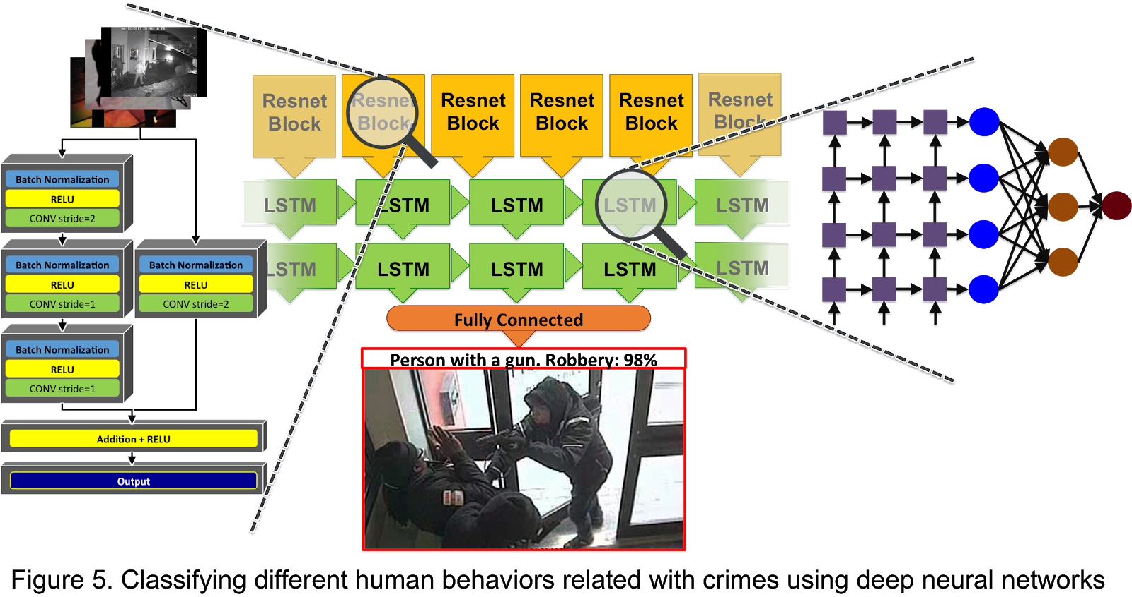
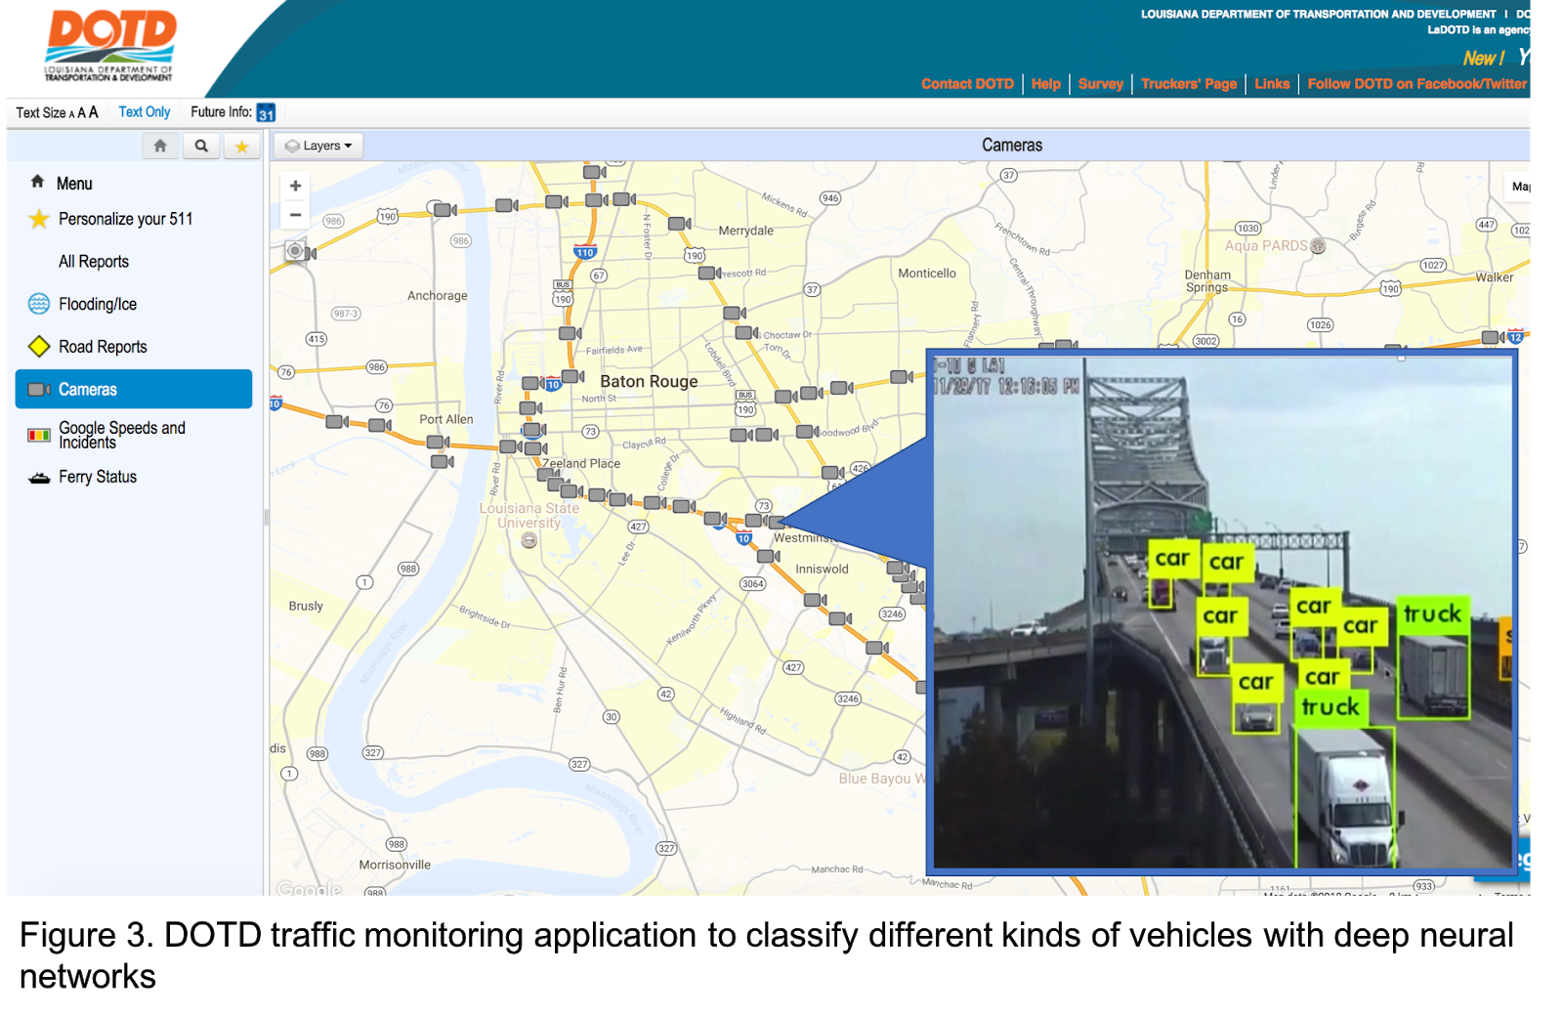
Outcomes
Collected datasets from Open Data Baton Rouge, DOTD camera video streams, Twitters, etc.
Developed real-time video analysis software tools using big data and deep learning technologies for public safety, crime and transportation
Notes:
the team developed proofs of concept projects, for example, counting different car types from DOTD traffic cameras so that they can use the statistics for city planning, another example is detecting a specific car make and model so that police department can locate a suspect.
Finally, we submitted an integrative proposal to SCC program this year for further research.

