Slide 2
°

Slide 4
Data don’t drive.
values, history, and
connecting communities
Peter Norton
Department of Engineering and Society
University of Virginia
Smart Cities Connect
Kansas City
March 26, 2018

Slide 6
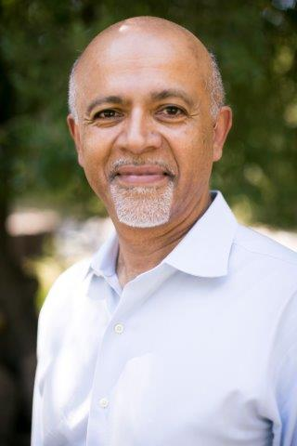
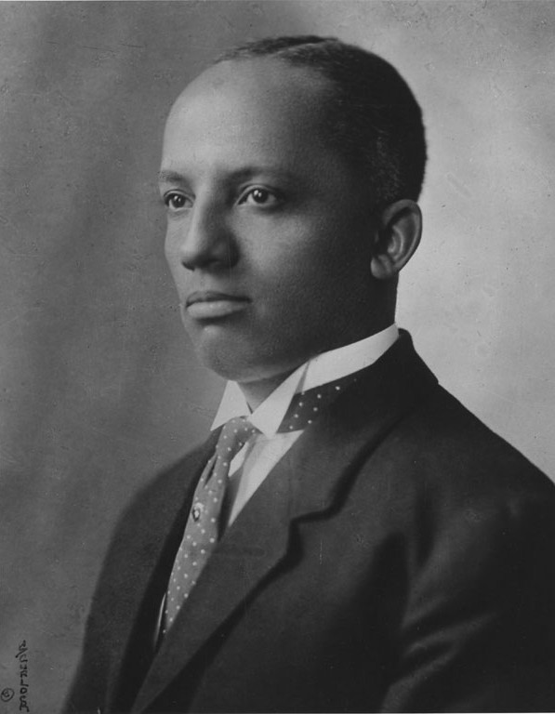

Slide 7
Where are we?

Slide 10
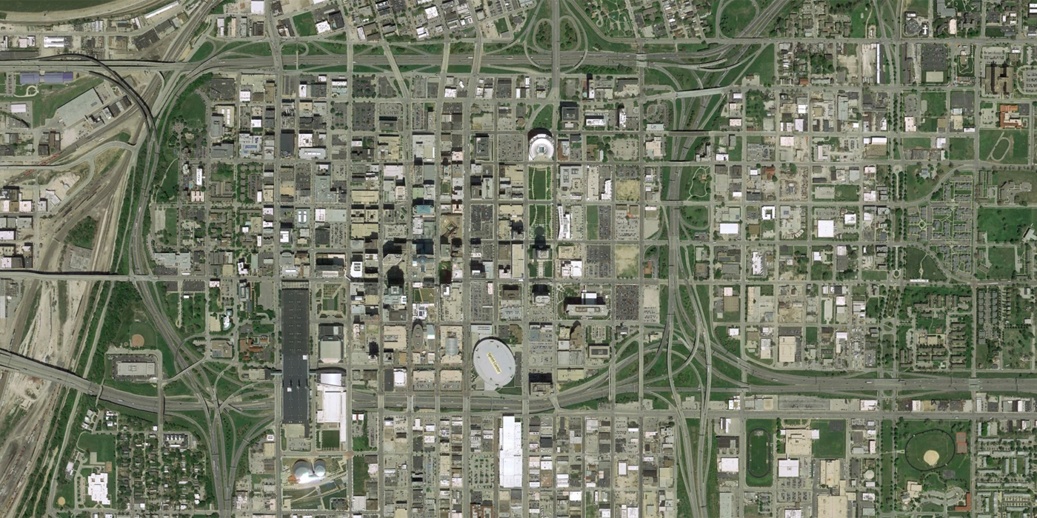

Slide 14
Her skills were so rare, so needed for the poorest of the poor, and even at times in the royal palace, that she felt valued.
Wasn't that the definition of home? Not where you are from, but where you are wanted?”

Slide 15
Her skills were so rare, so needed for the poorest of the poor, and even at times in the royal palace, that she felt valued.
Wasn't that the definition of home? Not where you are from, but where you are wanted?”

Slide 17
The MRI record “creates what I call an ‘iPatient’ — and this iPatient threatens to become the real focus of our attention, while the real patient in the bed often feels neglected, a mere placeholder for the virtual record. …
This ease of ordering a scan has caused doctors’ most basic skills in examining the body to atrophy.

Slide 18
The MRI record “creates what I call an ‘iPatient’ — and this iPatient threatens to become the real focus of our attention, while the real patient in the bed often feels neglected, a mere placeholder for the virtual record. …
This ease of ordering a scan has caused doctors’ most basic skills in examining the body to atrophy.

Slide 19
The MRI record “creates what I call an ‘iPatient’ — and this iPatient threatens to become the real focus of our attention, while the real patient in the bed often feels neglected, a mere placeholder for the virtual record. …
This ease of ordering a scan has caused doctors’ most basic skills in examining the body to atrophy.

Slide 21
part one
of four

Slide 22
Where are we?

Slide 23
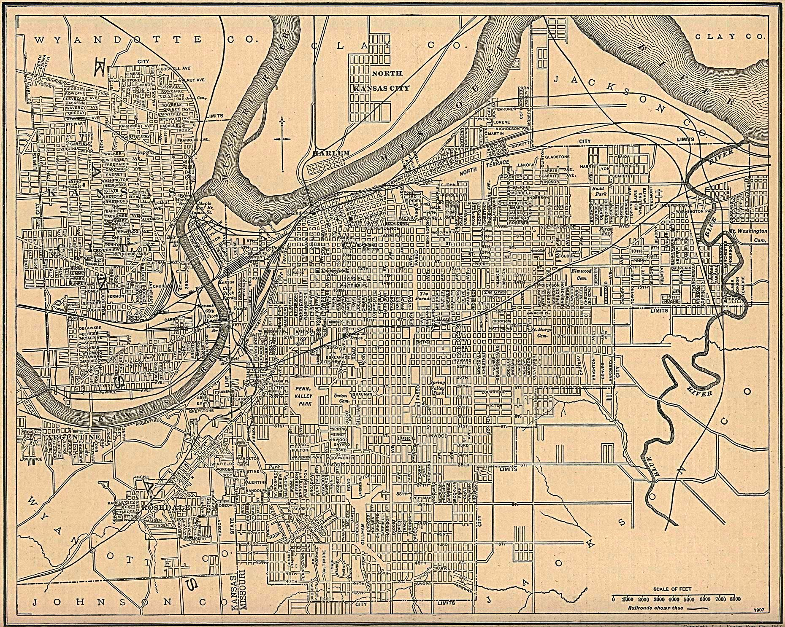

Slide 30
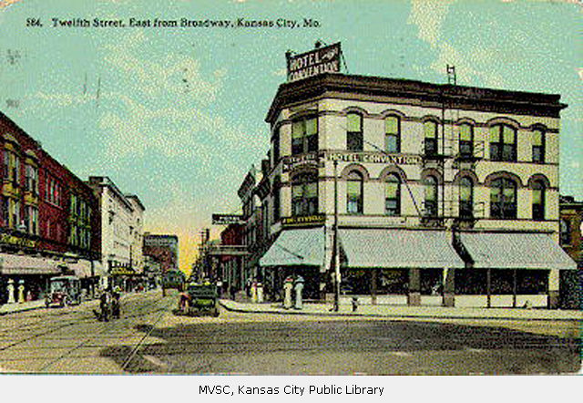

Slide 32
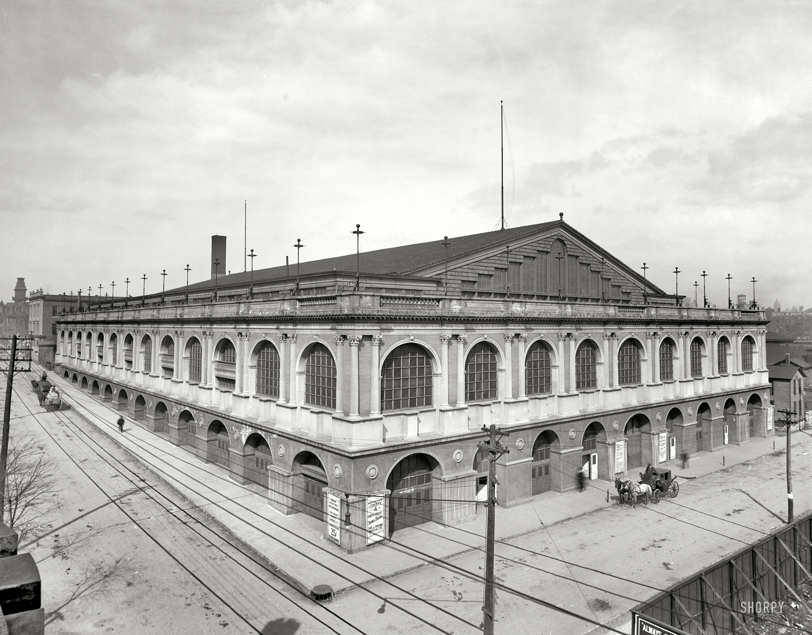

Slide 34
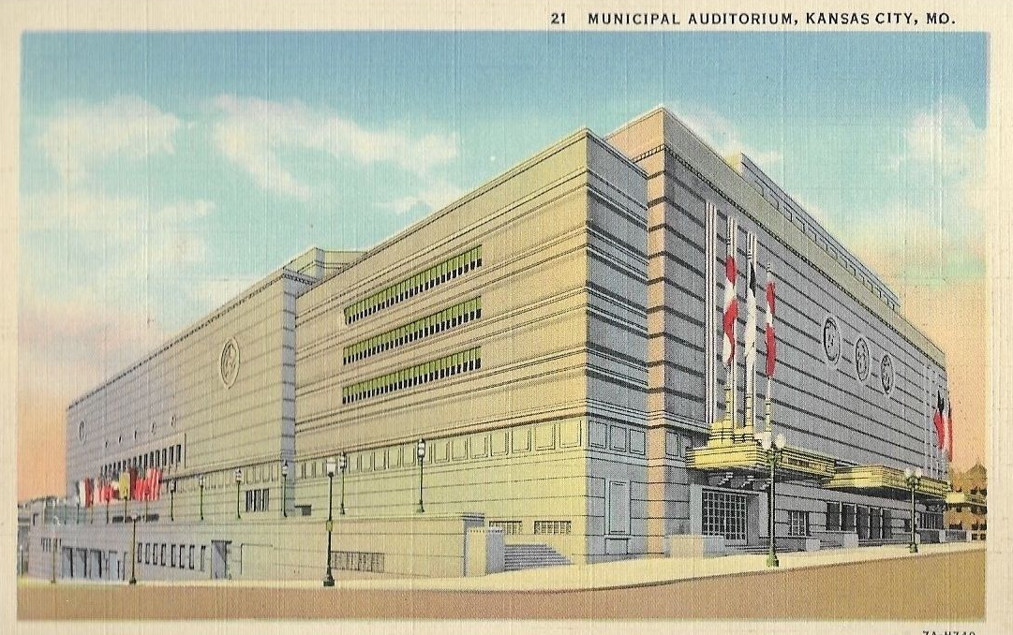

Slide 37
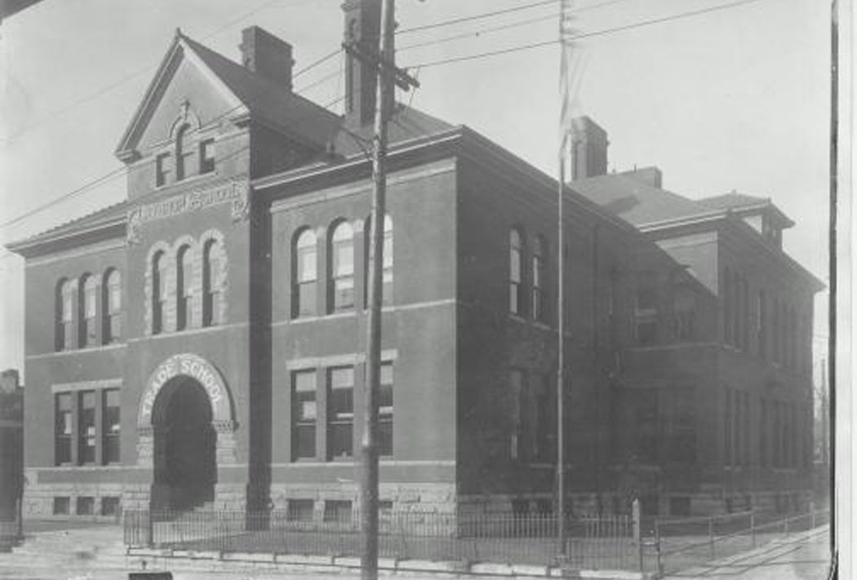

Slide 43
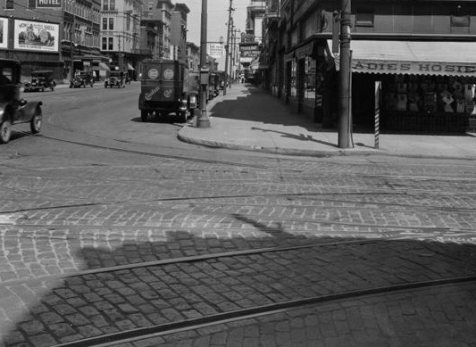
Looking north, 1925

Slide 46
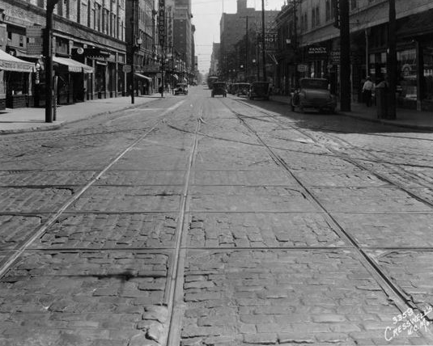
Looking east, 1925

Slide 49
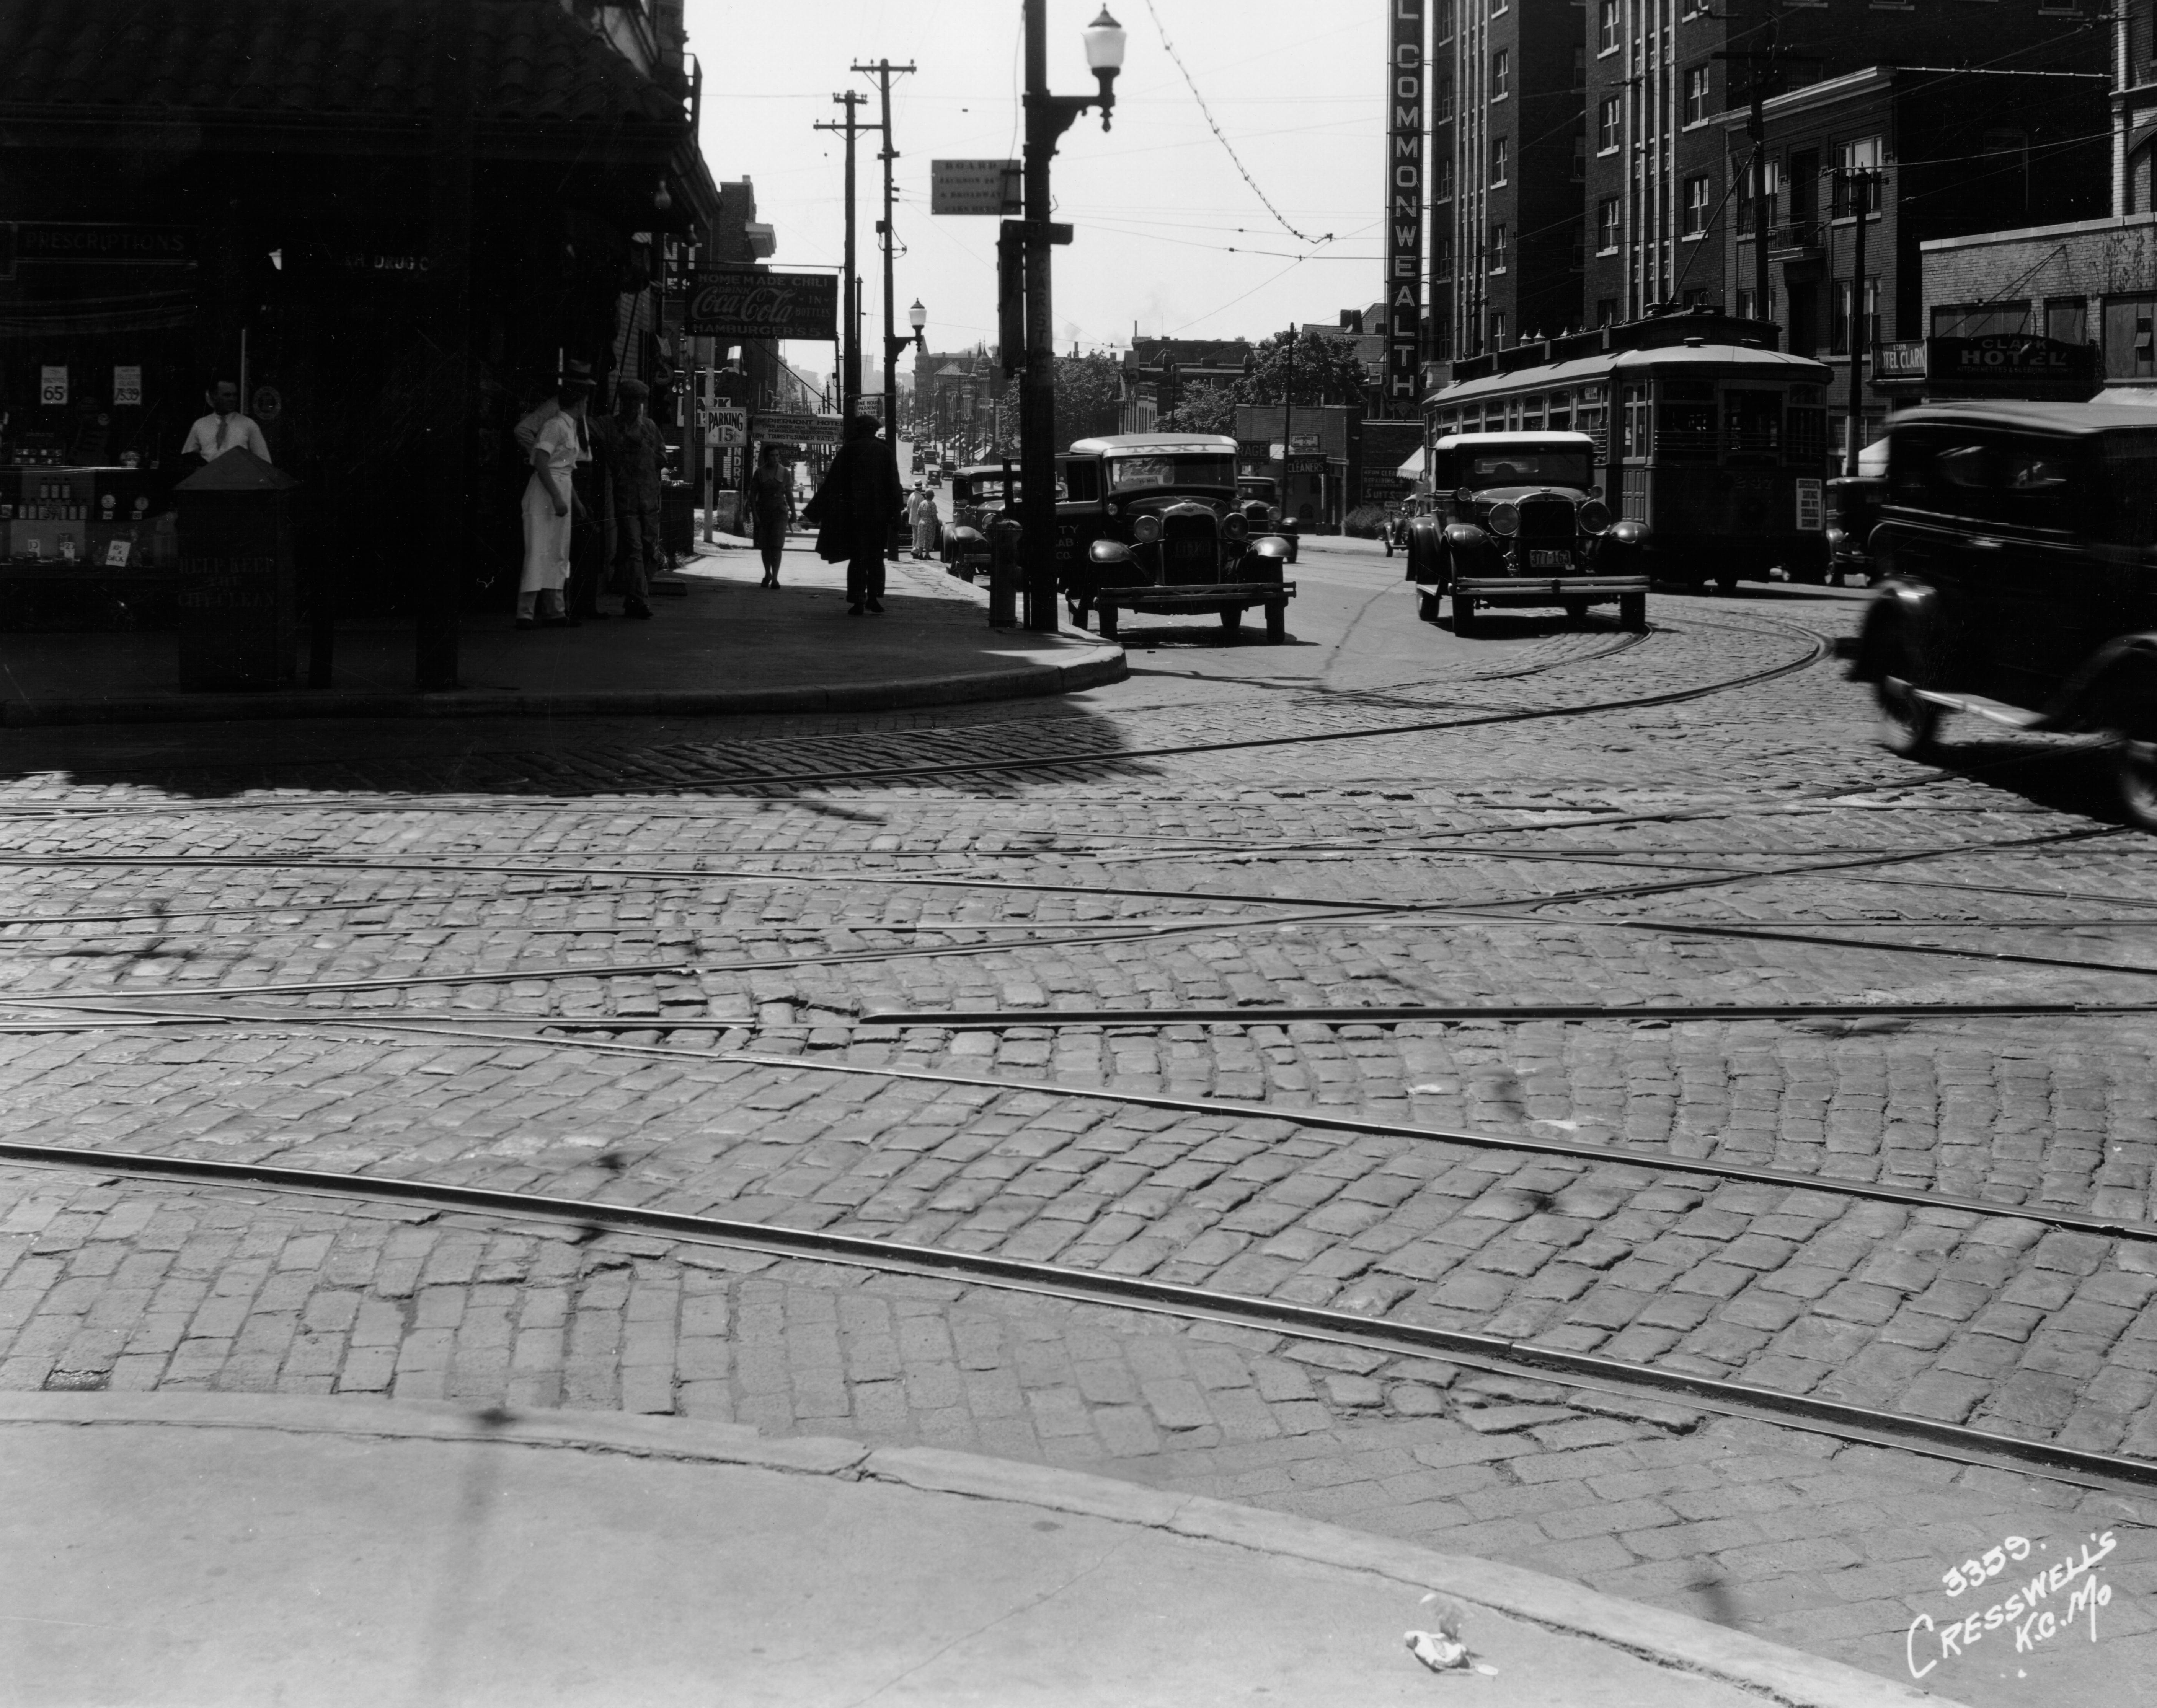
Looking south, 1925

Slide 52
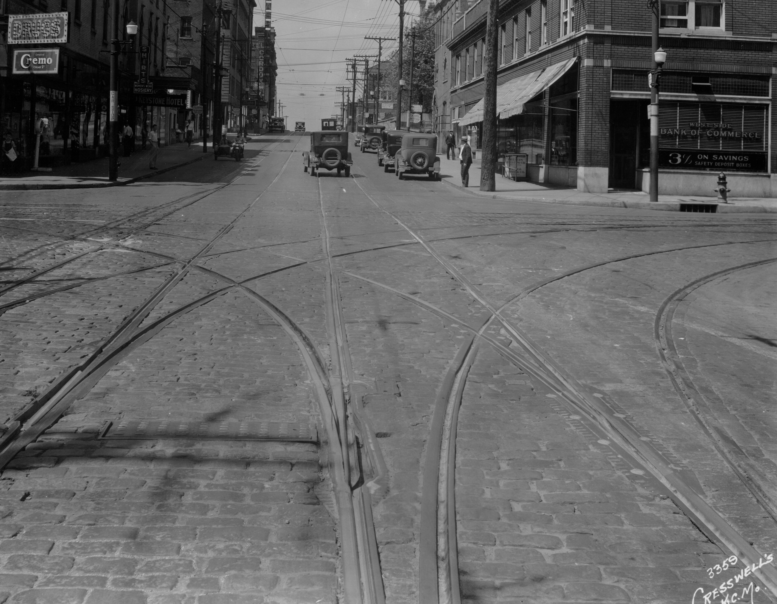
Looking west, 1925

Slide 54
1939

Slide 55
AUTO
PARKING
1939

Slide 56
AUTO
PARKING
AUTO
PARKING
1939

Slide 57
AUTO
PARKING
AUTO
PARKING
AUTO
PARKING
1939

Slide 58
AUTO
PARKING
AUTO
PARKING
AUTO
PARKING
AUTO
PARKING
1939

Slide 59
AUTO
PARKING
AUTO
PARKING
AUTO
PARKING
AUTO
PARKING
FILLING
STATION
1939

Slide 60
AUTO
PARKING
AUTO
PARKING
AUTO
PARKING
AUTO
PARKING
AUTO
SERVICE
FILLING
STATION
1939

Slide 61
AUTO
PARKING
AUTO
PARKING
AUTO
WASHING
AUTO
PARKING
AUTO
PARKING
AUTO
SERVICE
FILLING
STATION
1939

Slide 62
AUTO
PARKING
AUTO
PARKING
AUTO
WASHING
AUTO
PARKING
AUTO
PARKING
AUTO
SERVICE
FILLING
STATION
1939

Slide 63
AUTO
PARKING
AUTO
PARKING
AUTO
WASHING
AUTO
PARKING
AUTO
PARKING
AUTO
SERVICE
FILLING
STATION
1939

Slide 65
1960

Slide 69
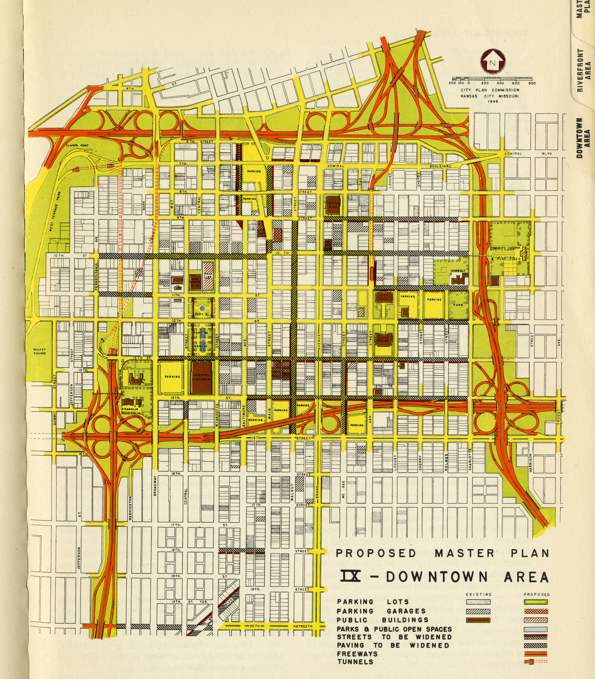
K.C. City Plan Commission, 1947

Slide 73
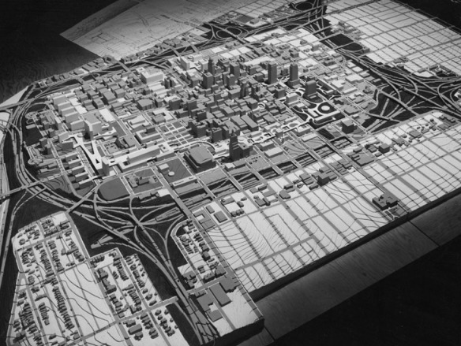

Slide 75
Kansas City Convention Center
BROADWAY
CENTRAL STREET

Slide 76
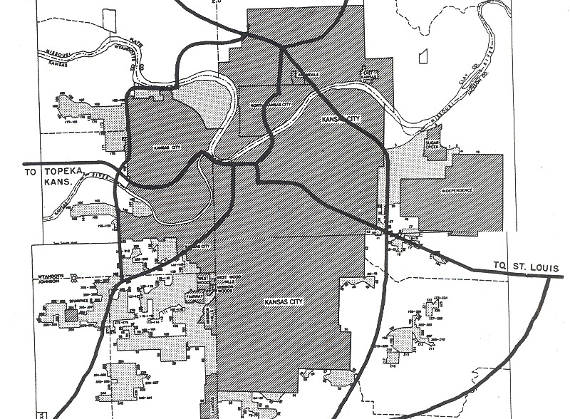
Bureau of Public Roads, 1955

Slide 77
Bureau of Public Roads, 1955

Slide 78
Bureau of Public Roads, 1955

Slide 81
part two
of four

Slide 82
driverless data

Slide 83
423
264
93
3
1970s
1980s
1990s
2000-09
2010-18
“data driven” in major U.S. daily newspapers, 1970-2018

Slide 84
1194
423
264
93
3
1970s
1980s
1990s
2000-09
2010-18
“data driven” in major U.S. daily newspapers, 1970-2018

Slide 85
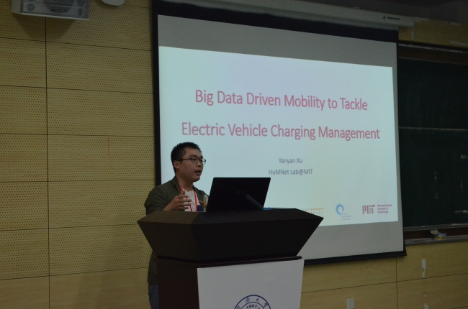

Slide 89
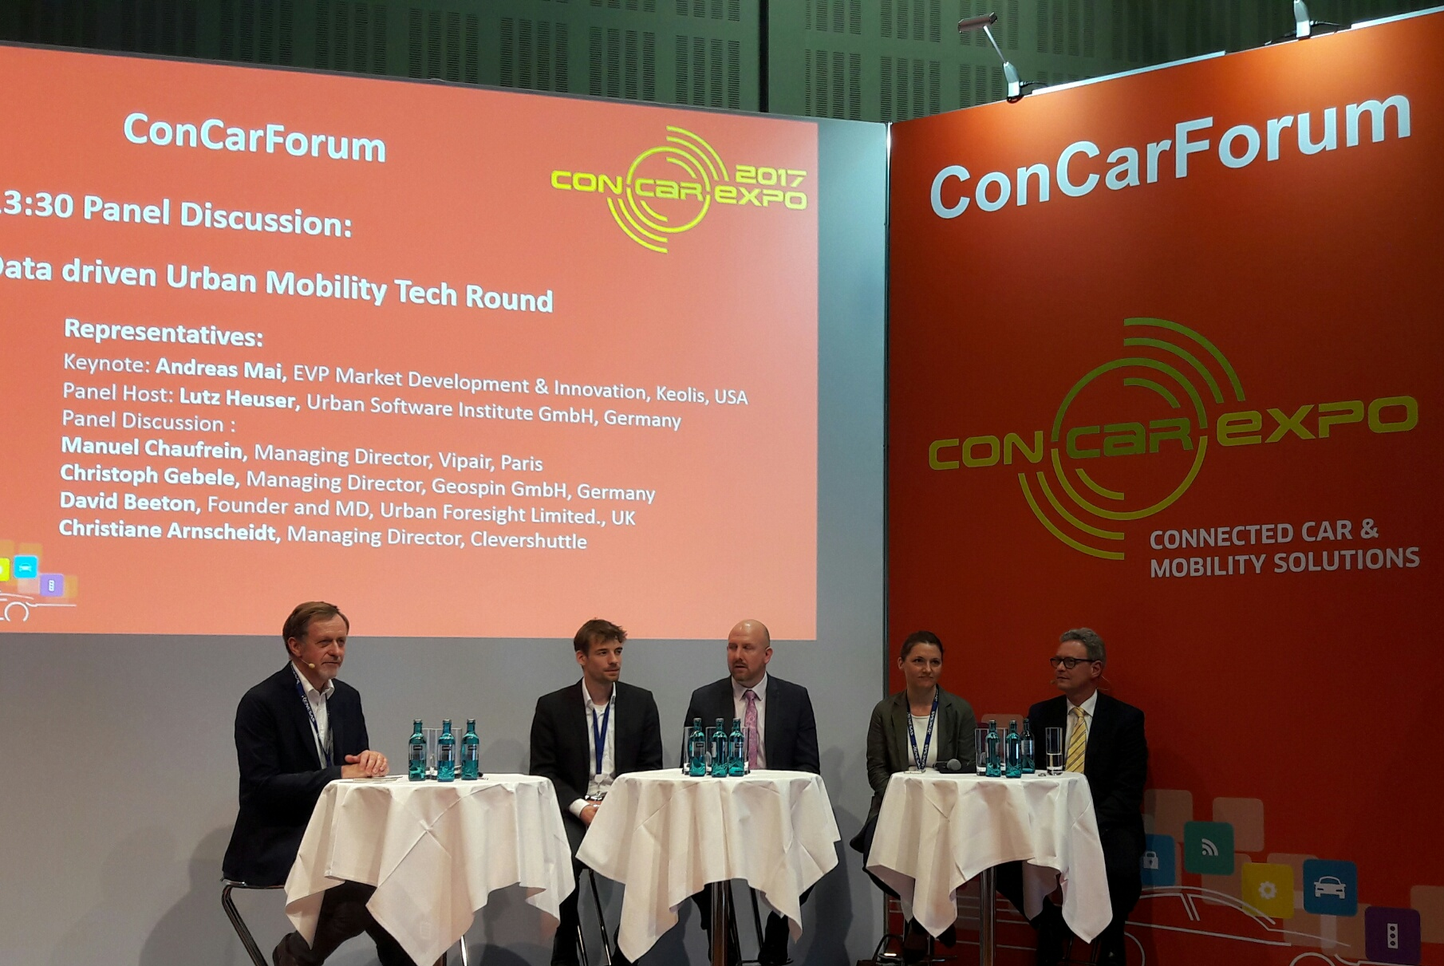

Slide 91
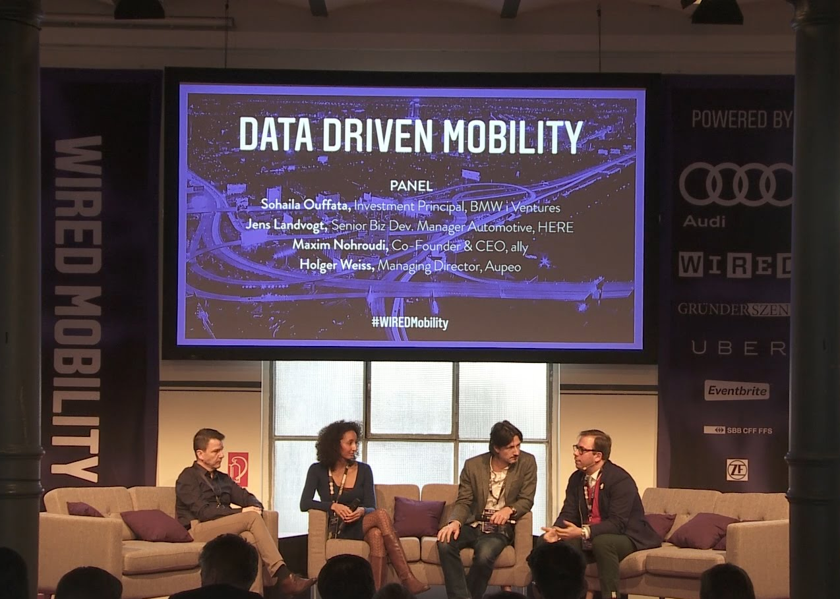

Slide 100
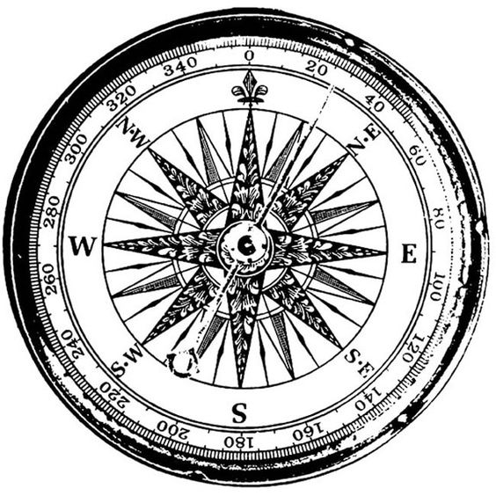

Slide 102
If data don’t drive —

Slide 103
If data don’t drive —
what does?

Slide 104
If data don’t drive —
what does?

Slide 105
F = ma

Slide 106
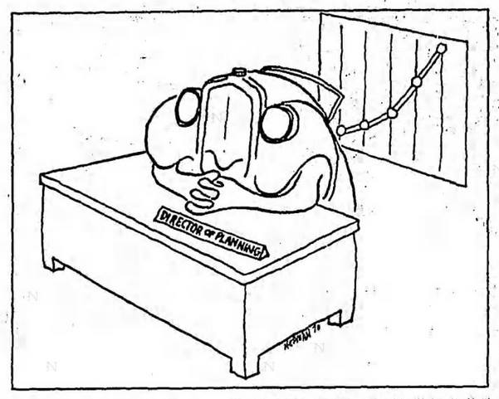

Slide 107
Everything we do is data driven.
DATA

Slide 108
Or you could say that we
drive data.
DATA

Slide 112
“The obvious solution … lies only in a radical revision of our conception of what a city street is for.”

Slide 113
“The obvious solution … lies only in a radical revision of our conception of what a city street is for.”

Slide 115
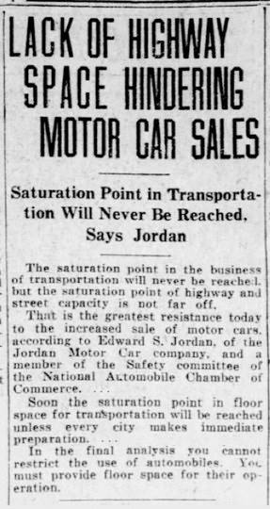

Slide 117
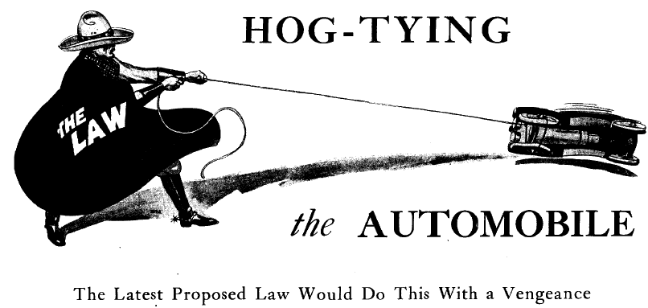

Slide 118
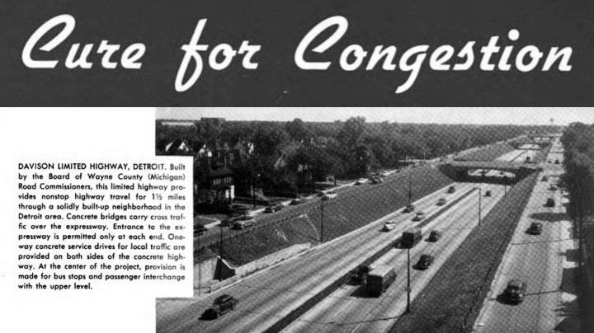
Portland Cement Association (1948)

Slide 119
Firestone Tire and Rubber Company (1955)

Slide 123
Everything we do is data driven.
DATA

Slide 124
Everything we do is data driven.
DATA
data-driven mobility?

Slide 125
Everything we do is data driven.
DATA
data-driven mobility?
or
agenda-driven mobility?

Slide 126
Okay, we
drive data.
DATA

Slide 128
Okay, what we’re really after is
self-driving data
DATA

Slide 129
What is self-driving data?

Slide 130
What is self-driving data?
U.S. Federal Highway Administration (1973):

Slide 131
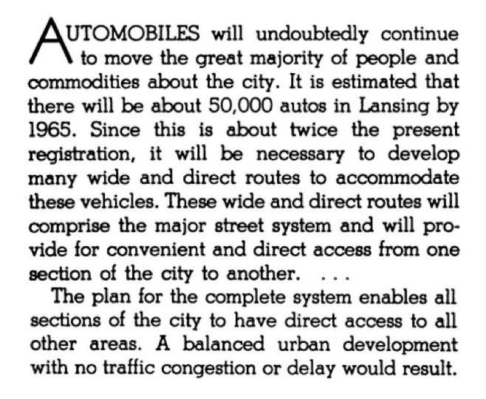

Slide 135
Everything we do is data driven.
DATA

Slide 136
Everything we do is data driven.
DATA
data-driven mobility?

Slide 137
Everything we do is data driven.
DATA
data-driven mobility?
or
self-driving data?

Slide 138
Okay, what we’re really after is
self-driving data.
DATA

Slide 140
as promised
U.S. Public Roads Administration (1946)

Slide 141
as promised
as delivered
U.S. Public Roads Administration (1946)
Boston’s Southeast Expressway (1971)

Slide 142
1959
Detroit (Hastings Street)

Slide 143
1961
Detroit (site of Hastings Street)

Slide 144
So delicately interwoven are the relationships that when we disturb one thread of the community fabric
we alter it all.
1961
Detroit (site of Hastings Street)

Slide 146
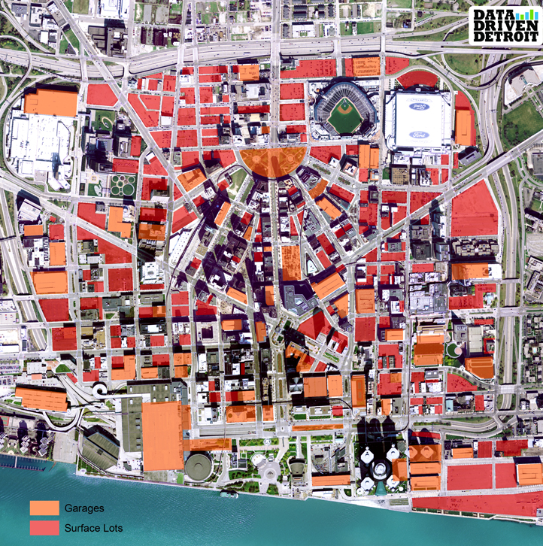
parking garages
surface parking lots

Slide 147
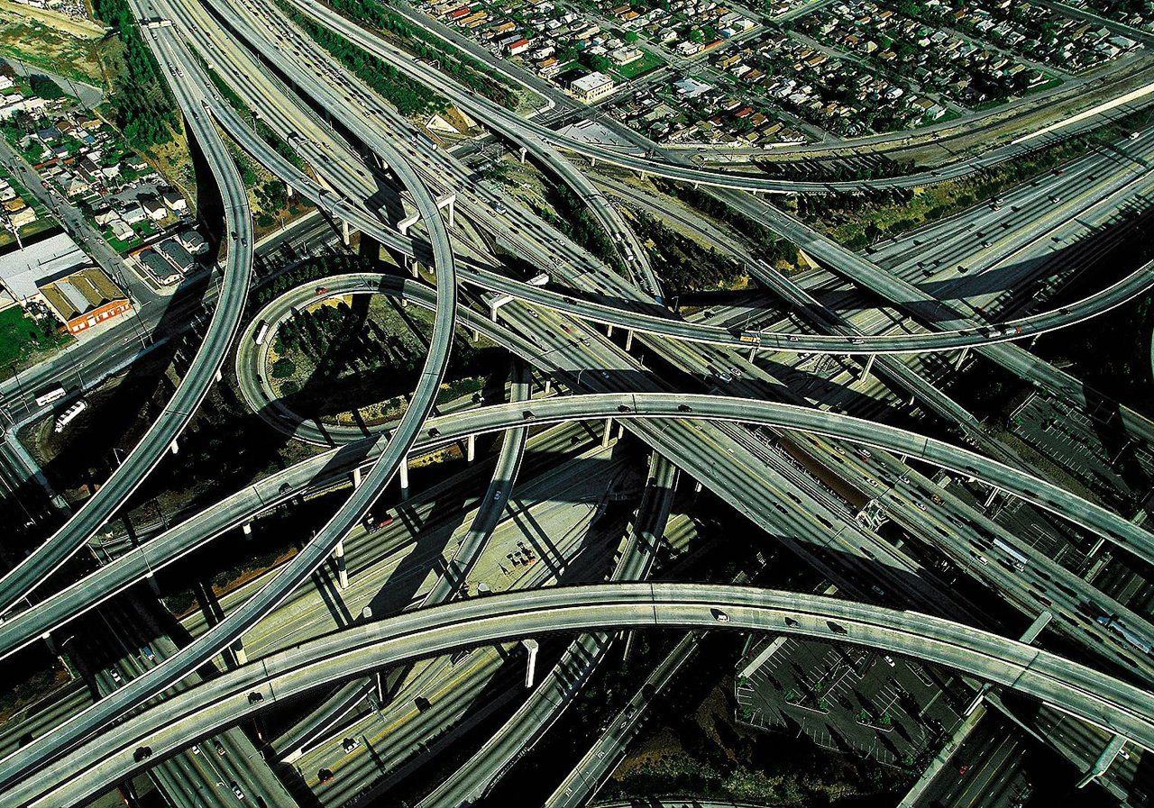

Slide 151
traffic

Slide 152
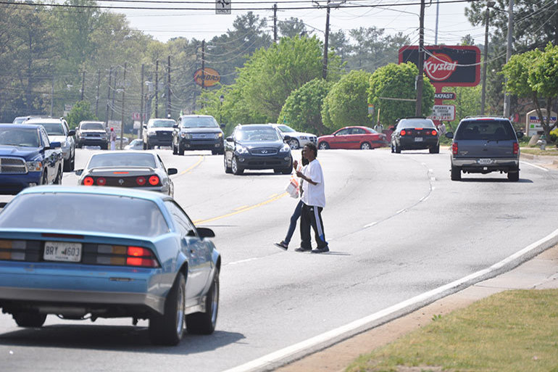
traffic
photo: Stephen Davis

Slide 153
So delicately interwoven are the relationships that when we disturb one thread of the community fabric
we alter it all.

Slide 154
We stand for data-driven mobility
DATA

Slide 155
We stand for data-driven mobility
DATA
Or just data, really. Mobility is just a way to collect it.

Slide 157
Outside of a vehicle, a typical connected person generates 1 - 1.5 GB/day.

Slide 158
Brian Krzanich, CEO

Slide 159
Brian Krzanich, CEO

Slide 160
Everything we do is data driven.
DATA

Slide 161
Mobility is nice, but we want data.
DATA
data-driven mobility?

Slide 162
Mobility is nice, but we want data.
DATA
data-driven mobility?
or
data-driven data collection?

Slide 164
part three
of three

Slide 165
trajectories

Slide 168
“The rewriters of history.”

Slide 169
future

Slide 170
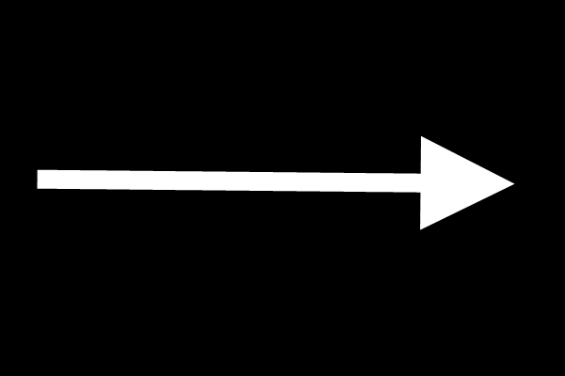
status quo
future

Slide 171
past
status quo
future

Slide 172
future 2
past
status quo
future

Slide 173
future 2
past
status quo
future

Slide 174
future 2
past
status quo
future
past 2

Slide 175
future 2
past
status quo
future
past 2

Slide 176
future 2
past
status quo
future
past 2

Slide 177
future 2
past
status quo
future
past 2

Slide 178
status quo

Slide 180
1932

Slide 181
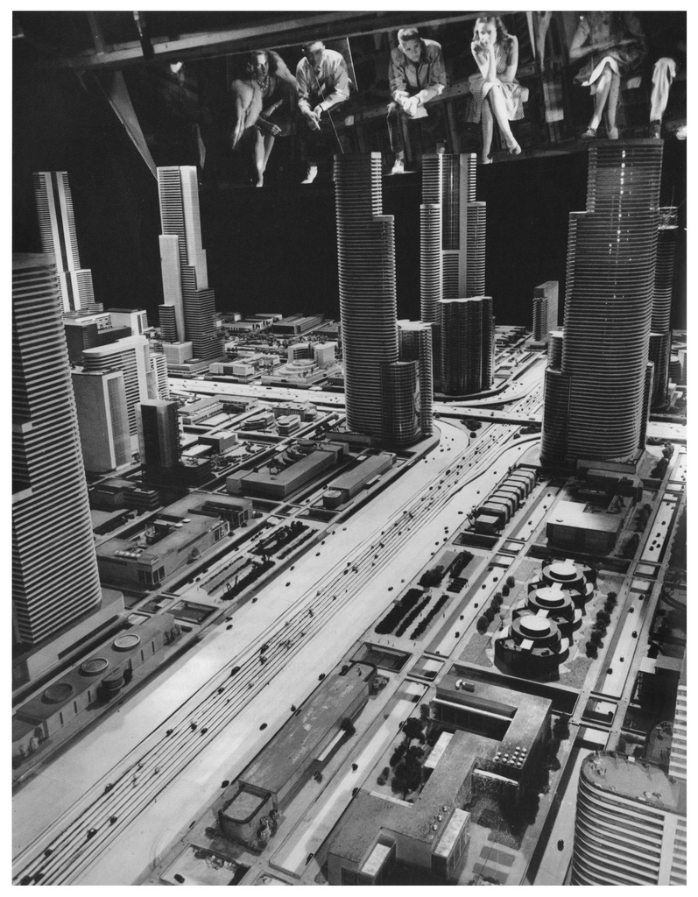
1932
1939

Slide 182
past 1 justifies future 1
1932
1939

Slide 183
past 1 justifies future 1
1932
1939

Slide 184
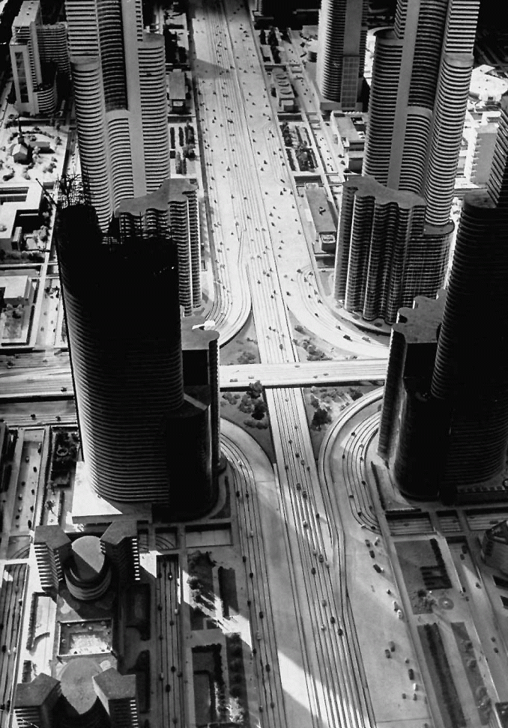
General Motors 1939: City of Tomorrow
1939

Slide 185
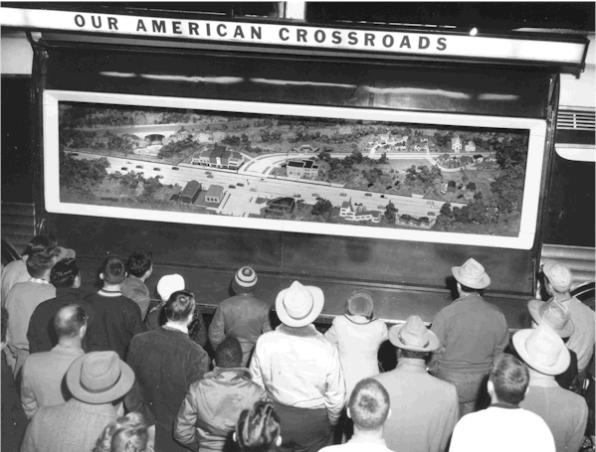
1940 -1956

Slide 186
1940 -1956
1958

Slide 187
past 1 justifies future 1
1940 -1956
1958

Slide 188
past 1 justifies future 1
1940 -1956
1958

Slide 189
1958

Slide 190
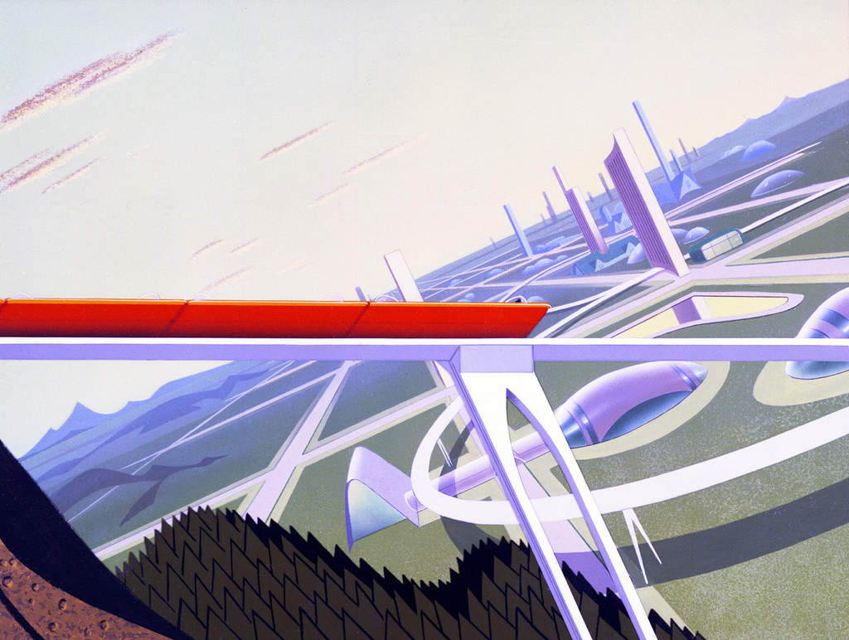

Slide 191
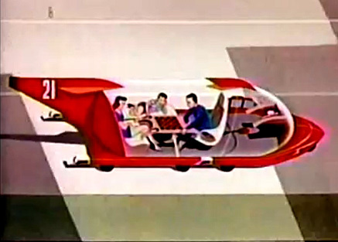

Slide 192
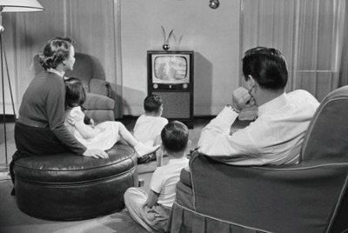
September 1961

Slide 193
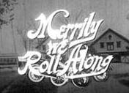
September 1961

Slide 194
September 1961

Slide 195
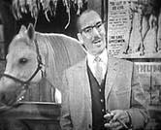
September 1961

Slide 196
1961

Slide 197
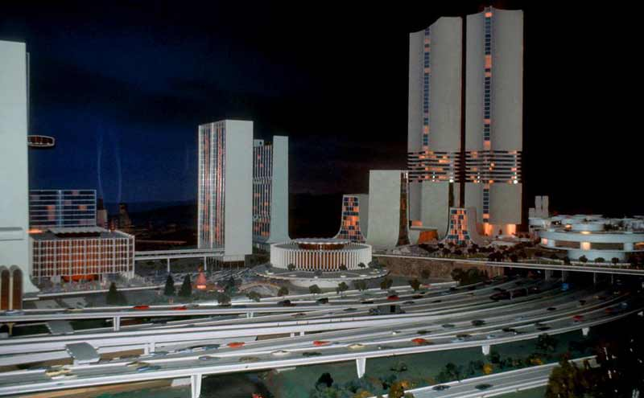
1961
1964

Slide 198
past 1 justifies future 1
1961
1964

Slide 199
past 1 justifies future 1
1961
1964

Slide 200
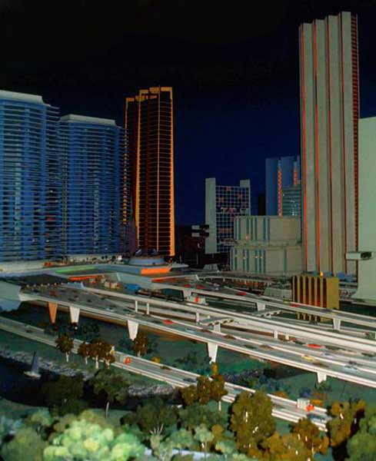
1964

Slide 201
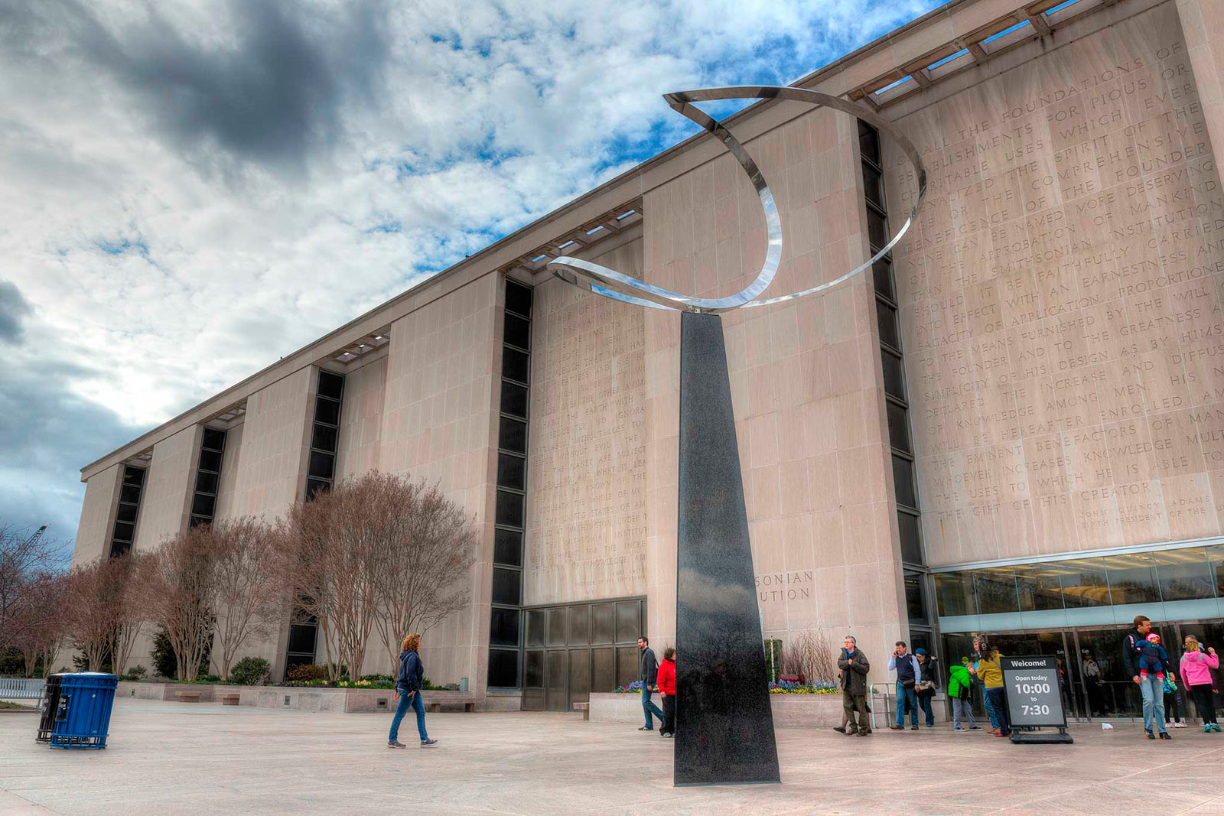

Slide 202
National Museum of American History
(Smithsonian Institution)
Washington, D.C.
2003 - present

Slide 203
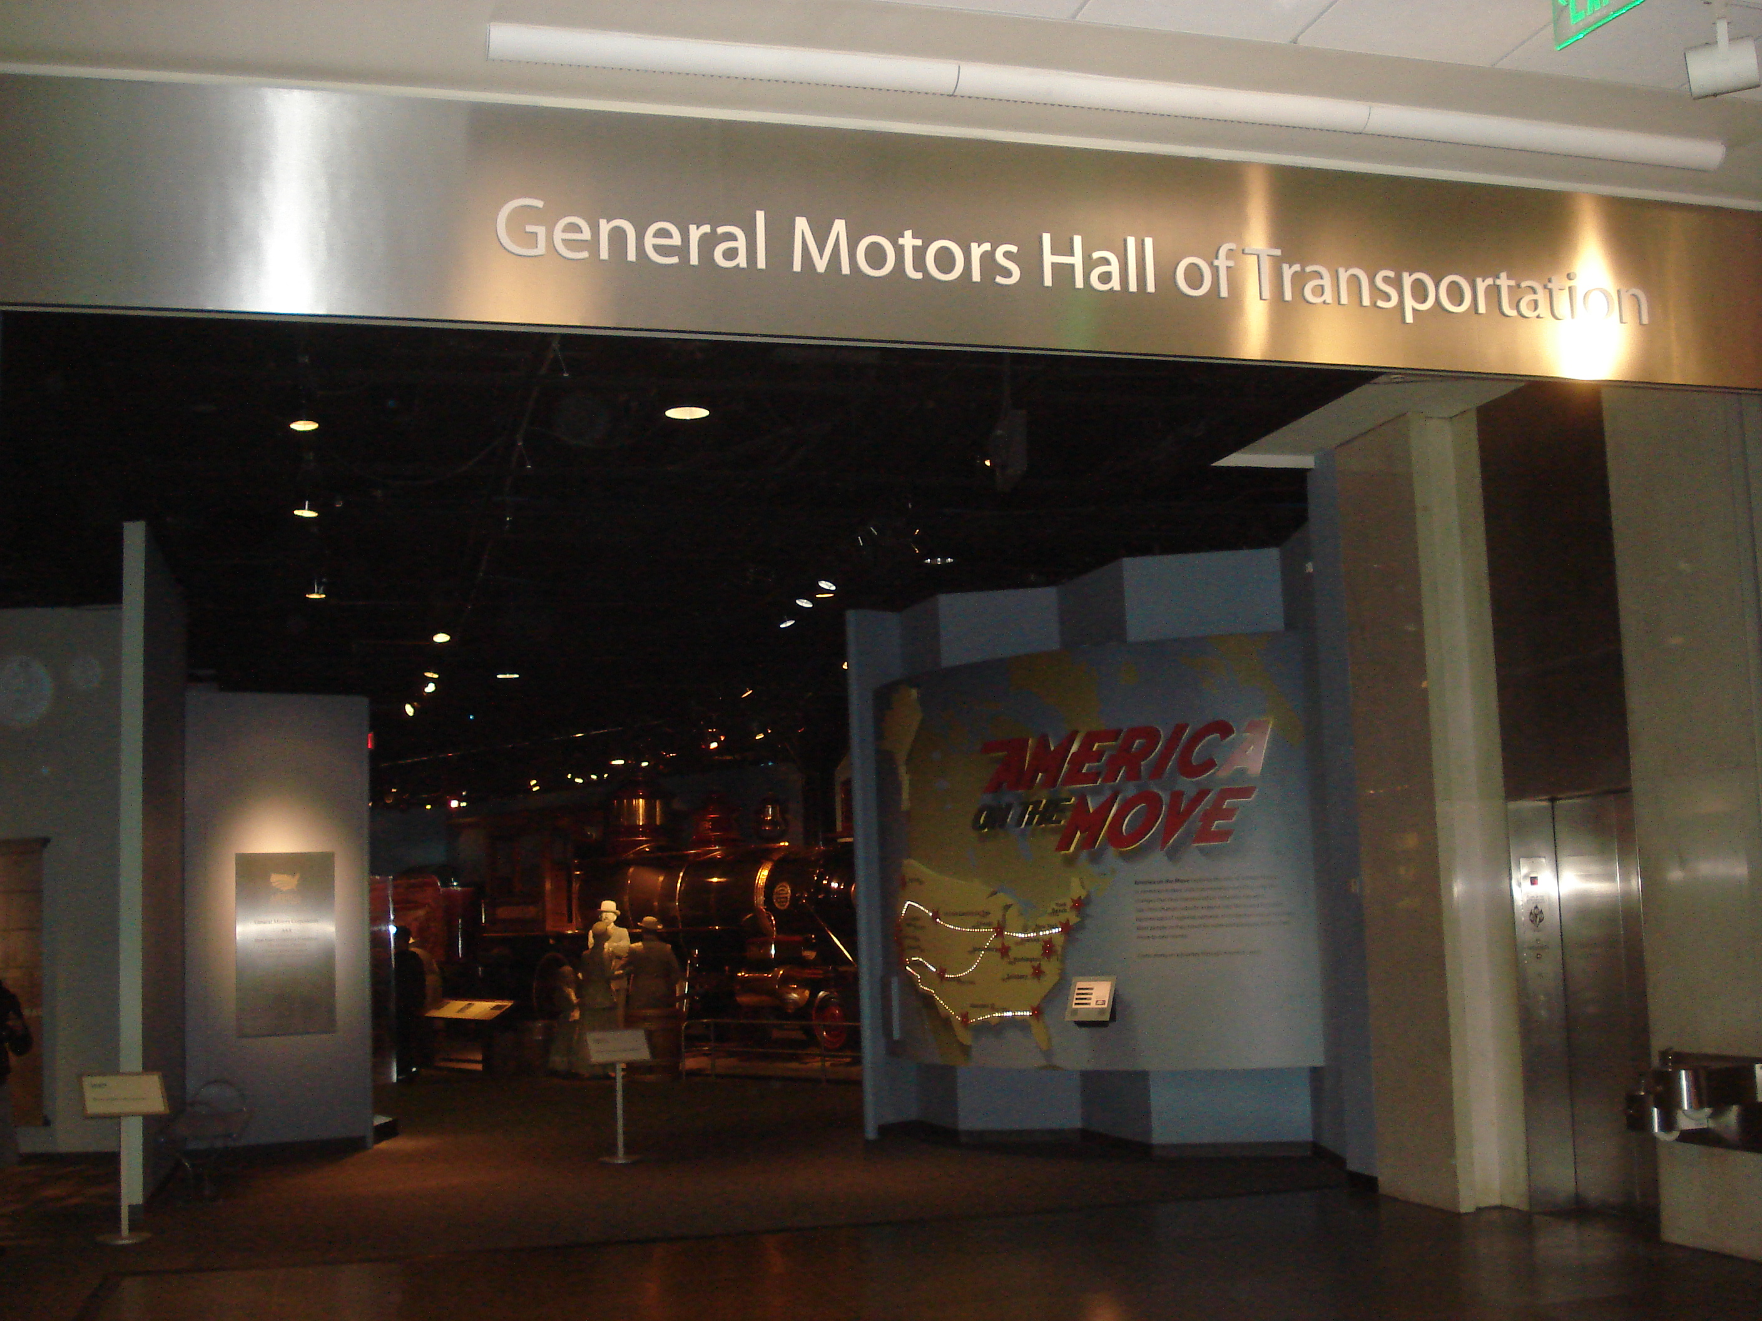
National Museum of American History
(Smithsonian Institution)
Washington, D.C.
2003 - present

Slide 204
2003 - present

Slide 205
past 1 justifies future 1
2003 - present

Slide 206
future 1

Slide 207
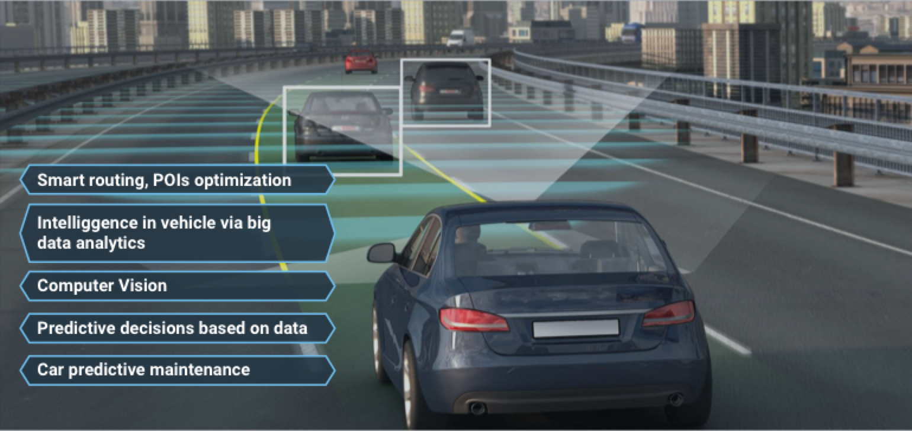

Slide 209
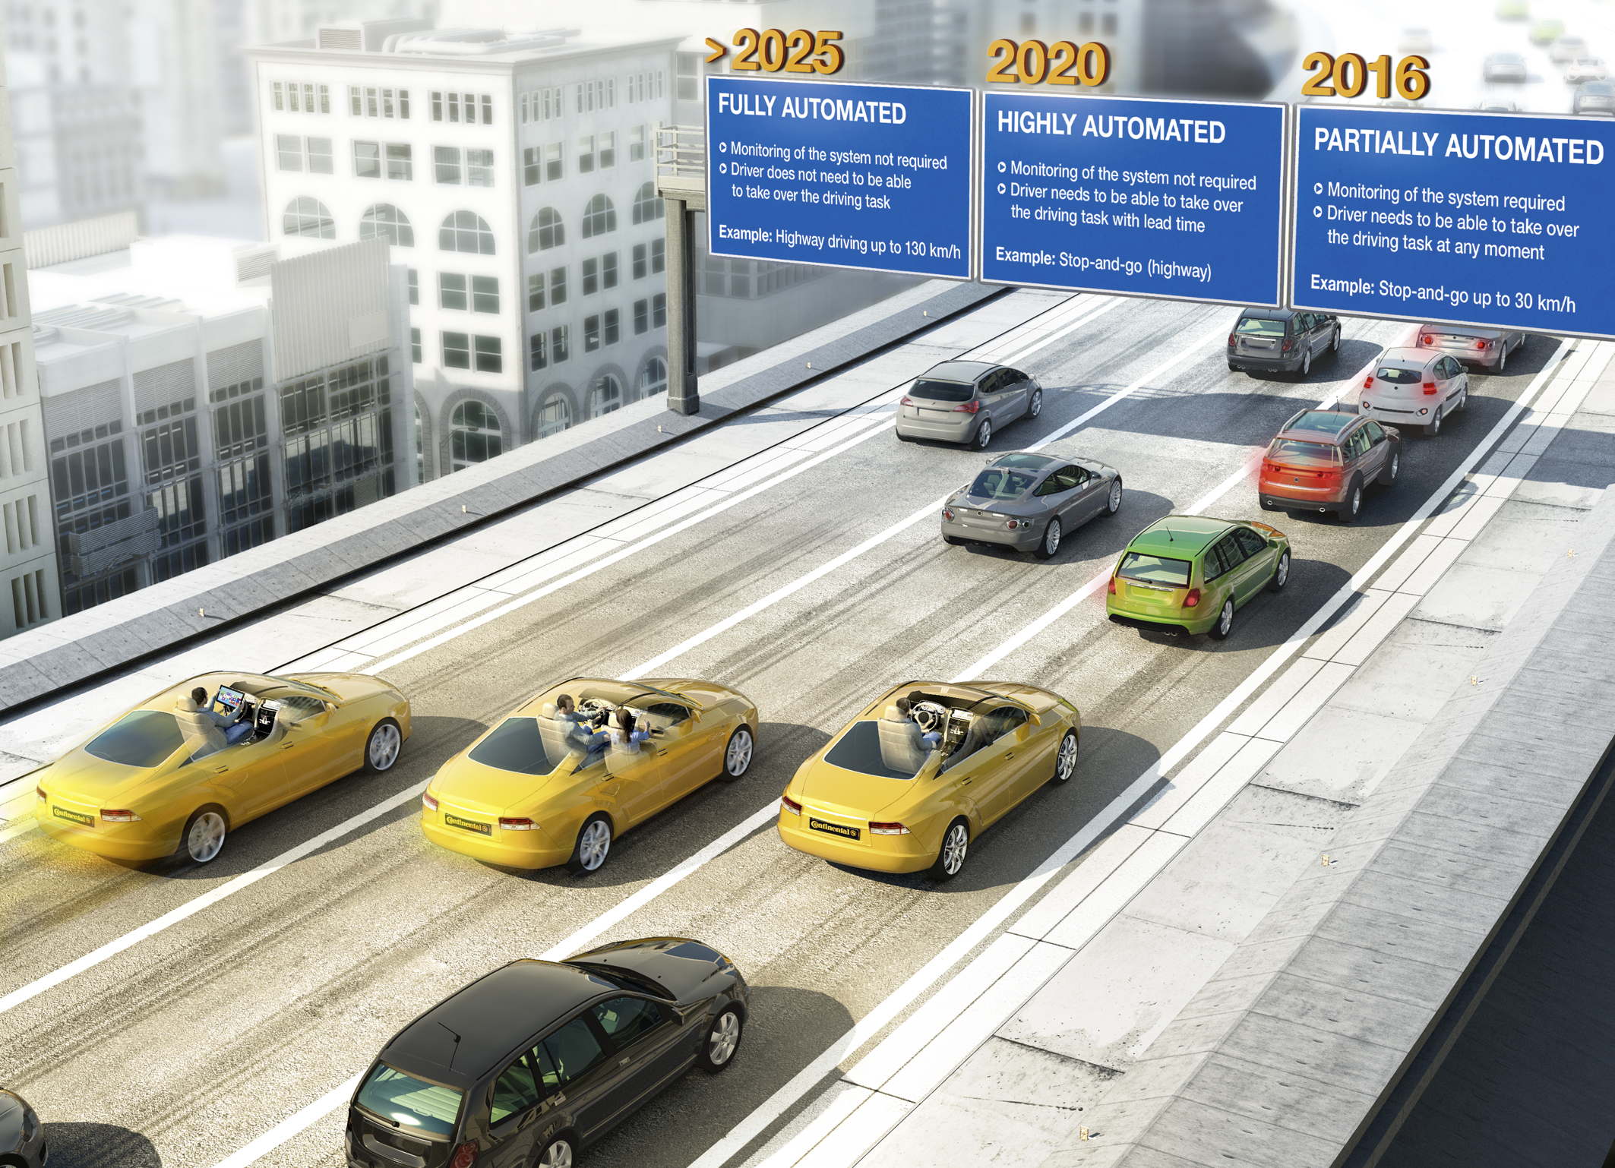
Continental AG

Slide 210
Continental AG

Slide 213
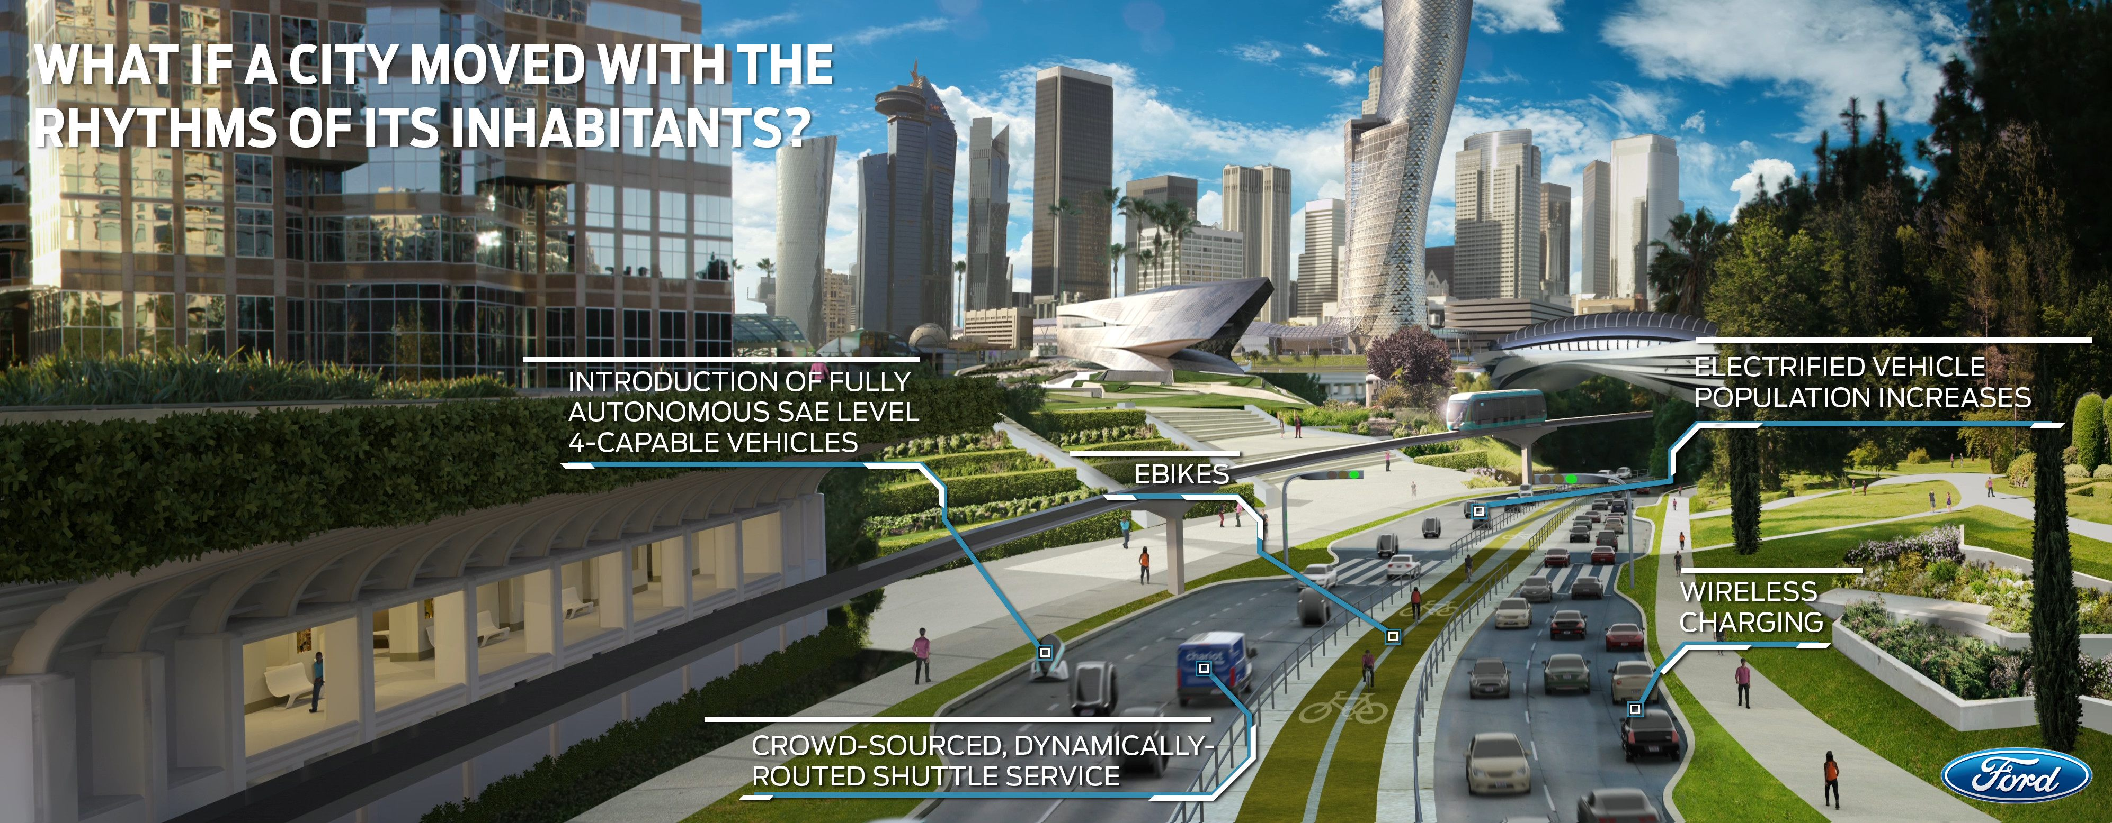

Slide 217
Values are inescapable elements of any rational decision-making process.
The right course of action is always a matter of choice, never of fact.
— Paul Davidoff, "Advocacy and Pluralism in Planning,” Journal of the American Institute of Planners (1965).

