Slide 1


2018 NSF SMART AND CONNECTED COMMUNITIES PI MEETING
PG: [SCC-Planning: CityGuide: Beacon-Based Community-Driven Inclusive Wayfinding], NSF Award [1737433]
Vinod Namboodiri, PI, Associate Professor, Dept. of Electrical Engineering and Computer Science, Wichita State University (WSU)
Rakesh Babu, Co-PI, Lead Accessibility Scientist, Envision Research Institute
Mike Mayta/Debbie Warren, Information Technology, City of Wichita
Additional Co-PIs: Nils Hakansson, Rui Ni, Maryam Zahabi, WSU
Notes:
BRIEFLY INTRODUCE YOURSELF AND YOUR INVESTIGATORS (10 sec slide)

Slide 2
Project Aims
Wayfinding remains a challenge for people with disabilities where GPS is limited or non-existent.
The project proposes the use of wireless beacons to provide auxiliary location-based services (beyond GPS) in indoor and outdoor spaces for people with various disabilities
how can location-based services be provided both indoors and outdoors seamlessly?
what contextual information and cues should be provided when location-based services are being used, especially with an emphasis on indoor wayfinding for users with one or more disabilities?
how can we design location-based systems that are usable by all but account for the constraints imposed by the needs of some?
Notes:
A brief background: Please describe the problem you are addressing and why it is important (20sec slide)

Slide 3
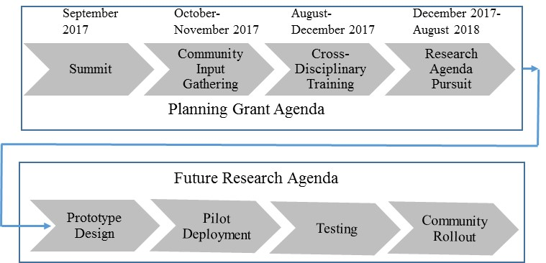
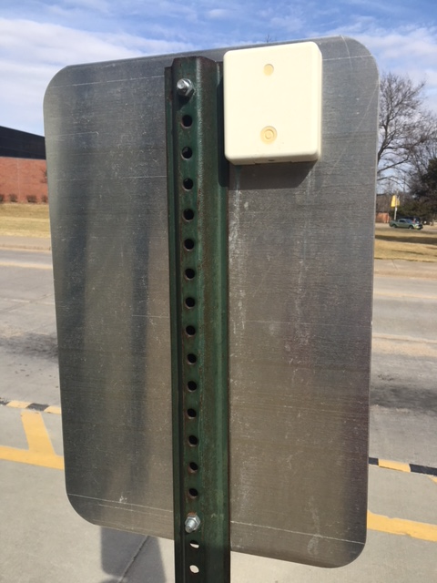

Status of the Project
Beacons deployed on all transit stops in Wichita
Early, limited indoor wayfinding prototype for BVI on demo at US Ignite Event
University, Envision, Wichita Transit Center awaiting pilot deployments
Proposal for next phase submitted with an expanded research team with expertise in the following areas:
  computer science and engineering, biomechanics, visual perception and cognition of older adults, human computer interaction, cognitive task analysis, economic analysis
Notes:
A brief background: Please describe the problem you are addressing and why it is important (20sec slide)

