Slide 1
2018 NSF SMART AND CONNECTED COMMUNITIES PI MEETING
RCN: Smart Civic Engagement in Rapidly Urbanizing Regions, NSF Award #1737563
PI: Ross Meentemeyer¹ Co-PI: Helena Mitasova¹ Co-PI: Todd BenDor² Co-PI: Kevin Foy⁴ Co-PI: Emily Bernhardt³
¹Center for Geospatial Analytics, North Carolina State University ²University of North Carolina at Chapel Hill ³Duke University ⁴North Carolina Central University
Community Partners: City of Raleigh Information Technology, Town of Chapel Hill Public Works, South Atlantic Landscape Conservation Cooperative, Water Resources Research Institute of UNC, UNC-Chapel Hill Energy Services
go.ncsu.edu/TomorrowNow
Notes:
SLIDE TRANSITIONS TO NEXT IN 40 SECONDS
Hello everyone, I’m Todd BenDor, Associate Professor of City and Regional Planning at the University of North Carolina at Chapel Hill and Co-PI of this RCN project: Smart Civic Engagement in Rapidly Urbanizing Regions. Ross Meentemeyer, our lead PI, can’t get here till tonight, and so it’s my pleasure to describe our project to you.
Our research team includes a total of five PIs from four universities across the Triangle Region of North Carolina, with the support of a growing list of community partners.

Slide 2
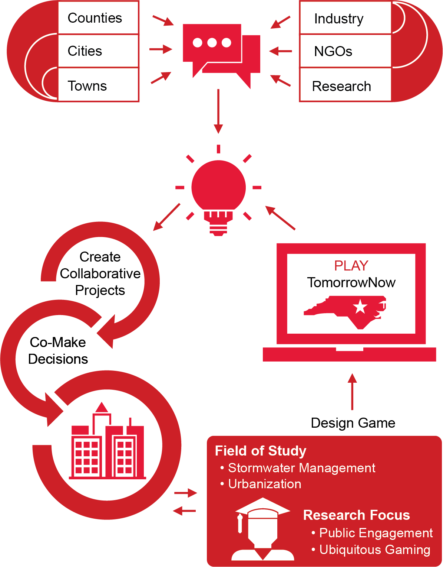
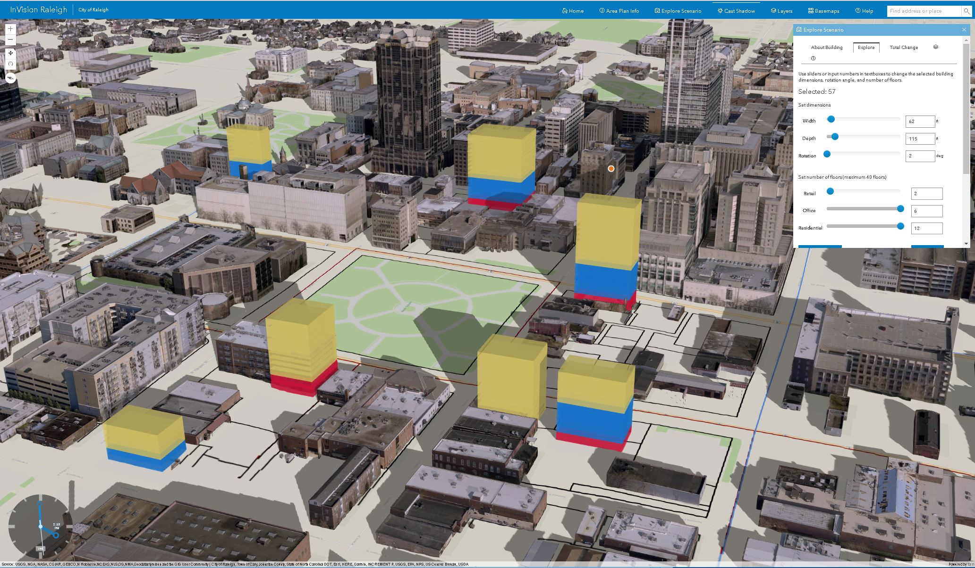
Project Aims
Challenge
Can online serious games, using geospatial models & crowdsourced management scenarios, transform civic engagement and public policy decisions?
Aim
Unite stakeholders in the Triangle to develop an online engagement system called TomorrowNow that will aid decision-making for stormwater management
Example: InVision Raleigh prototype for urban planning
This network will bridge technical research and social engagement through research about engagement with scientific models.
Notes:
SLIDE TRANSITIONS TO NEXT IN 1 MINUTE, 50 SECONDS
And our work focuses on how to innovate citizen engagement through the use of serious games that use geospatial models and crowdsource the design of management scenarios to improve decision-making in rapidly urbanizing regions. We see this as a way of getting a greater diversity of citizen input by essentially putting big data and sophisticated models into everyone’s hands and letting them “play” with alternative scenarios. Our initial focus for these games is urbanization and stormwater management – rallying people around these problems, because they are really pressing in rapidly growing areas like the Triangle, which faces extensive impervious surface and extreme precipitation events.
So, to develop this game – this new engagement system that we’re calling TomorrowNow – into something that will be useful and effective, we are uniting stakeholders and community leaders in the Triangle to co-create it. These stakeholders represent local and regional governments, non-governmental organizations, industry, and research teams specializing in natural and social sciences. Our purpose in bringing them together is to understand current barriers to collaboration for decision-making about stormwater and how to overcome those barriers, as well as to generate consensus for developing an engagement system that will essentially democratize decision-making.
As we say here, this network is meant to bridge technical research and social engagement through research about engagement with scientific models.

Slide 3
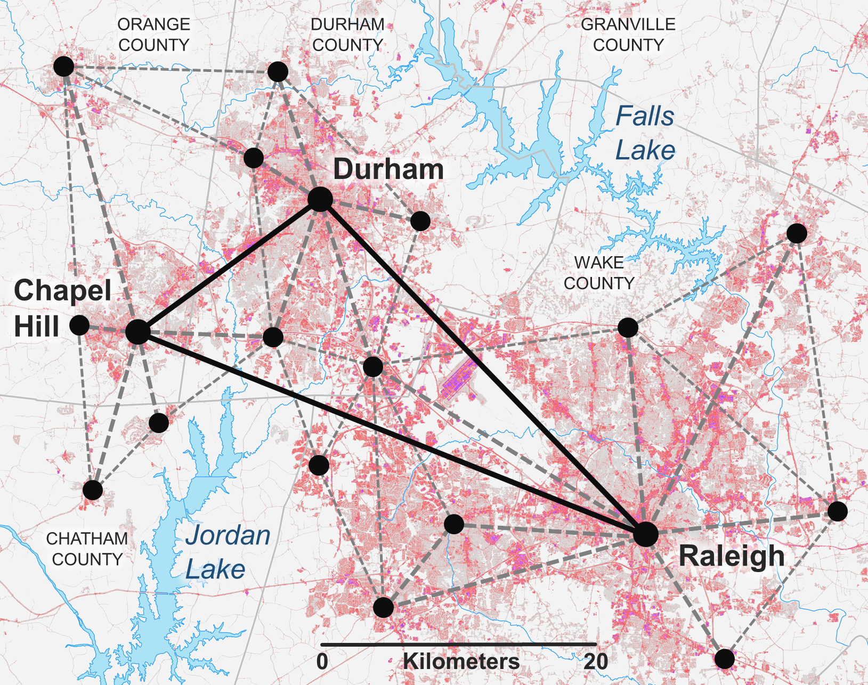
Status of the Project
Established Interdisciplinary Steering Committee & Network Coordinator,
Recruited Key Stakeholders
We have secured the participation of leaders from the major municipalities in the Triangle Region of North Carolina who will serve on our Stakeholder Advisory Board:
Jim Alberque City of Raleigh
Allison Weakley Town of Chapel Hill
Sally Hoyt
UNC-Chapel Hill
Dan Ault Town of Cary
Carter Vickery Wake County
Notes:
SLIDE TRANSITIONS TO NEXT IN 1 MINUTE 20 SECONDS
We already have an Interdisciplinary Steering Committee in place—consisting of scientists and other researchers from our four core universities––and have brought onboard a Network Coordinator who will be responsible for managing day-to-day logistics including workshop planning, data collection, and report writing, and we now also have the core members of our Stakeholder Advisory Board.
Besides several NGOs, they include representatives from the four cities and three counties in the Triangle Region crucial to this effort. They will engage in all aspects of the network’s activities –– workshops, discussions, symposia –– to co-create the game, and they will be key to securing even more participation from diverse voices. Historically, urban stormwater pollution in this area has been a “wicked” policy problem, in that it is not clear to all parties how to structure or frame the problem, or even what the biggest problem is. Bringing all of these stakeholders to the table is essential to bridge previous institutional silos and jointly characterize problems and ways to approach their solutions.

Slide 4
Timeline
Next Steps:
Assemble the Interdisciplinary Steering Committee & Stakeholder Advisory Board for Workshop #1: Goal-defining Meeting
Launch web-based discussion portal to follow up on workshops, inspire dialogue, and outline action items for Workshop #2: Work-plan Meeting
Timeline of RCN events.
Regular workshops and symposia will establish and maintain both personal interactions and a collaborative online space for knowledge-sharing.
Goal: Cultivate smart connections among stakeholders in the Triangle and culminate in consensus for the best strategy to develop TomorrowNow.
Notes:
SLIDE TRANSITIONS TO NEXT IN 1 MINUTE, 05 SECONDS
Our next step is to host the first workshop—bringing together the members of our Interdisciplinary Steering Committee and our Stakeholder Advisory Board.
As you can see in this graphic of our expected timeline, we plan to hold a total of five workshops over the course of four years, and two symposia designed to engage an even wider group of members of the public in our progress. The first workshop is a goal-defining meeting, where all of our stakeholders will lay out their expectations for the project.
As the glue between all of these meetings, we will also launch an online collaboration tool that will keep the discussion going.
Over the course of all these workshops, symposia, and interactive online discussions, we will come to a consensus about the technical specifications of the serious game.
And we hope that the success of this network –– and the initial game –– will eventually transform the way citizens participate in management decisions that affect where they live and work. Thanks for listening.

