Slide 1
2018 NSF SMART AND CONNECTED COMMUNITIES PI MEETING
PG: Using Innovations in Big Data and Technology to Address the High Rate of Infant Mortality in Greater Columbus, Ohio, NSF Award 1737560
Raghu Machiraju, Courtney D. Lynch, Anish Arora, and Christopher R. Browning with Moms2B Ohio
Translational Data Analytics Institute and College of Medicine,
The Ohio State University
Websites: https://discovery.osu.edu/tda/ https://wexnermedical.osu.edu/obstetrics-gynecology/pregnancy/moms2b
Notes:
BRIEFLY INTRODUCE YOURSELF AND YOUR INVESTIGATORS (10 sec slide)

Slide 2
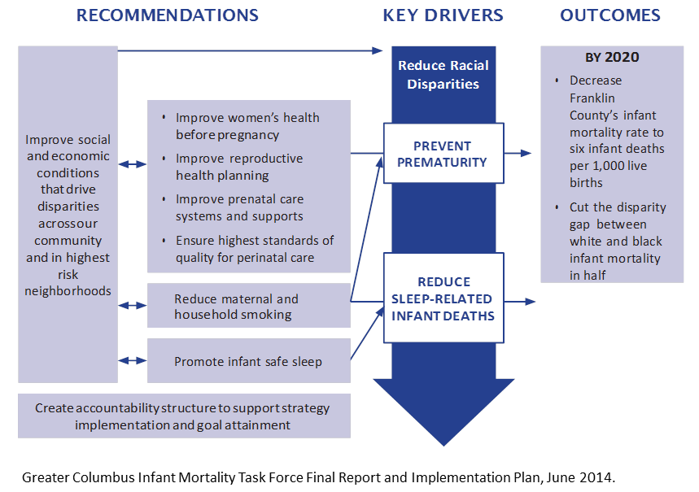
Project Aims
Identify data gaps
Align with key stakeholders and partners
Formulate a plan to leverage our technological and content expertise to design and implement novel interventions to improve maternal and infant health
Infant Mortality Reduction Implementation Plan and Targets for Intervention
TDAI
Notes:
A brief background: Please describe the problem you are addressing and why it is important (20sec slide)

Slide 3
Status of the Project
Working with Moms2B to collect qualitative input from moms regarding challenges
Aligning with key stakeholders to identify targets for intervention
Implementing stakeholder needs assessment survey
Notes:
A brief background: Please describe the problem you are addressing and why it is important (20sec slide)

Slide 4
Preliminary Findings and Planned Outcomes
Preliminary Findings
Inadequate investment to date in informatics approaches to combine and analyze relevant multilevel (e.g., individual lifestyle factors, neighborhood characteristics) data
Coordinated multi-provider interventions (e.g., healthcare, transport, food providers) can help improve outcomes
Determined technological and big data capabilities that team could offer
Planned Outcomes
Plan (with an intent to implement) an innovative big data and technology approach to help address the high rate of infant mortality in Greater Columbus
Notes:
A brief background: Please describe the problem you are addressing and why it is important (20sec slide)

