Slide 1
2018 NSF SMART AND CONNECTED COMMUNITIES PI MEETING
PG: Urbanism Next Network Planning Grant, NSF Award 1737645
Nico Larco, AIA; Rebecca Lewis, PhD (presenter)
University of Oregon, Sustainable Cities Initiative
http://sci.uoregon.edu and http://urbanismnext.com
Notes:
BRIEFLY INTRODUCE YOURSELF AND YOUR INVESTIGATORS (10 sec slide)

Slide 2
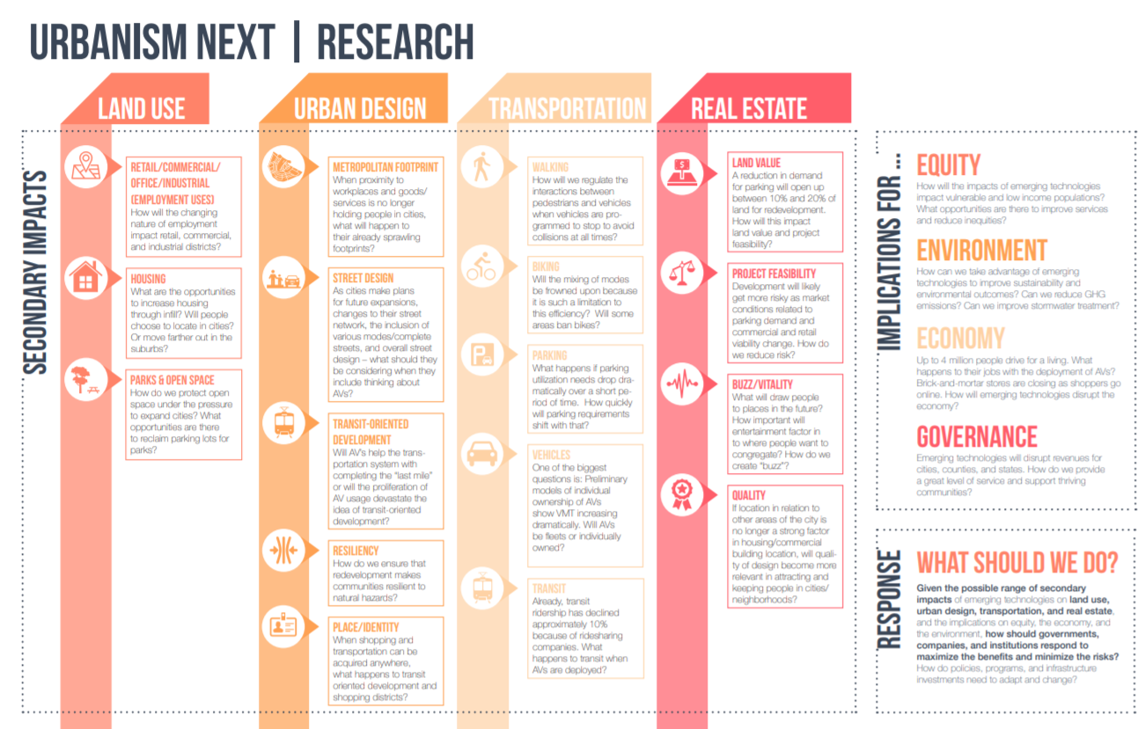
Project Aims
Impacts of Autonomous Vehicles (AVs) on city form and function, the well-being of residents, and regional economic competitiveness
Leaders from academia, industry, government, think tanks and community partners
Engage a range of disciplines
Develop framework for policy-relevant guidance
Create a web-based clearinghouse
Notes:
A brief background: Please describe the problem you are addressing and why it is important (20sec slide)

Slide 3
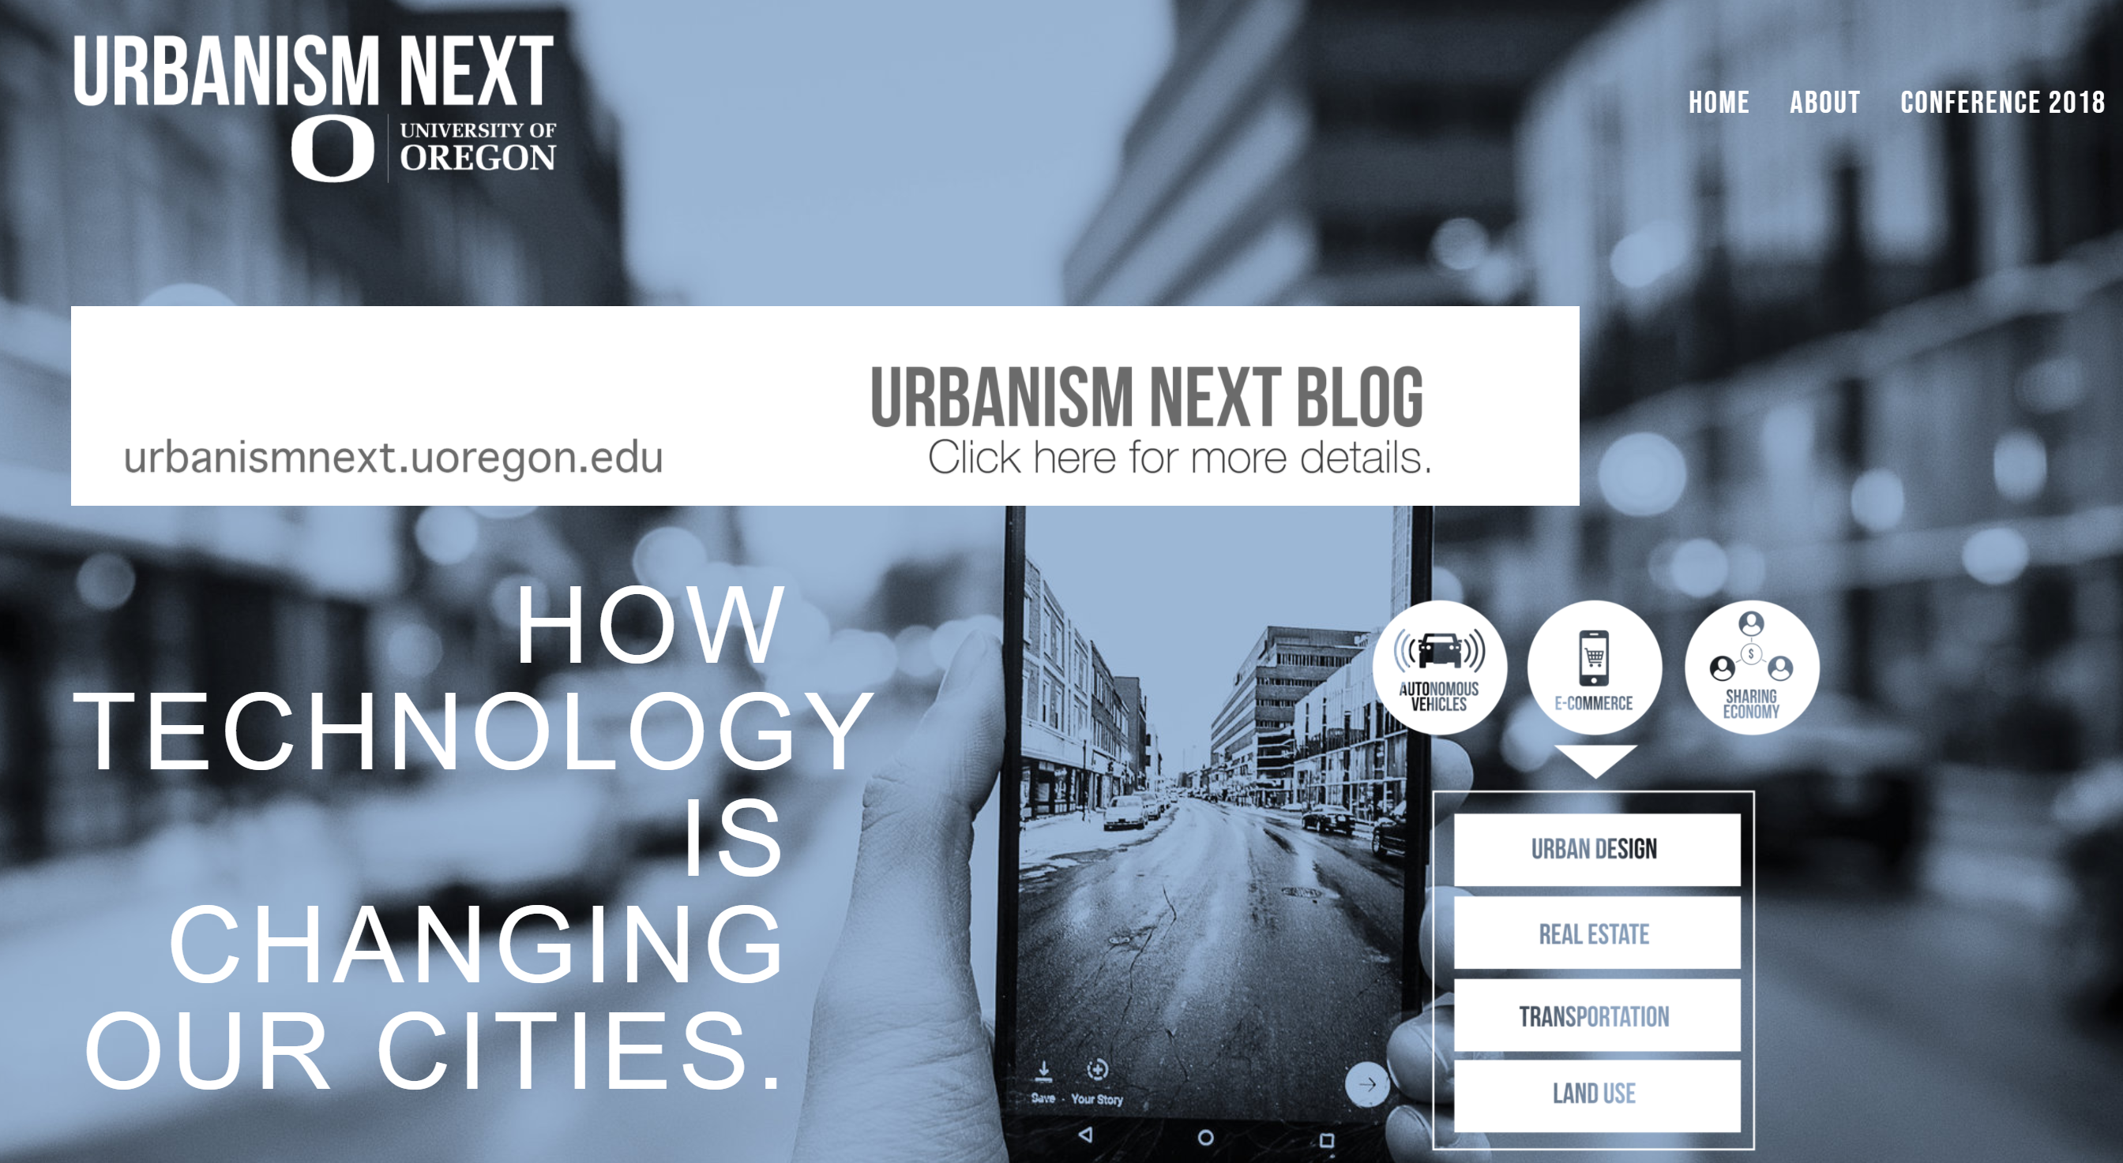
Status of the Project
Draft framework to understand impacts on urban form
Emerging Technology Group in Portland
Outreach to national network
Urbanism Next Conference (500+)
Created blog (http://urbanismnext.uoregon.edu
Notes:
A brief background: Please describe the problem you are addressing and why it is important (20sec slide)

Slide 4
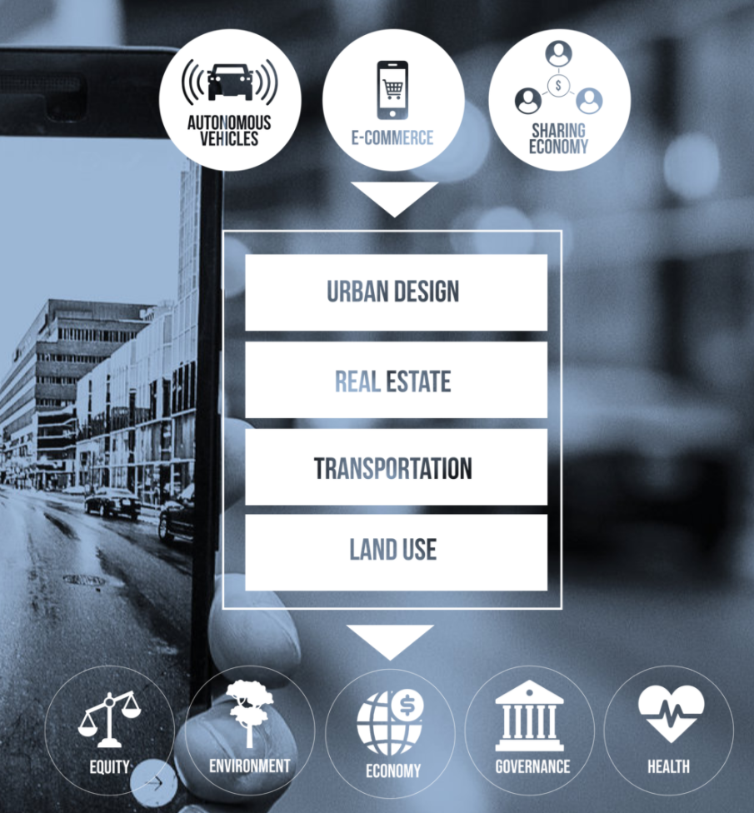
Planned Outcomes
Sub-groups within national network to flesh out framework
Structure and content in Urbanism Next Clearinghouse
Delineate policy and research questions related to city design
White papers to outline research needs
Notes:
A brief background: Please describe the problem you are addressing and why it is important (20sec slide)

