Slide 1
2018 NSF SMART AND CONNECTED COMMUNITIES PI MEETING
IRG Track 2: Building a Smart City Economy and Information Ecosystem to Motivate Pro-Social Transportation Behavior (CNS-1739413)
Alexandros Labrinidis (PI)
University of Pittsburgh
https://PittSmartLiving.org
Twitter: @PittSmartLiving
Notes:
BRIEFLY INTRODUCE YOURSELF AND YOUR INVESTIGATORS (10 sec slide)

Slide 2
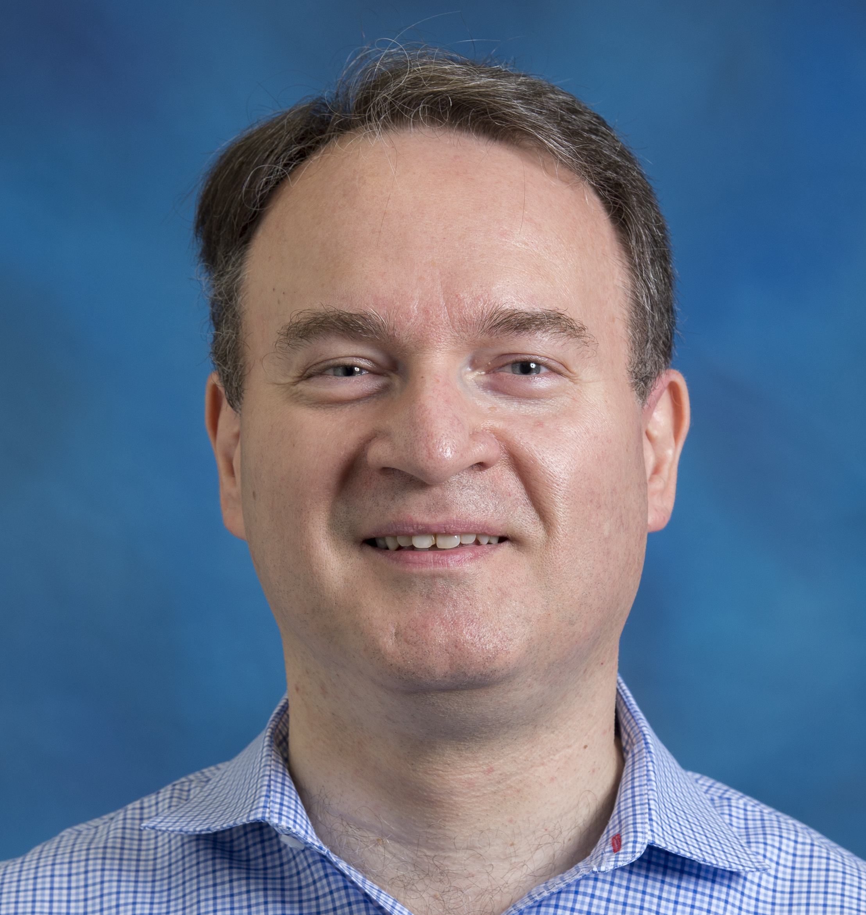
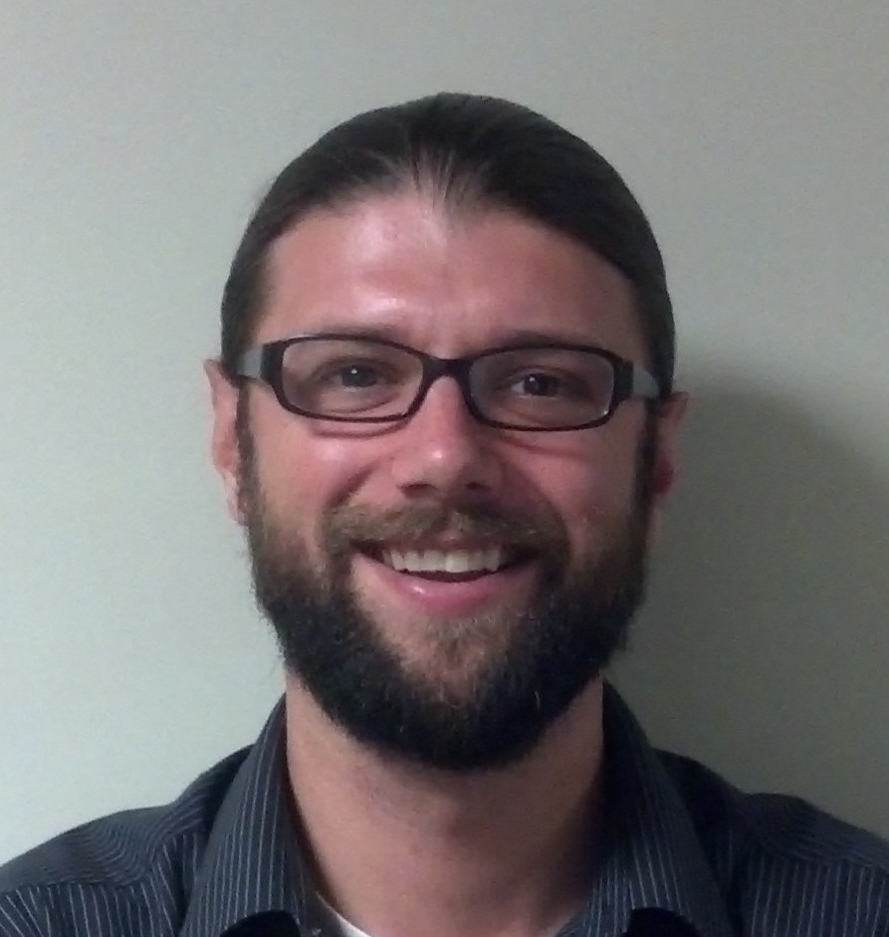
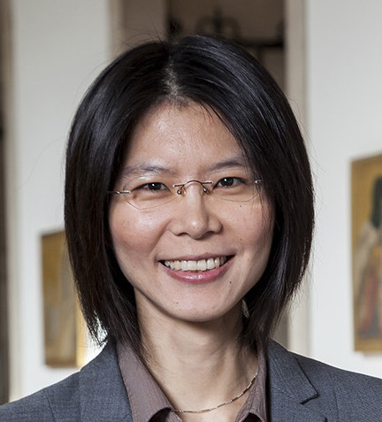
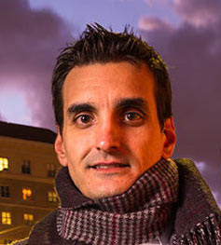
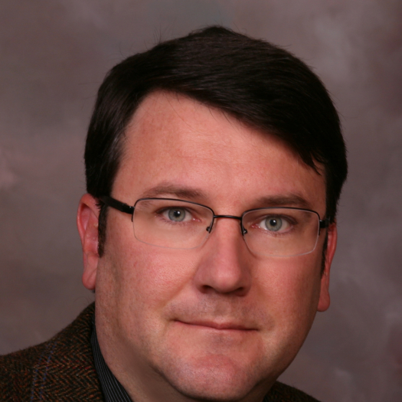
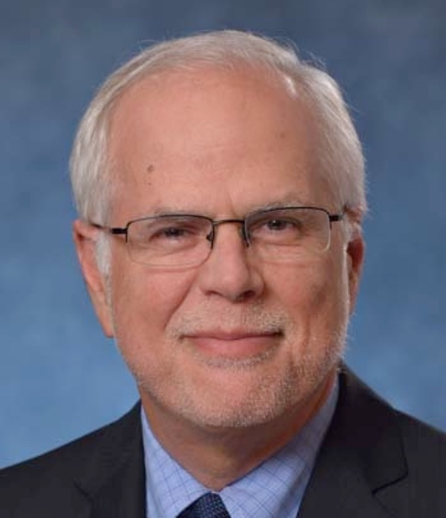
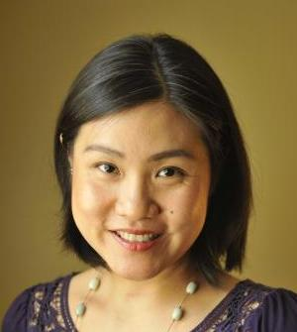
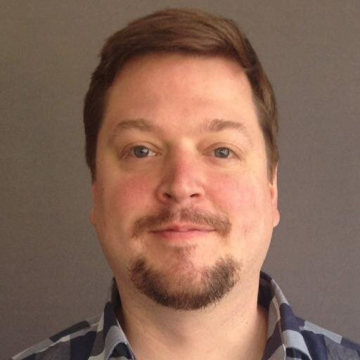
Team Members
School of Computing and Information
Alexandros Labrinidis (PI)
Adam Lee
Yu-Ru Lin
Konstantinos Pelechrinis
School of Engineering
GSPIA
TransitScreen
Kent Harries
Mark Magalotti
Sera Linardi
Matt Caywood
Notes:
BRIEFLY INTRODUCE YOURSELF AND YOUR INVESTIGATORS (10 sec slide)

Slide 3
Project Partners
Port Authority of Allegheny County
Healthy Ride Pittsburgh
City of Pittsburgh
Oakland Business Improvement District
Pittsburgh Downtown Partnership
Envision Downtown
Oakland Transportation Management Association
Pittsburgh 2030 District
Radius Networks
UPMC
Daniele Quercia, Bell Labs, Cambridge, UK
University of Pittsburgh – Department of Parking, Transportation & Services
University of Pittsburgh – Office of Community and Governmental Relations
University of Pittsburgh – Center for Social & Urban Research
Notes:
BRIEFLY INTRODUCE YOURSELF AND YOUR INVESTIGATORS (10 sec slide)

Slide 4
Project Aim #1
Design, develop, deploy, and evaluate a multimodal trip planning mobile app that:
Provides commuters with real-time information of arrival and utilization of all relevant options of public transit (e.g., bus, subway, shuttles, bikes, etc.)
Enables commuters to automatically ”compose” smart multimodal trips
Supports other criteria for routing beyond trip duration (e.g., healthy life-style, scenic routes, etc)
Notes:
BRIEFLY INTRODUCE YOURSELF AND YOUR INVESTIGATORS (10 sec slide)

Slide 5
Project Aim #2
Build a marketplace around multimodal mobility, where businesses can offer time-sensitive incentives connected to real-time transit information to nearby commuters
(e.g., the next bus is too full, come in and enjoy $1 off coffee).
Incentives must be in support of pro-social behavior (e.g., reduce peak demand)
Desired pro-social behavior can be influenced by Transit Operators
Notes:
BRIEFLY INTRODUCE YOURSELF AND YOUR INVESTIGATORS (10 sec slide)

Slide 6
The Big Picture
Mobility Providers
Incentives
Pro-Social “rules” (e.g., reduce peak demand)
Travelers
Realtime Information
Incentives
Better Quality of Life
Realtime Information
Marketplace for incentives
User Preferences
Historical Data
Predictive Models
Local Businesses
Employers
Incentives
Redemption rules (e.g., no coupons before 5pm)
Sustainability Incentives
Redemption “rules” (e.g., verify carpooling)
Notes:
A brief background: Please describe the problem you are addressing and why it is important (20sec slide)

Slide 7
Status of the Project
Progress on multiple fronts:
Understanding data (building predictive models over historical data)
Ongoing discussions with Port Authority, HealthyRide, Pitt Shuttles
Understanding human behavior (designing lab experiments)
Design and development of prototype mobile app
Installation of PittSmartLiving Displays (w/ TransitScreen)
increase multimodal focus and project footprint
Presentations/booths at multiple events:
City’s Mobility Showcase, SW PA Transit Operators Committee, Transportation Forum, Pittsburgh Downtown Partnership Annual Meeting
Notes:
BRIEFLY INTRODUCE YOURSELF AND YOUR INVESTIGATORS (10 sec slide)

Slide 8
What’s Next
Mobile app prototype
early beta release in summer
bus capacity alerts
use for feedback on predictive models
Travel preferences survey
Lab experiments to understand user preferences for incentives
Marketplace design
Recruit businesses
Notes:
BRIEFLY INTRODUCE YOURSELF AND YOUR INVESTIGATORS (10 sec slide)

Slide 9
Alex Labrinidis
http://labrinidis.cs.pitt.edu
@labrinid
https://pittsmartliving.org
@pittsmartliving
Notes:
BRIEFLY INTRODUCE YOURSELF AND YOUR INVESTIGATORS (10 sec slide)

