Slide 1
2018 NSF SMART AND CONNECTED COMMUNITIES PI MEETING
How can we use smart cities technologies to improve the lives of low income, inner city residents?
NSF Award: 1737495
Gerrit Knaap, Vanessa Frias-Martinez, and others
National Center for Smart Growth and Urban Computation Lab, University of Maryland
http://www.umdsmartgrowth.org/projects/smart-cities/
Notes:
BRIEFLY INTRODUCE YOURSELF AND YOUR INVESTIGATORS (10 sec slide)

Slide 2
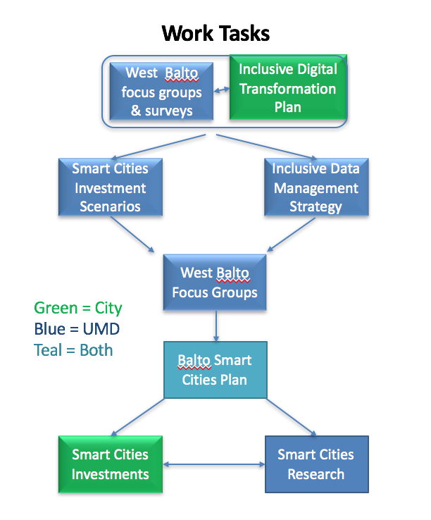
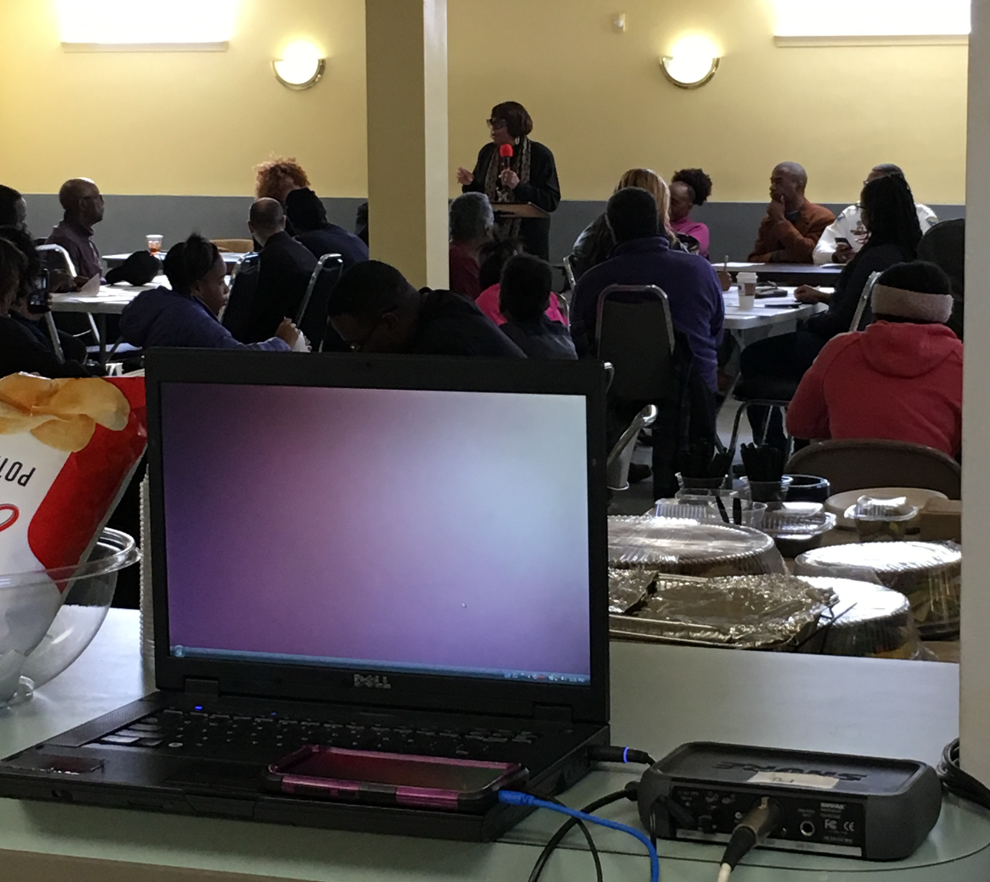
Project Aims
The purpose of this project is to lay the foundation for research designed to improve the lives of low-income, inner city residents.
Whereas much activity in smart cities represents solutions looking for problems, our approach is to work closely with inner city residents to identify their needs and jointly design appropriate smart city solutions.
Notes:
A brief background: Please describe the problem you are addressing and why it is important (20sec slide)

Slide 3
Status of the Project
The University of Maryland has
conducted seven focus groups with residents of West Baltimore;
administered and analyzed results of 108 survey response forms;
is soon to release a web-based geo-targeted survey.
Johns Hopkins and University of Baltimore now developing an inclusive data management strategy.
Morgan State University is currently developing smart cities investment scenarios.
The City released its Inclusive Digital Transformation Plan and is currently soliciting feedback.
Four related SCC proposals were submitted in February.
An interdisciplinary workshop on smart cities interventions and research is planned for June.
Notes:
A brief background: Please describe the problem you are addressing and why it is important (20sec slide)

