Slide 1
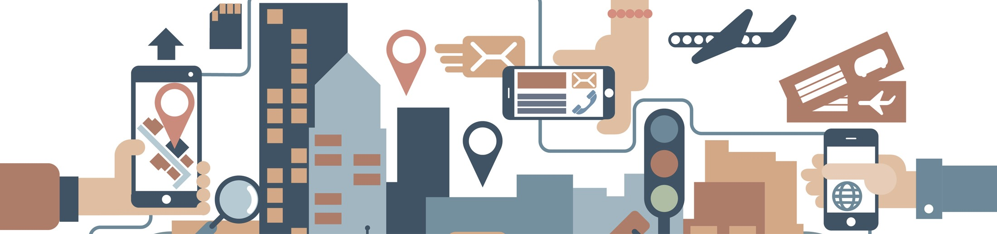

2018 NSF SMART AND CONNECTED COMMUNITIES PI MEETING
IRG Track 2: A Novel Architecture for Secure Energy Efficient Community-Edge-Clouds with Application in Harlem: SEEC Harlem, NSF #CNS-1737453
Dan Kilper¹ (Lead), Clayton Banks², Bryan Carter¹, Rider Foley³, Sheila Foster⁴, Bruce Lincoln², Olivier Sylvain⁵, Malathi Veeraraghavan³, Ron Williams³
¹University of Arizona (Lead), ²Silicon Harlem, ³University of Virginia, ⁴Georgetown University, ⁵Fordham University
http://cian-erc.uawebhost.arizona.edu/seec-harlem
Notes:
BRIEFLY INTRODUCE YOURSELF AND YOUR INVESTIGATORS (10 sec slide)

Slide 2
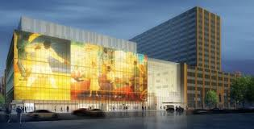

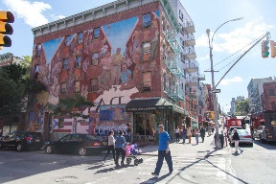

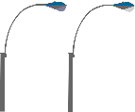
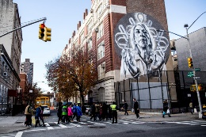

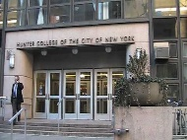
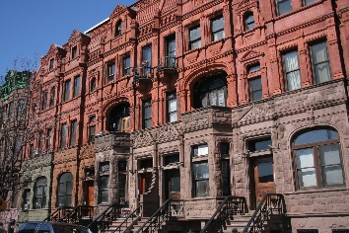
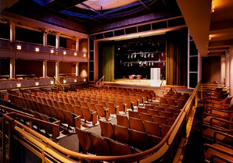
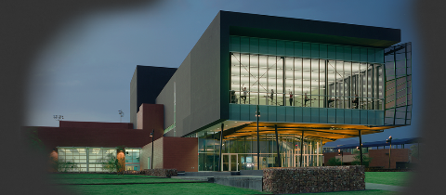
Connecting Harlem
Street Artists
Hospitals
Address long standing lack of broadband access and digital readiness in dense urban area of Harlem, NY
Overcome legacy infrastructures, outdated legal arrangements, norms, and behaviors, computer literacy deficiencies, and limited budgets
Businesses
Schools
Theaters
Share with the world
University/ Community Centers
Students/Residents
Create, collaborate, and share locally like nowhere else
Remote Performers/Artists/Hospitals

Slide 3
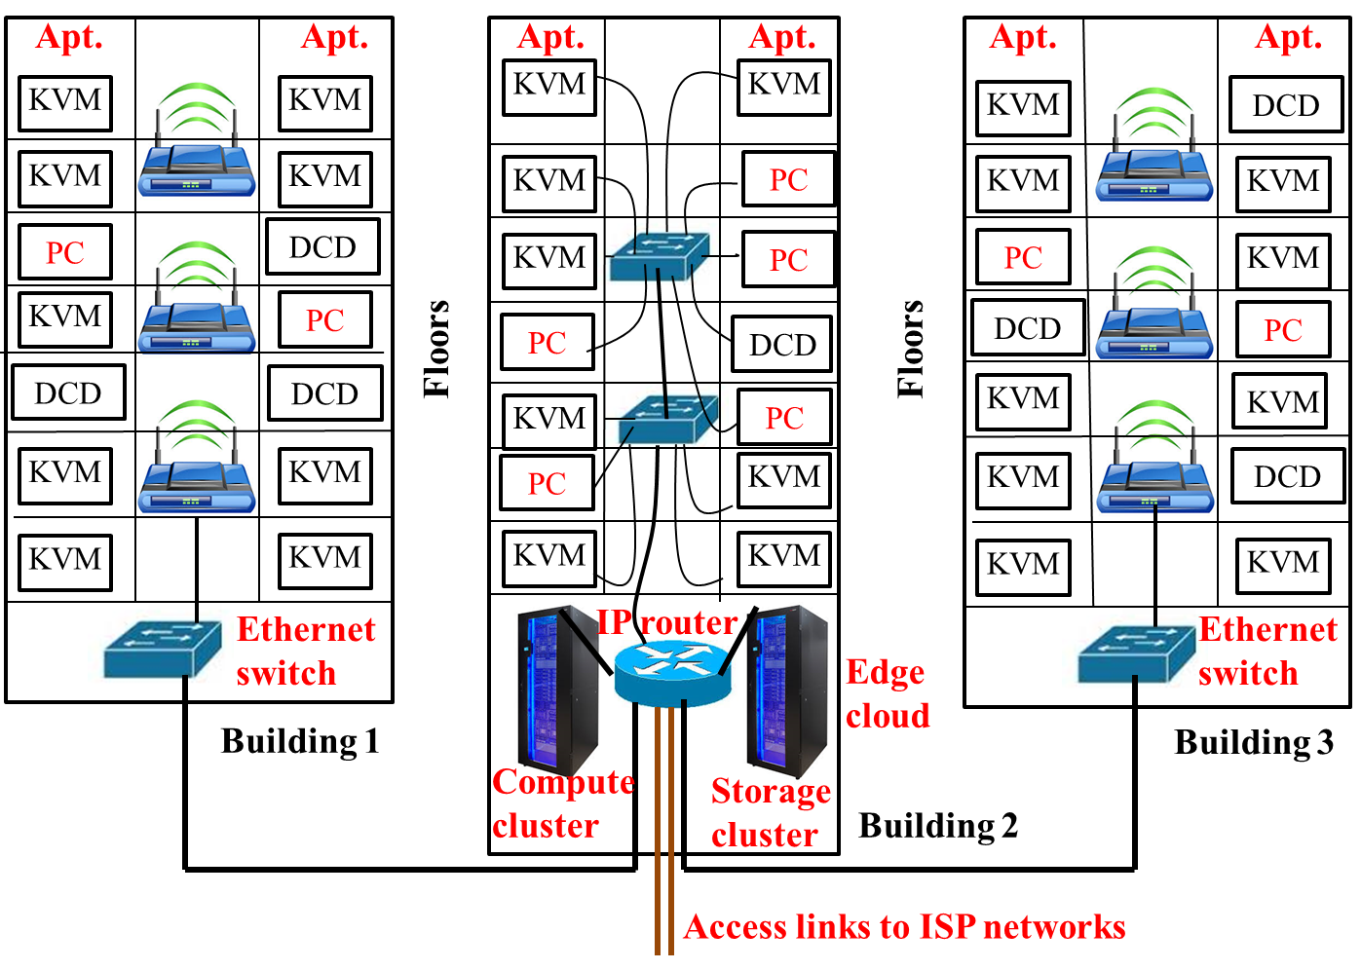
Community Network + Edge Cloud
Edge cloud to disaggregate hardware
  Low cost, secure user devices: KVM/Zero Client user interfaces, sensors, audio, VR/AR
  Shared, centralized IT management of high performance edge cloud
  Can this approach meet technology performance, ease of use, and cost?
Community network as digital constructed commons resource
  Develop groundbreaking model for distributed community governance of Internet resources: equitably provide benefits & transferrable to other communities
Technology
  Participatory technology assessments (pTA) on the highest priority criteria related to the community edge cloud and disaggregated devices
  Smart community education and engagement

Slide 4
Where We Are
Kick-off at Silicon Harlem Conference 2017
  Panel sessions, community input
Evaluated performance of remote access platforms
  Reviewed user experience metrics: objective and subjective
Design and planning of edge cloud
  Working with industry partners
Jointly developing governance and business models
  Including privacy and security constraints
Generating maps and materials for public engagement/pTA
Notes:
A brief background: Please describe the problem you are addressing and why it is important (20sec slide)

Slide 5
What’s Next
Complete zero client lab tests
Develop initial software for trials
Establish initial architecture and performance requirements
In-lab technology assessment trials on campus
March-August 2018: multiple stakeholder convening’s
August 2018: Harlem Week
  Initial zero client tests/user interviews
October 2018: SH conference
Notes:
A brief background: Please describe the problem you are addressing and why it is important (20sec slide)

Slide 6
Project Plan
Comp Case Studies
Public Trust Model
Microsoft/Cisco Hardware
Edge Cloud Design & Opt.
Community Contributions
Technology Assessments
COSMOS
Gigabit Center
Initial ZeroClient Trial
100 User ZeroClient Trial
Apollo Theater Demo
School Demo
Co-Produced Edge Cloud
Community Apps & Demos
Zero Client Test Platform
Appl & VR Test Platform & SW
EC-DC Software
Service Provider Contributions
Notes:
Elucidate service provider role

