Slide 1
2018 NSF SMART AND CONNECTED COMMUNITIES PI MEETING
Track 1: Overcoming Social and Technical Barriers for the Broad Adoption of Smart Stormwater Systems, 1737342
Branko Kerkez¹, Jon Hathaway², Jon Goodall³, Teresa Culver³
Lisa Reyes Mason², Noah Webster¹, Joan Nassauer¹, Ruben Kertesz⁴
Community Partners: Harry Sheenan⁵, Evan Pratt⁵, Ric Lawson⁶ Santiago Garces⁷, Chris Howley⁸, Dawson Garrod⁹
¹University of Michigan, ²University of Tennessee, ³University of Virginia, ⁴EmNet, ⁵Washtenaw County, ⁶Huron River Watershed Council, ⁷City of South Bend, ⁸City of Knoxville, ⁹Facilities Engineer
Notes:
BRIEFLY INTRODUCE YOURSELF AND YOUR INVESTIGATORS (10 sec slide)

Slide 2
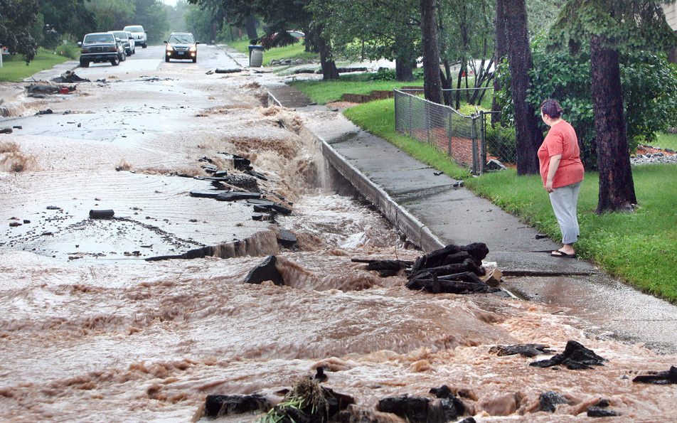
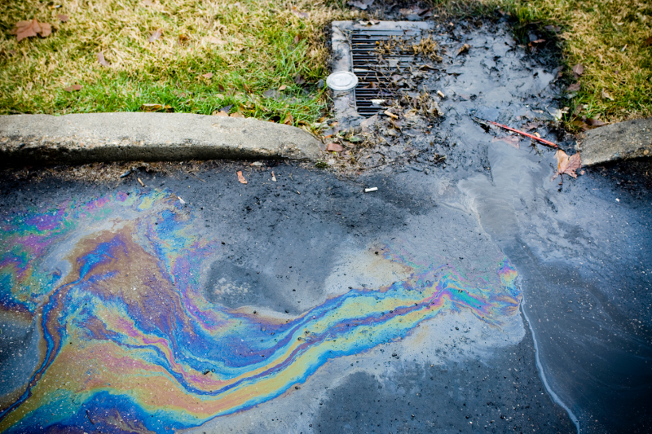
Motivation
Floods are the leading cause of severe weather fatalities
Pollutant loads in stormwater are one of our greatest environmental challenges
NAE Grant Challenge to improve and restore infrastructure
Source: Duluty, Water Technology Online
Notes:
We are motivated by the NAE goal to “restore and improve urban infrastructure
In particular as it related to stormwater, arguably the “forgotten” and leastfunded of all water infrastructures
Throughout the US, Flash Floods are the leading cause of death in the context of extreme weather
Furthermore, large quantities of metals, nutrients, and other pollutants are washed off during storm events, making their way via streams and rivers to lakes
Urban runoff is readily acknowledged as one of our largest ENV challenges
For example, it’s a billion dollar problem in paces like the cheaspeak bay

Slide 3
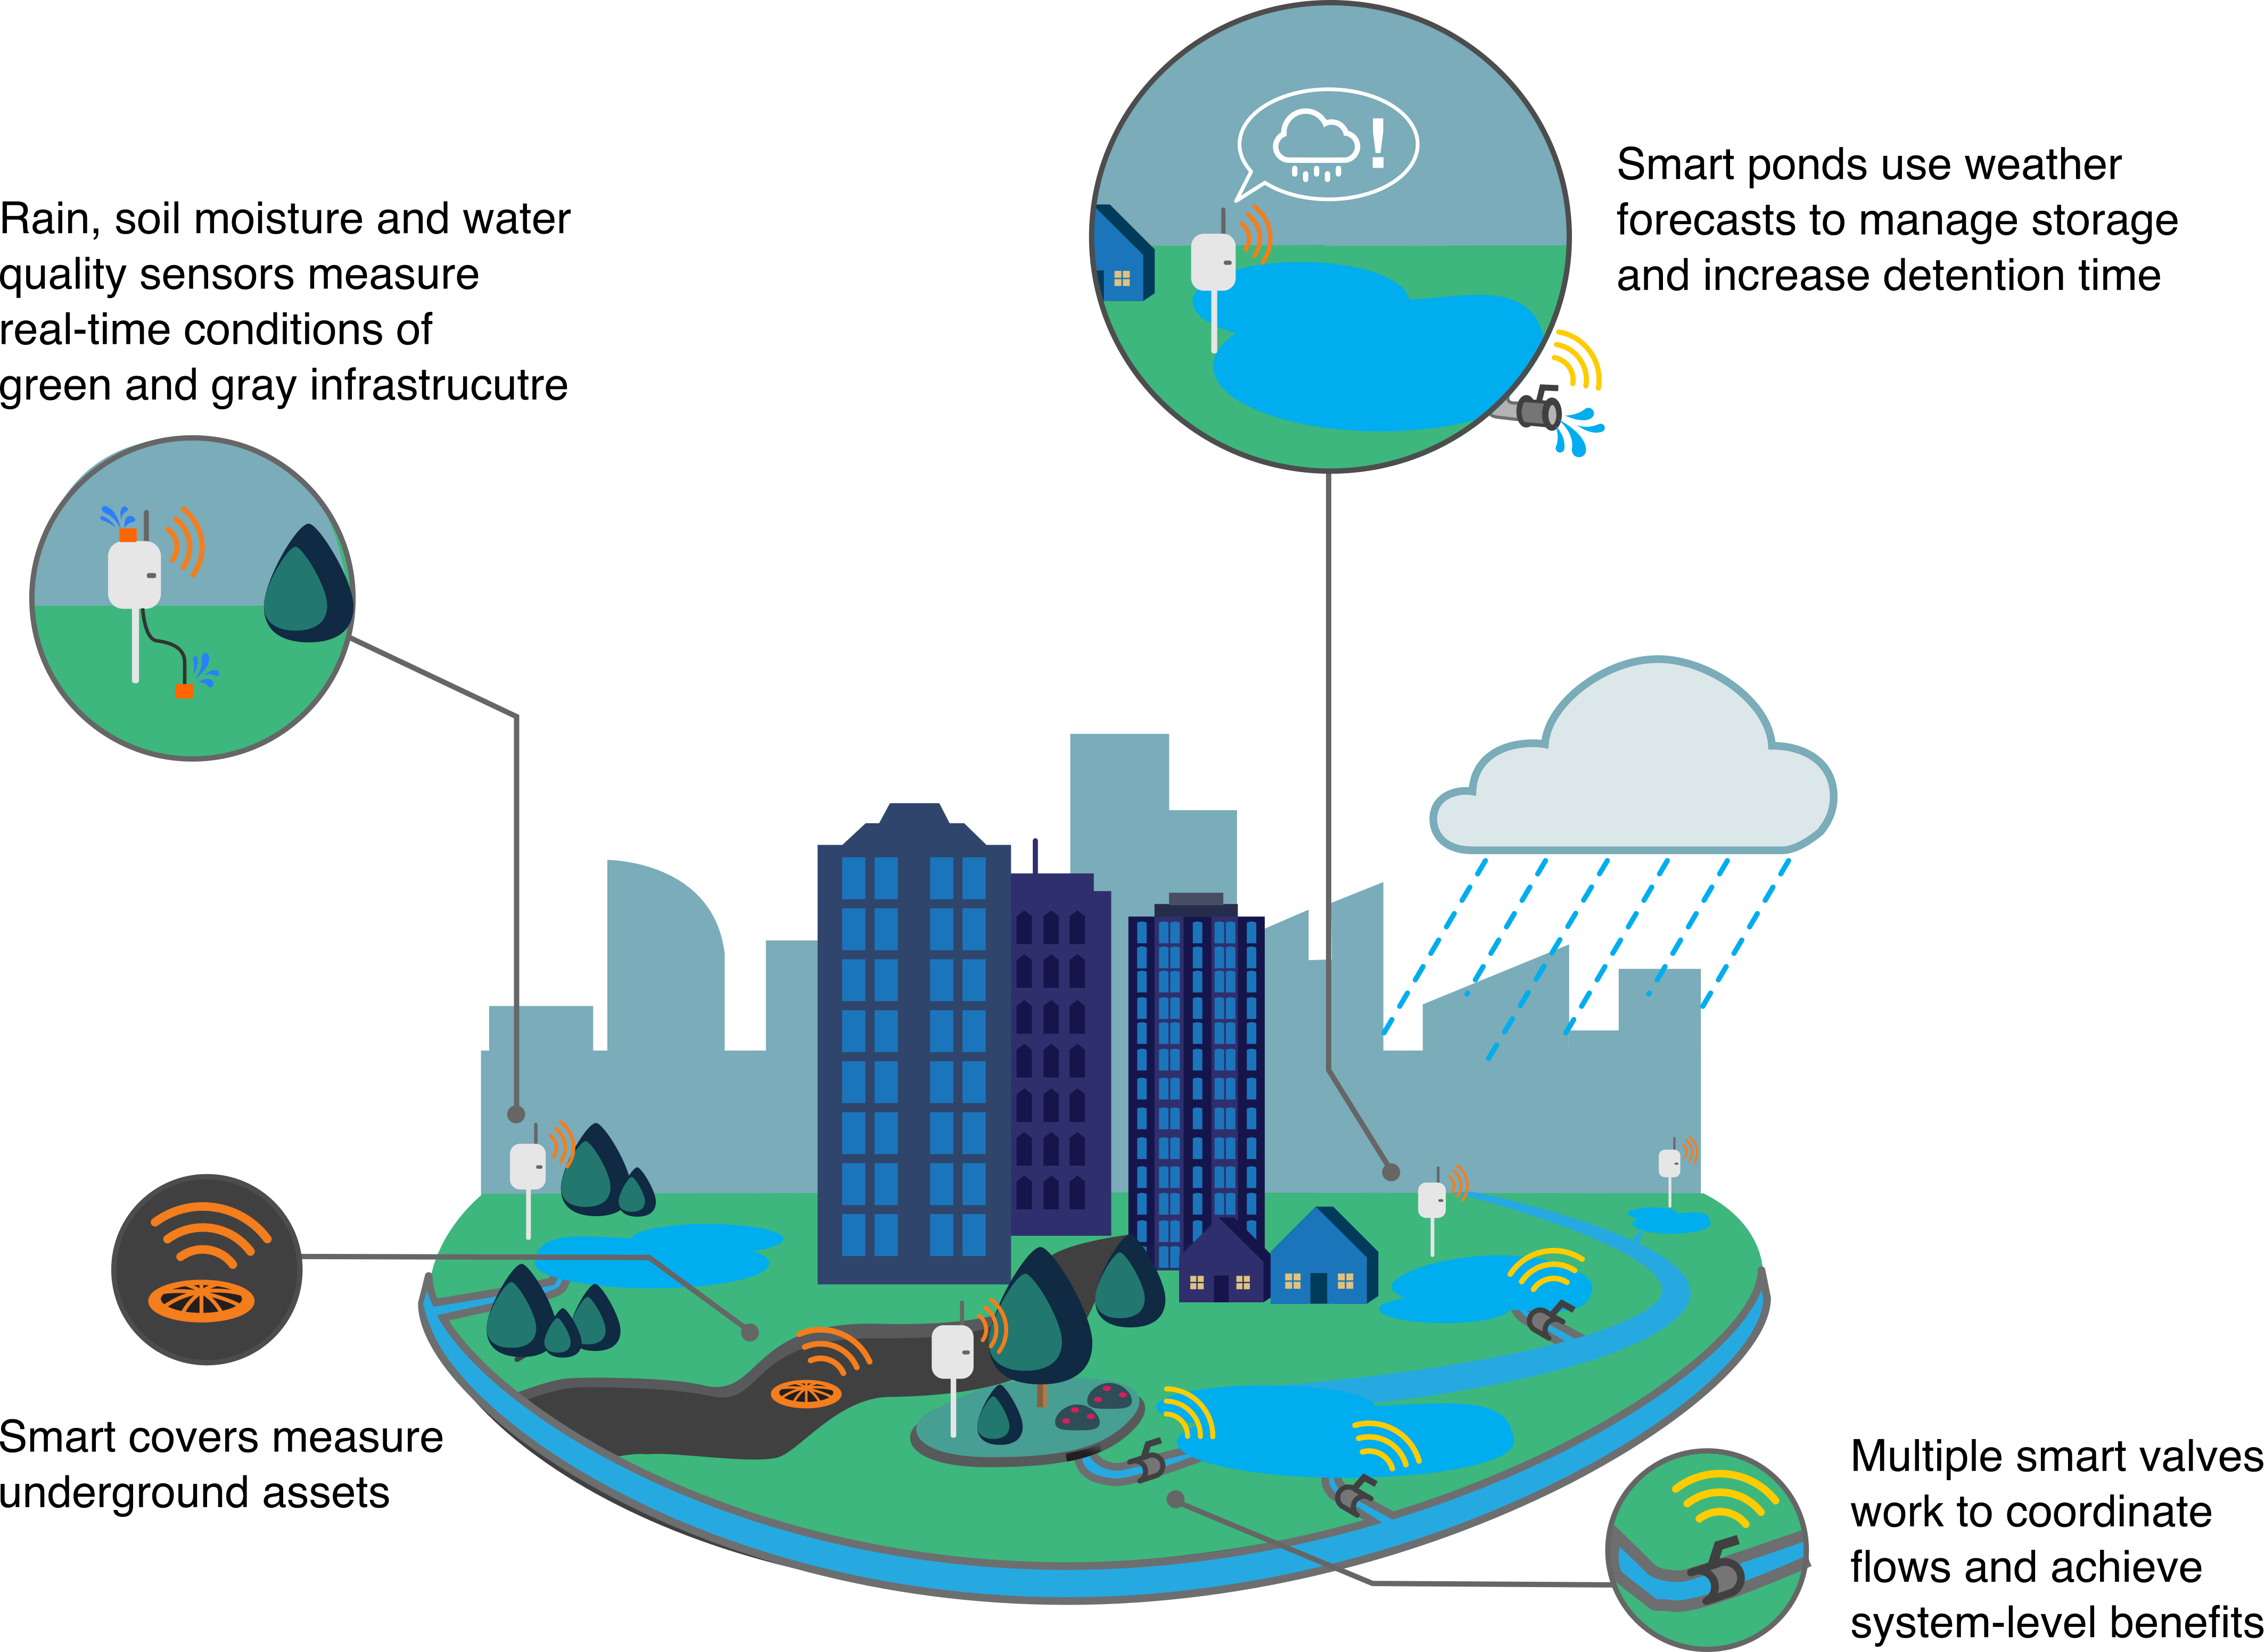
Source: Kerkez et al. (2016)¹
Notes:
Our goal is to enable the next generation of smart and connected stormwater systems, which will use sensors to anticipate changes in weather and adapt their operation using active flow controls (gates, valves, pumps).
Redesign in real-time
This will drastically improve community resilience to floods and water quality impairments, which have been increasing due to expanding urbanization and changing weather.
This vision was recently recognized by our community
Step one, over the past few years, was trying to convince people thais this was possible. Namely, technology delvelopment.

Slide 4
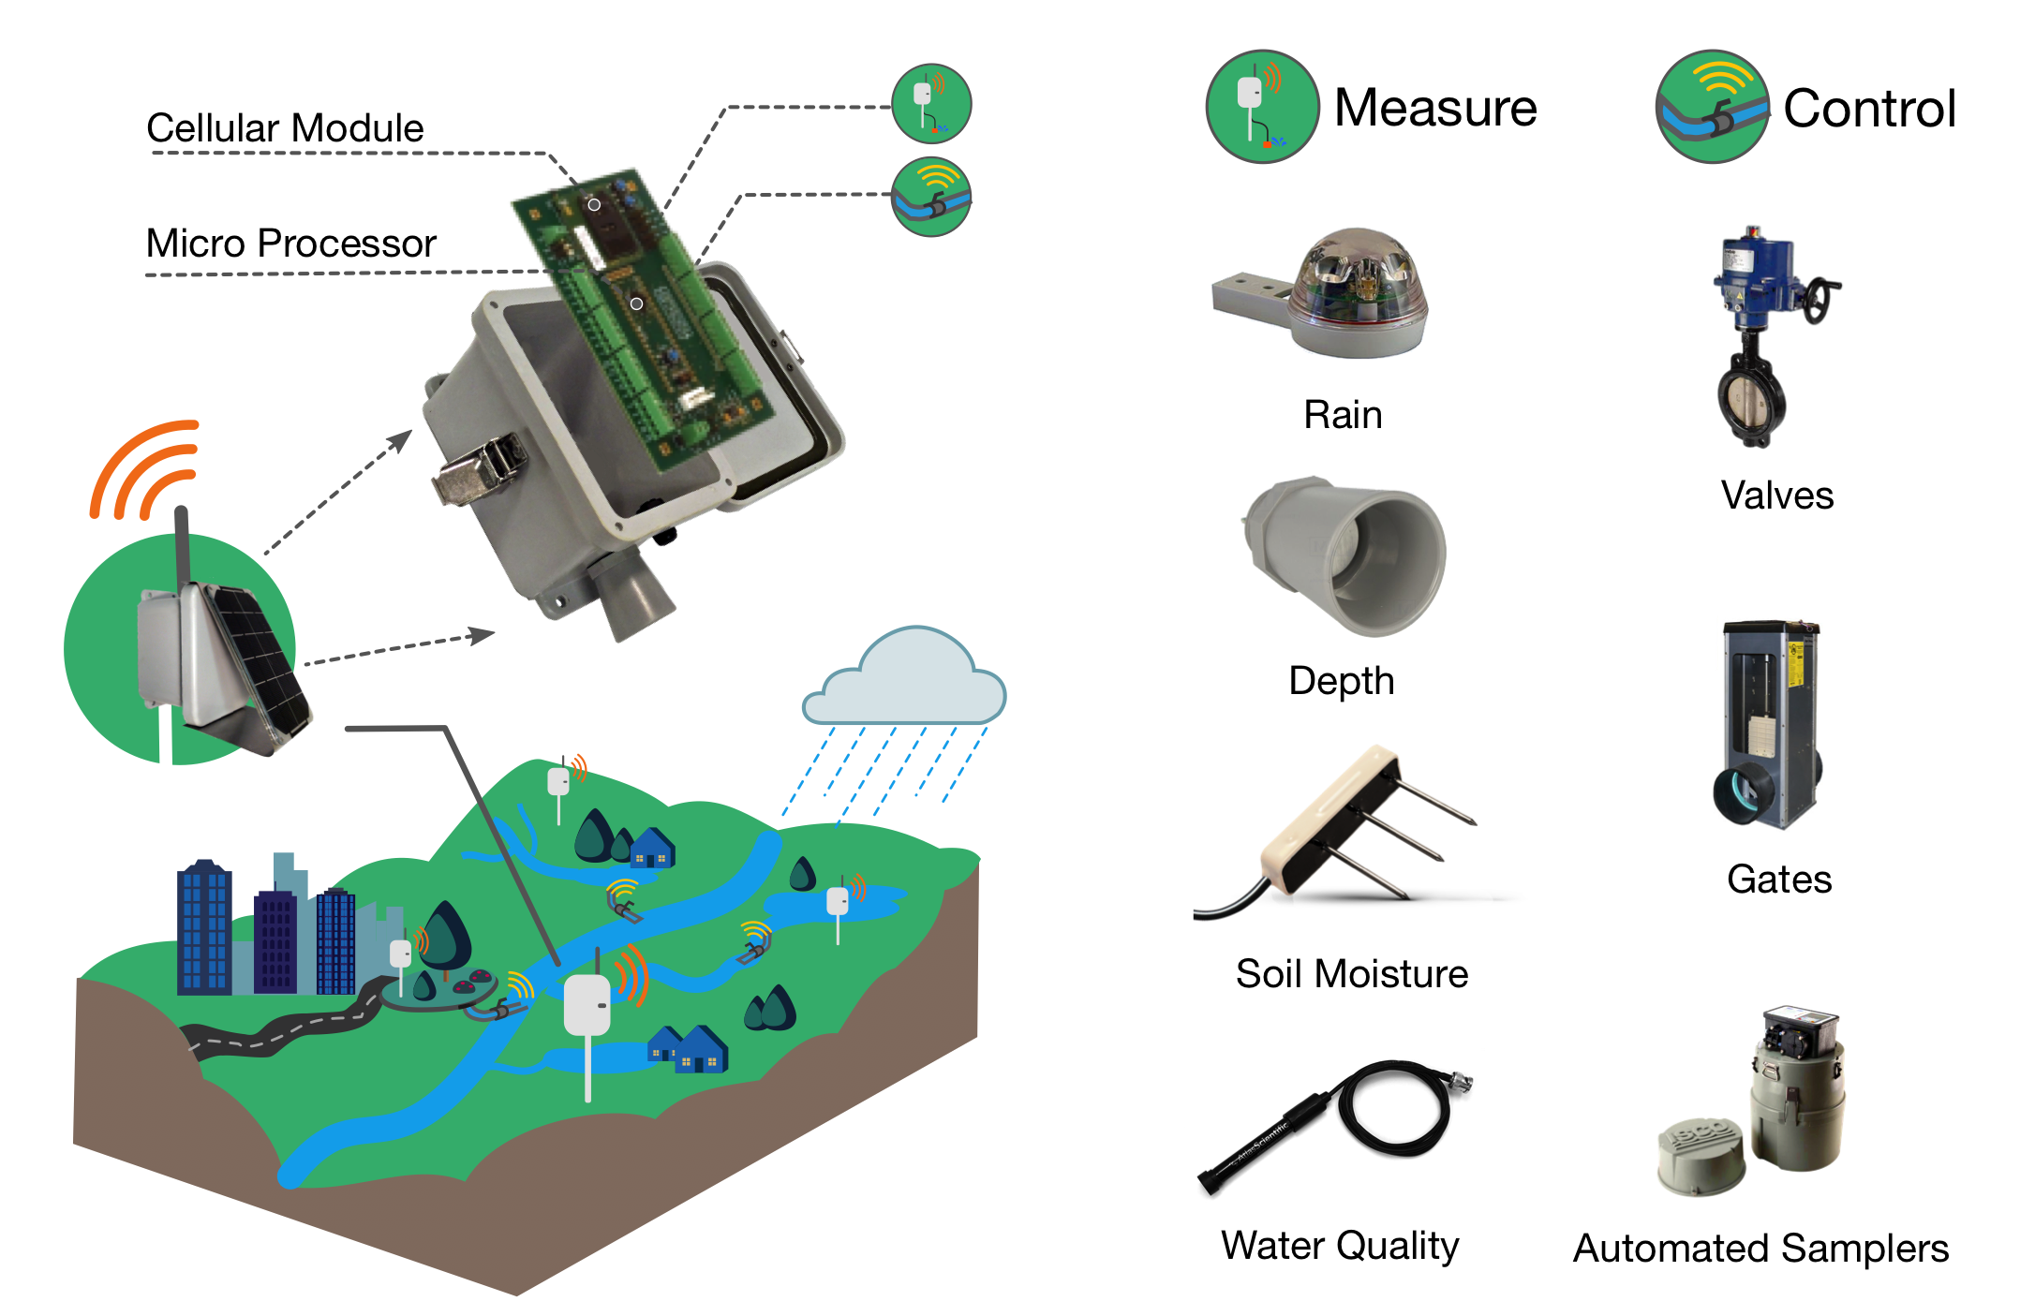
Open-storm.org
Notes:
This shows our wireless sensor node design, which we share as part of our open-source initaitieve, called open stroms
We can deploy many of these nodes across communiteis to receive real-time measurments
We can also control

Slide 5
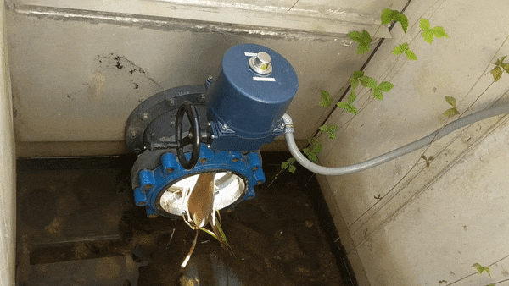
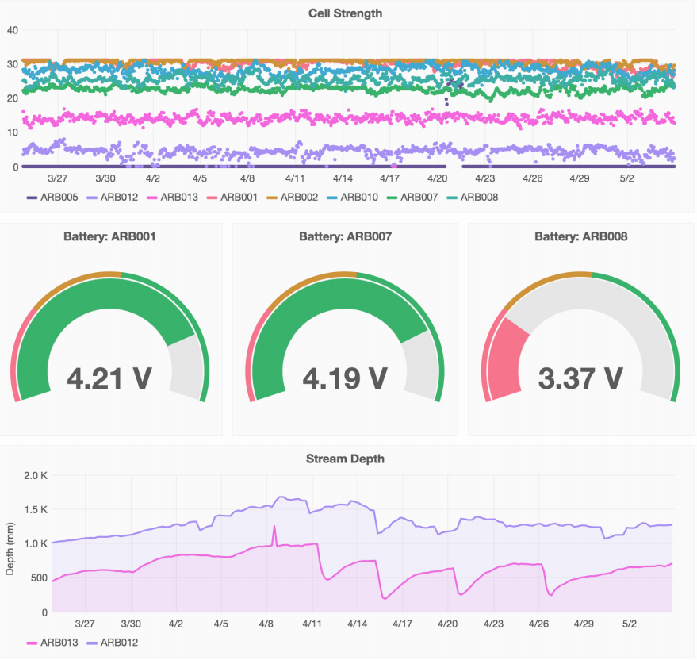
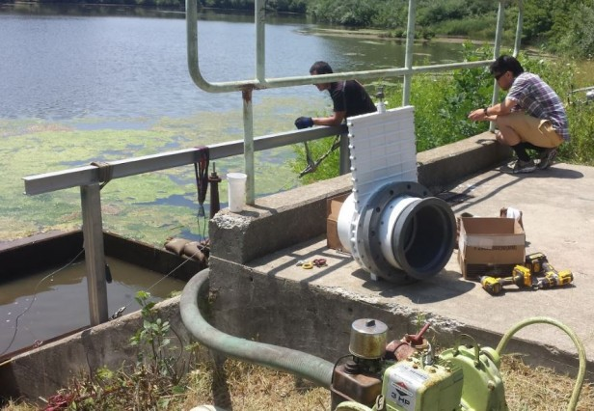
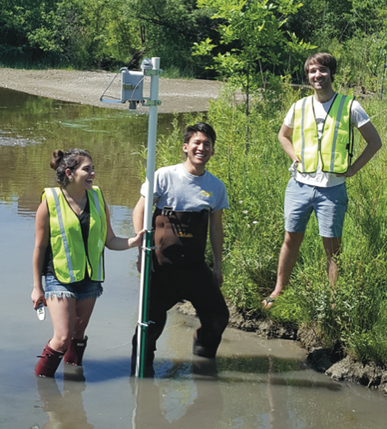
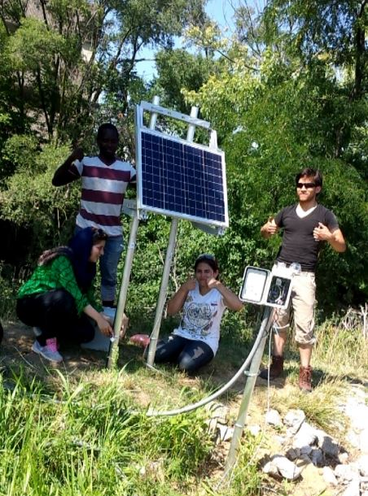
Notes:
Shows some pictures of our deployements that have been made possible by these tehcnologoes
Sensor nodes to measure
Valves to control
And web-based interfaces to help run everything in real-time
Amazing how much adding one valve can accomplish
Completely repurpose a site. If it did one things before (e.g. detetion basin for fllod control), it can all of a sudden do way more (you can set the rates of flow)
We can even control for water quality, by deciding how much time the water system spends in a basin, for exmepl
So it affords a ton of flexibiliyt for a small investment
We even hand out “smart” rain barrels to homeowners that allow them to use apps to irrigate their plants and maximie storage.
An educaiton tool and all of these are shared for free on open-storm.org
But, just because we have proof of concept technology, we don’t have a smart system

Slide 6
Knowledge gaps and barriers
Broader Adoption
And Future Research
Objective 3
Kerkez/Goodall/Kertesz
System-level Barriers
Control robustness
Input uncertainty
Real-time interoperability
Objective 2
Nassauer/Reyes Mason/Webster
Social Barriers
Public Perception
Adoption mechanisms
Objective 1
Culver/Hathaway
Site-level Barriers
Impact to bioretention dynamics
Impact to aesthetics
Technological Barriers
Embedded hardware
Sensing technologies
Connectivity
Prior Work
Notes:
How do we actually achieve community-scale control and adoption?
Technology is not the problem any more.
Rather, we’ve identified a number of key barriers that have to be overcome before we can scale up
Starts at the site level (pond, wetland etc)
without understanding the range of benefits that can be achieved at the scale of individual sites,
it becomes nearly impossible to posit which water quality and flooding benefits can be achieved at the scale of entire communities
Need to understand individual elemtns.
Social
we do not understand how stress and risk aversion affect how open residents are to these systems (how scared people are)
Presently, we do not know how residents will perceive the benefits of smart stormwater systems on these and other important values.
We don’t understand to what extent people would be willing to adopte these tystenms
Systems
we do not understand the requirements for data and communication architecture needed for interoperability, and we are lacking a computational framework that would allow these entities to collaborate as part of a broader system.
Furthermore, we also do not know under which circumstances the robustness and stability of system-level control algorithms can be guaranteed,

Slide 7
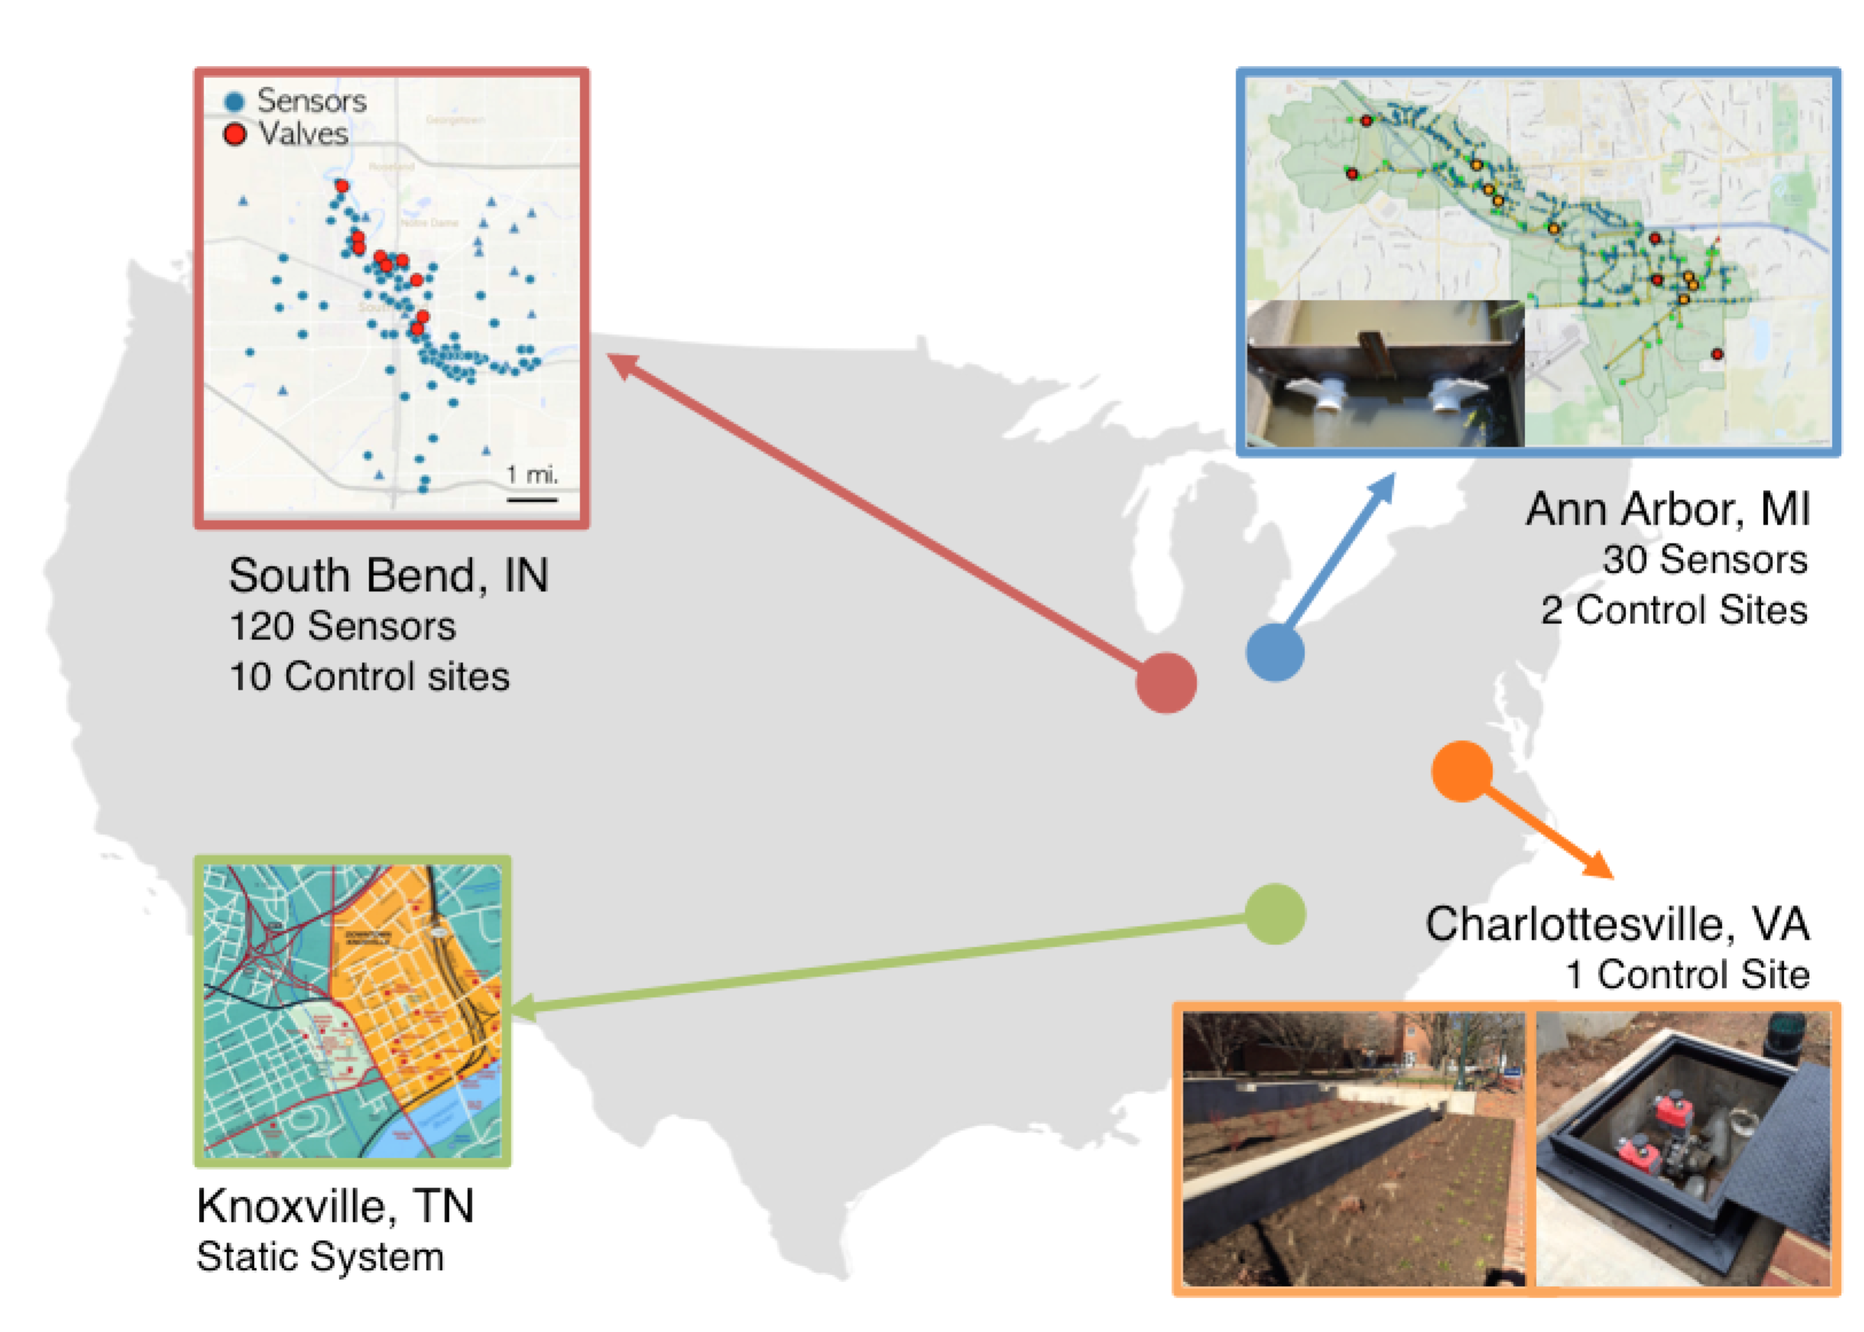

Slide 8
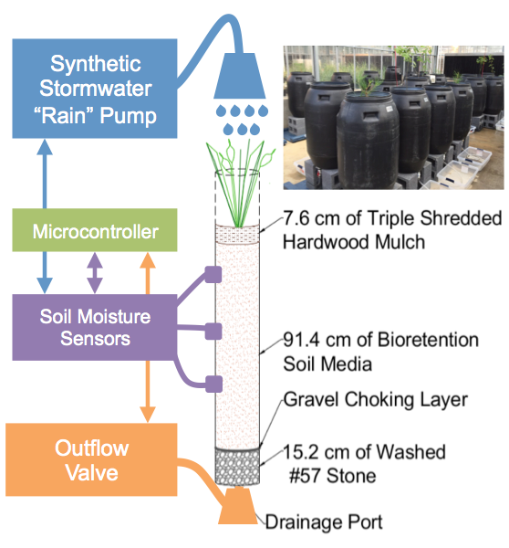
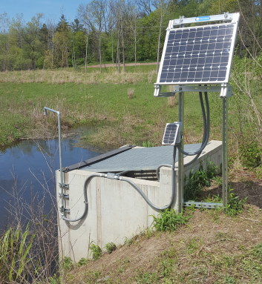
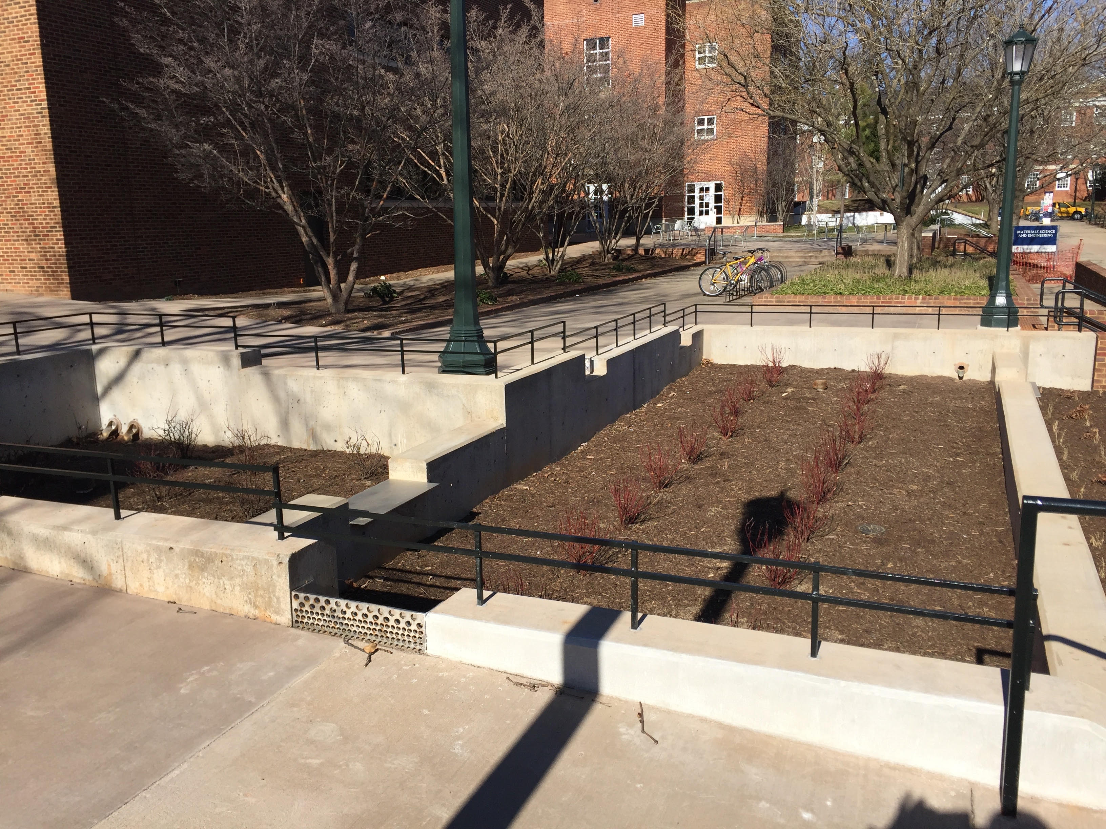
Objective 1 Overcoming physical barriers to scalability
Quantify range of site-scale benefits
Test the hypothesis that a control algorithm tuned to reducing soil-moisture variability will improve site-scale bioretention and the treatment of stormwater pollutants
Knoxville
Ann Arbor
Charlottesville
Notes:
Jon is going to start us off with the plan for the 1st objective
We will control real-world sites, but we don’t want to damage them
We also want to generalize physical factors so we can cahracterize entiure watersehds

Slide 9
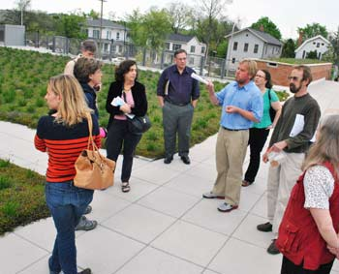
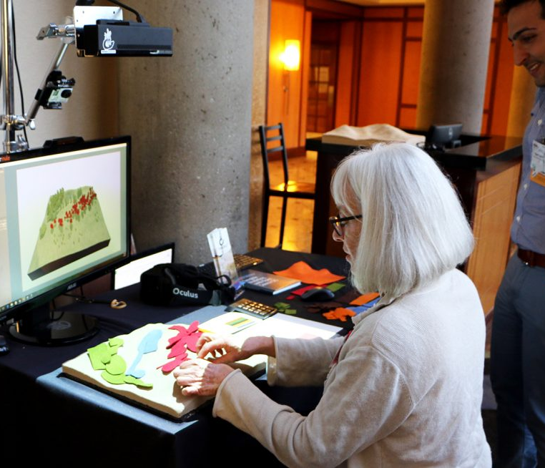
Objective 2 Overcoming social barriers
Formation of advisory committee, focus groups, and workshops
Develop visualizations and survey of three cities that are at varying stages of adoption of smart stormwater systems
Analyze survey to develop agent typologies for use in third objective
Source: Ann Arbor Chronicle
Notes:
Joan will talk to us about the plan for the second, social sicnece objective
Form AC and citizen focus groups
1) develop resident and decision maker agent typologies that we will iteratively test and refine in both the social and engineering components of this project;
2) identify potential decisive aspects of landscape appearance for development of visualizations to be used in the resident survey^{45,46}
3) identify governance, system-operation, and landscape appearance approaches through which to overcome those barriers, and use these approaches as a basis for development of items in the survey instrument; an
Typologies will be used to represent vairous entitiesand boudnary conditions in the broader sytem-lelve mode, objective 3.

Slide 10
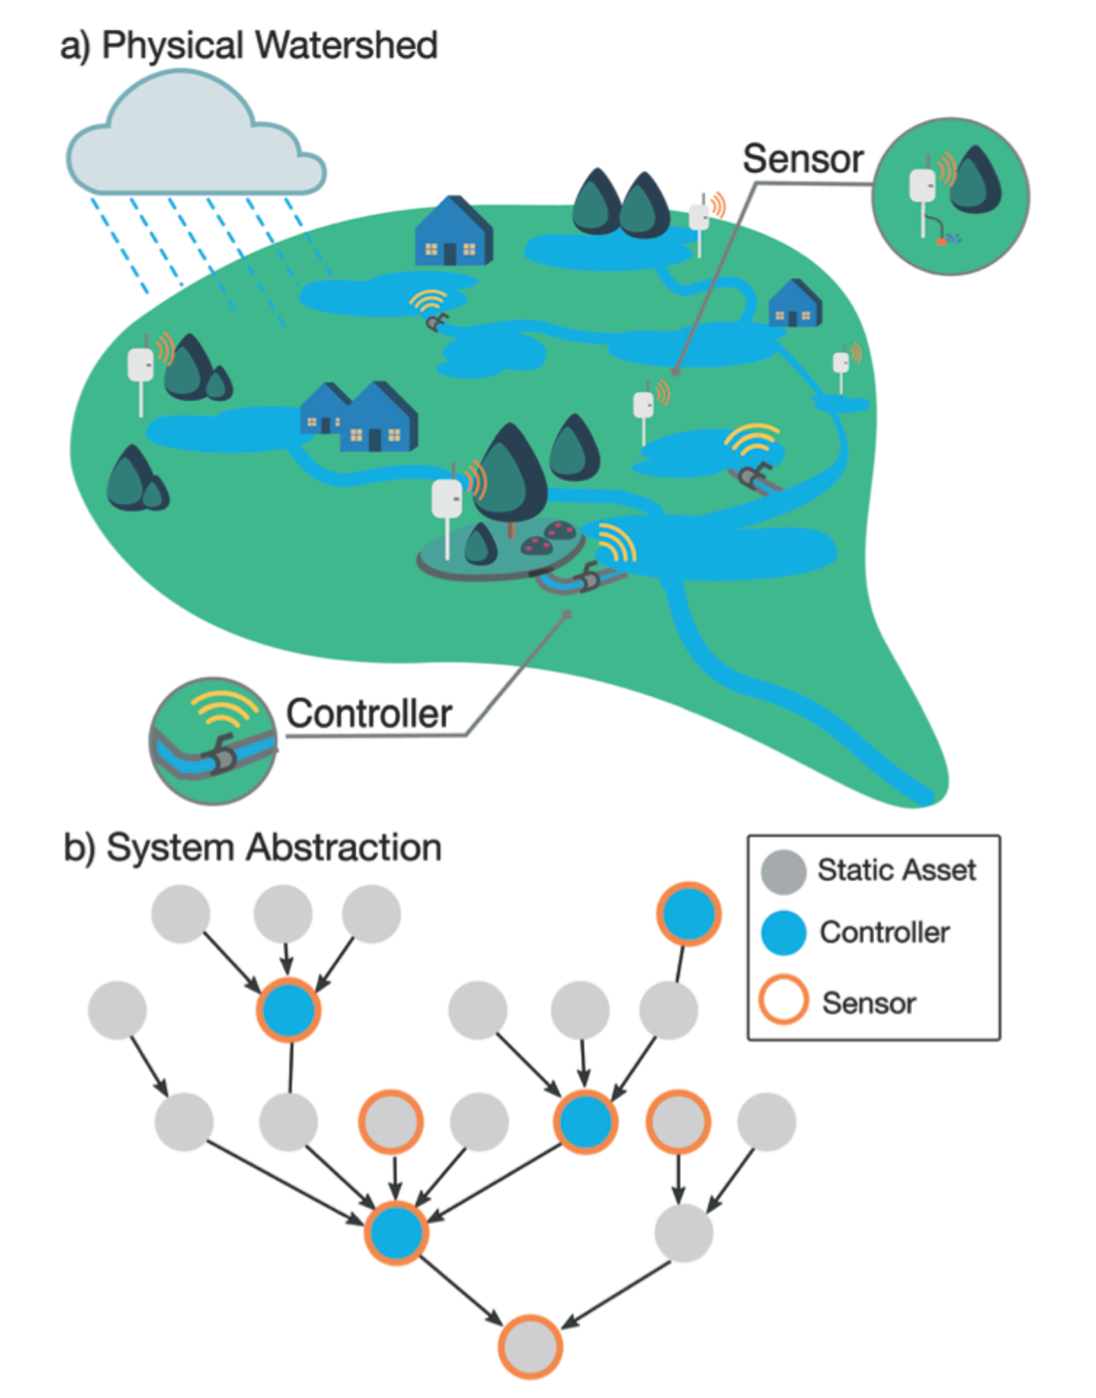
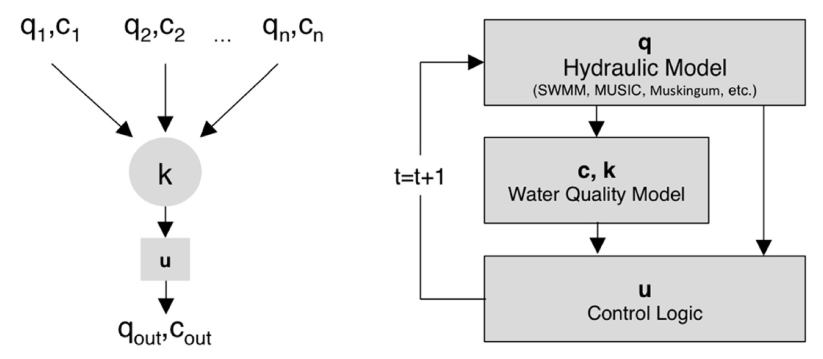
Objective 3 Overcoming barriers to system-level control
Examine the data structures and interoperability mechanisms to enable real-time, system-level coordination between various stakeholders
Investigate the fundamental properties of algorithms for system-level stormwater control
Notes:
how to enable coordination of distributed stormwater sites across an entire community.
Two partts
1) Data frameworks and abstractions for interoperatbility
2) How to enable safe, distributed control to incentivize participation by various stakeholders
May one day enable real-time exchanges
Obj 3.1
How do we go from our domain knowdleged of the physical and social compoents, to l system-level representation?
there are many data standards, protocols, and ontologies that may provide a foundation for such coordination.
We will extend exsiting ontologies with new methods and objects for stormwater.
Physical pramerters from obj1 and social paramerer from obj2 to reflect individual oweners with varying priories and levels of engagement
Turn into directed graph that embeds info into real-time exchange
Obj 3.1
Investigate the fundamental limitations of algorithms for system-level stormwater control.
Given social compoent, game-theoretic control algorithms⁵³ which will specifically take the form of agent-based (or market-
Each agent hasa comodity (flow, flooding, treatmen) and trades it in the network
We will look at decentralized instatiations: Prior studies all assumed a centralized controller,
Look at Stability under uncertainty is unclear (emperical and formal – dissipative prpperties)
Quantify Rainfall uncertainty: Assume directed graphs strucutreevaluate weather forecasts PDFs
Woprk with AC: Should regulations require facilities to comply with city goals? Should stormwater be controlled by a central municipal utility or through distributed coordination?
Figure out how incentives from this model map to real-world inceptives/typologies

Slide 11
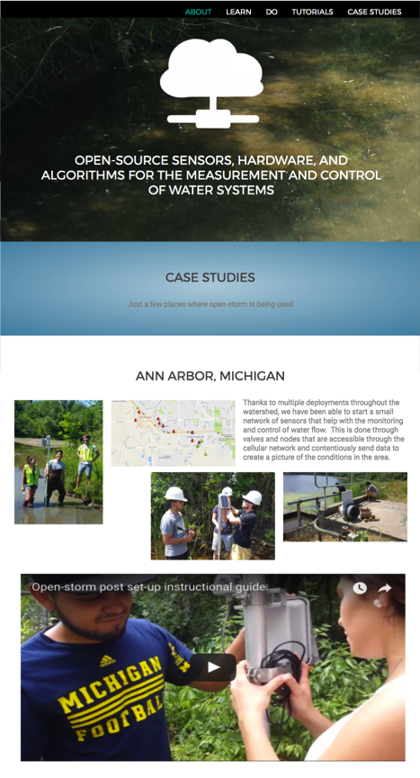
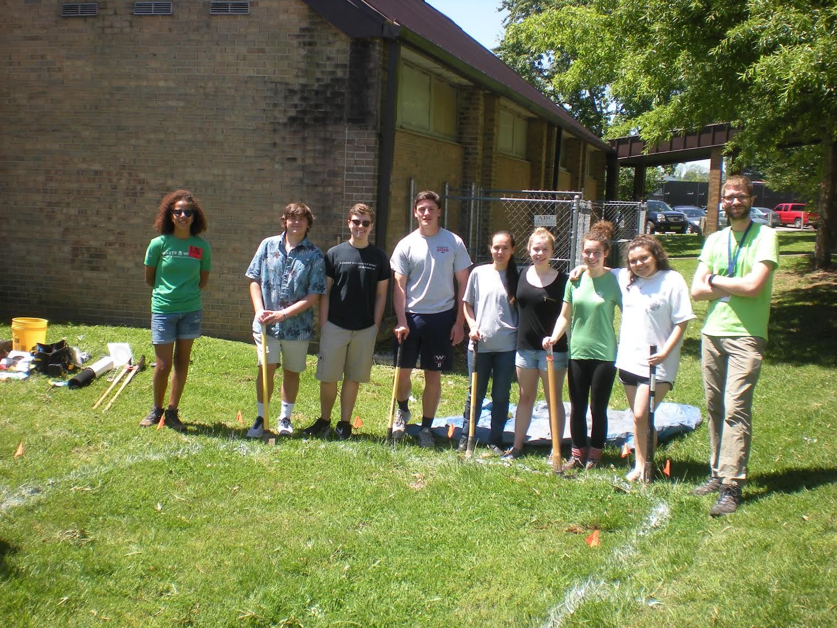
OPEN-STORM.ORG
Openly share all blueprints and research methods through videos, tutorials and case studies
Engage and educate students and the community
Engage broader S&CC researchers
Notes:
We also already have a strong track record of research capacity building
In fact, the formation of our proposal team is a direct result of our prior efforts to spark interest on smart stormwater systems.
a strong presence on the Internet through our Open-storm.org portal
Videos, blueprints, etc
Cuahsi workshop
Propose to expand this education portal to make how-to videos and virtual tours (students)

Slide 12
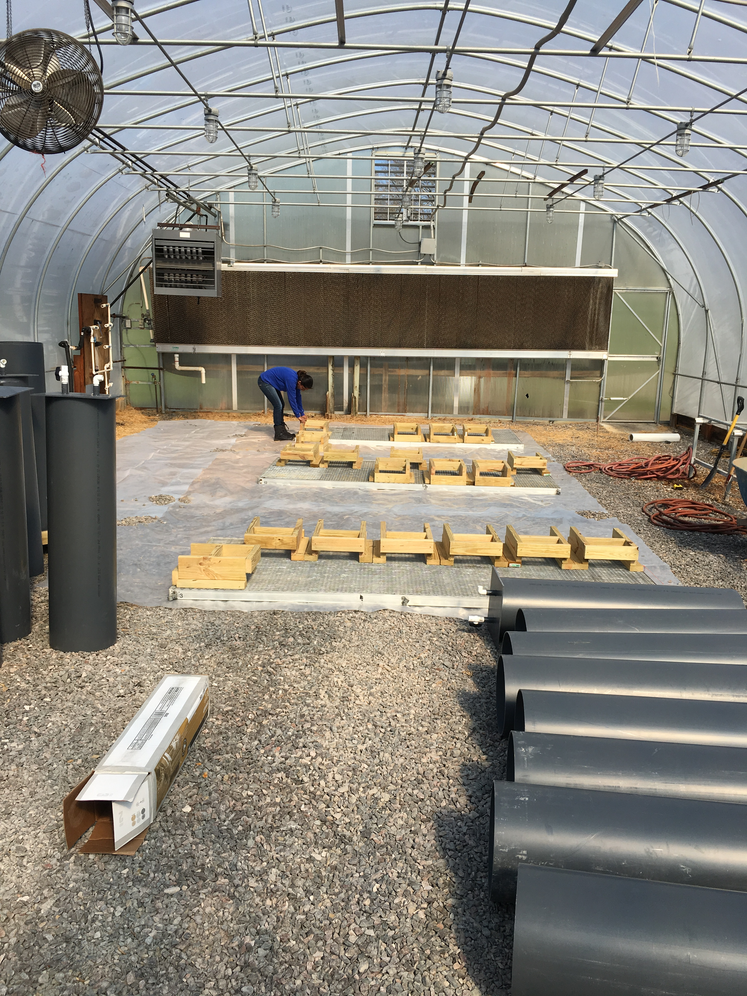
Status
Lab
Advisors
Case Studies

Slide 13
Next Steps
Automated
Columns
Interviews
Case Studies

Slide 14
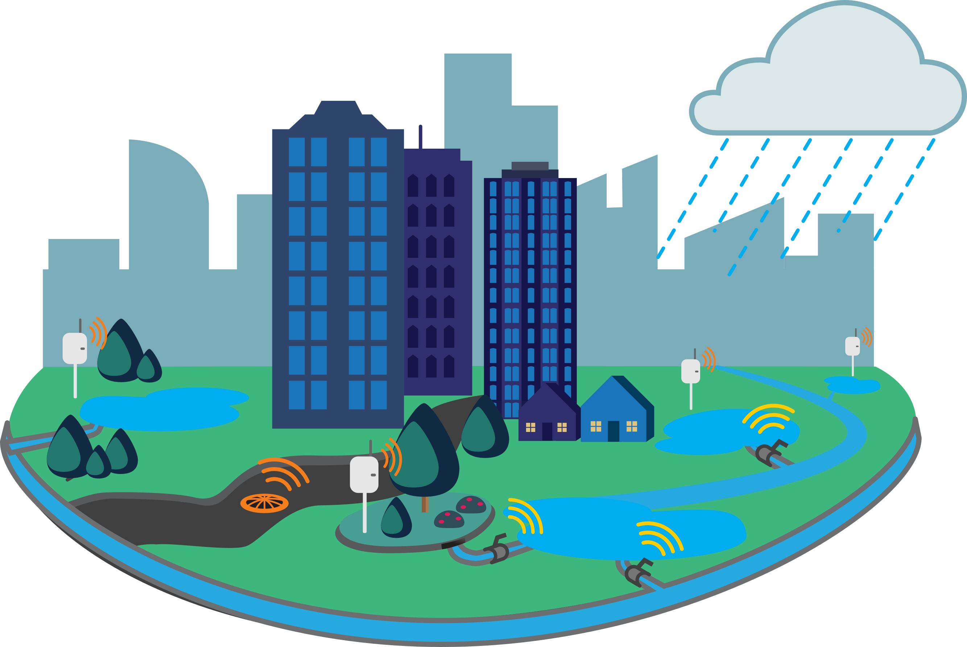
open-storm.org

