Slide 1
2018 NSF SMART AND CONNECTED COMMUNITIES PI MEETING
PG: ZER0H: Zero Energy Ready Homes, NSF# 1737538
Lead-R.Kavasseri, D. Cao, Q. Zhang, M. Srivastava, D. Fischer (Electrical|Computer|Architecture|Landscape)
Community: Native Indian Reservations in North Dakota
North Dakota State University, NDSU, Fargo
Notes:
BRIEFLY INTRODUCE YOURSELF AND YOUR INVESTIGATORS (10 sec slide)

Slide 2
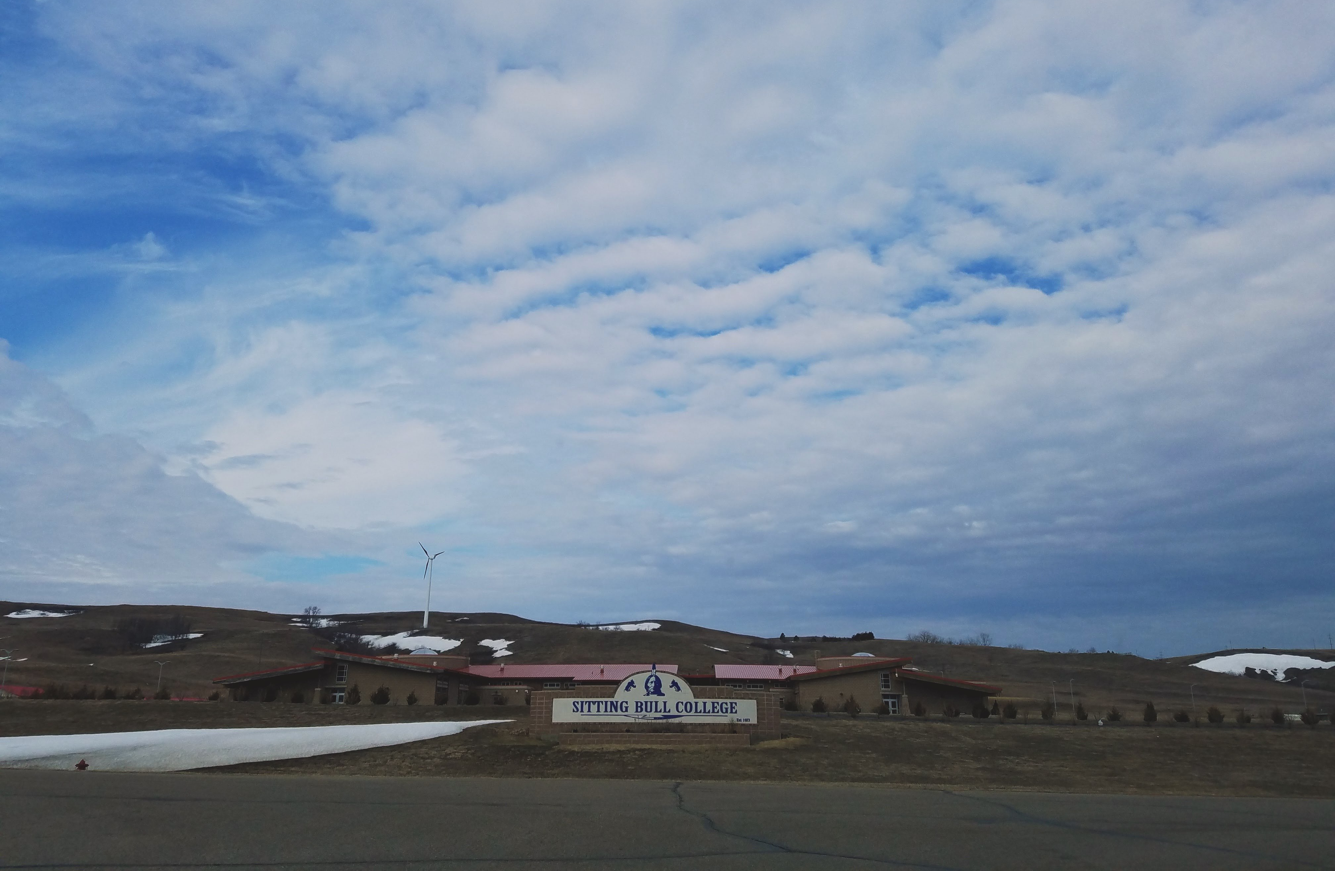
Challenge:
communities in remote rural areas face economic and environmental barriers to routine electrification;
cultural, environmental, and ethical dimensions are often overlooked in energy planning projects;
Community Engagement:
The community is constituted by residents of the Native American reservations in North Dakota;
An artist-mediated engagement plan is being developed to glean and integrate community’s perspectives on land/energy use with cultural factors.
Integrative Research:
Exploit passive home design technologies to develop primarily DC energy delivery systems for residences;
Integrate photovoltaic and energy storage systems using next-generation earth-abundant materials;
Community inputs will be factored into residential energy design module;
Impact:
Development of culturally-informed zero-energy ready systems for remote rural communities;
Improve survivability of existing micro/nano grids systems in the wake of natural or system disasters;
Engage Native American communities in sustainable energy technologies;
Notes:
Building continuing support for the S&CC program and growing the S&CC community requires that we convey the essence and community engagement of S&CC-funded research to diverse stakeholders in a clear, concise, and visual way, quantifying impacts where possible. The summary should be understandable by the broader S&CC community– those who know S&CC, but aren’t in your specific domain.
Consider including your graphic on a separate slide if space is a concern. These slides may be used to promote the program both within and outside NSF. For project abstract, posters, and videos, please prepare one page for each.

Slide 3
Notes:
A brief background: Please describe the problem you are addressing and why it is important (20sec slide)

Slide 4
Notes:
A brief background: Please describe the problem you are addressing and why it is important (20sec slide)

