Slide 1


2018 NSF SMART AND CONNECTED COMMUNITIES PI MEETING
IRG Track 1: Sociotechnical systems to enable smart
& connected energy-aware residential communities
#1737591
Purdue University
Panagiota Karava (PI)
Ilias Bilionis, James Braun, Leigh Raymond, Torsten Reimer
Sabine Brunswicker, Yingjie Chen, Travis Horton, Eckhard Groll, Thanh Nguyen, Julia Rayz
Government
Jacob Sipe, Indiana Housing and Community Development Authority (IHCDA)
Industry
BWI/ClearObject, Pedcor, RealAmerica Development, TWG Development
Community action groups
Area IV Community Action Agency, Community Action of Greater Indianapolis

Slide 2
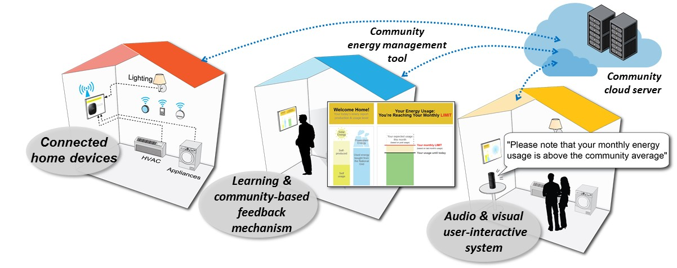
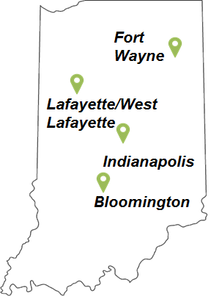
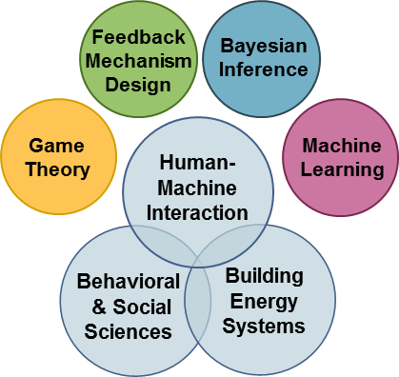

Project Aims
Foster energy-aware communities that can be scaled across the U.S based on data analytics and predictive modeling.
Demonstrate user-interactive devices and feedback mechanisms that optimize and incentivize energy management.
Integrative Research
Community Engagement
Partner with IHCDA, industry, and affordable housing residents to demonstrate S&C energy-aware communities in 4 Indiana cities

Slide 3
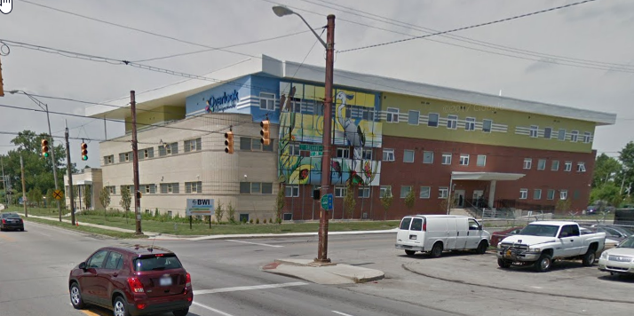

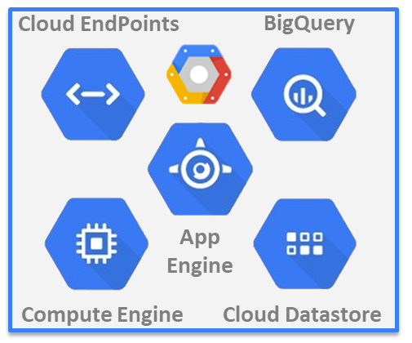
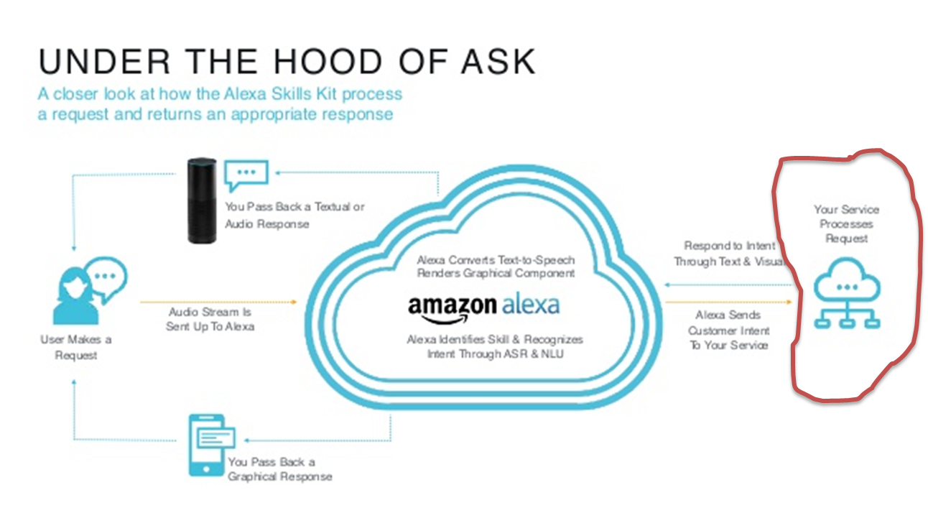
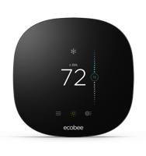

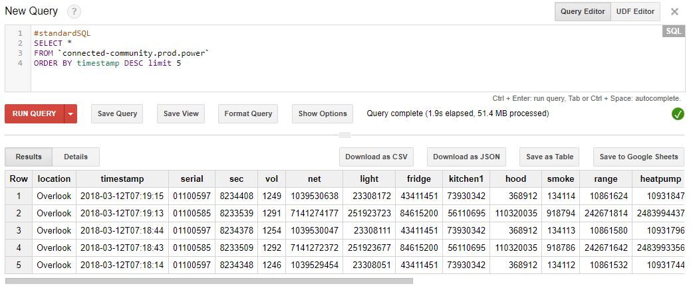
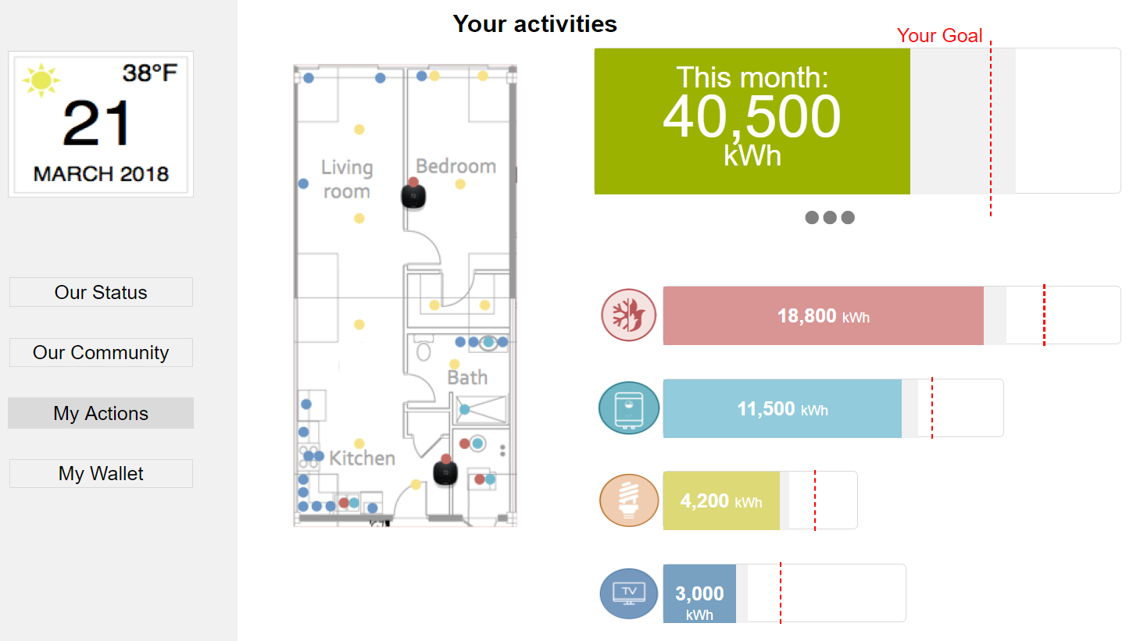
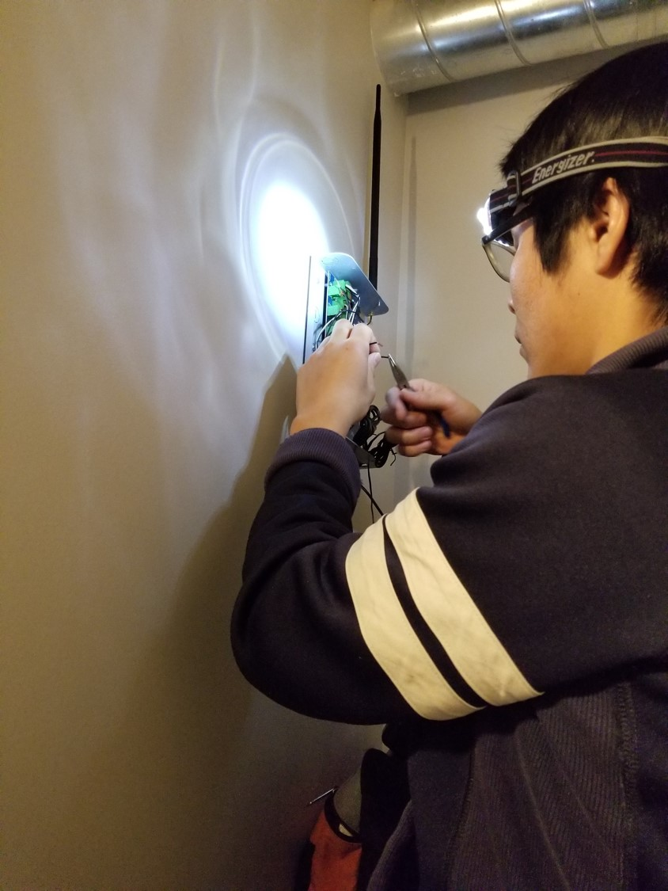
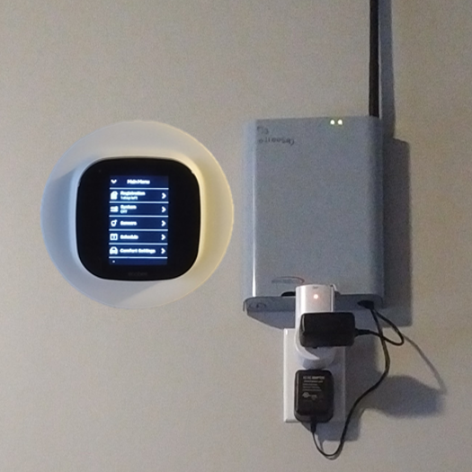
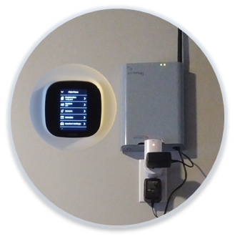
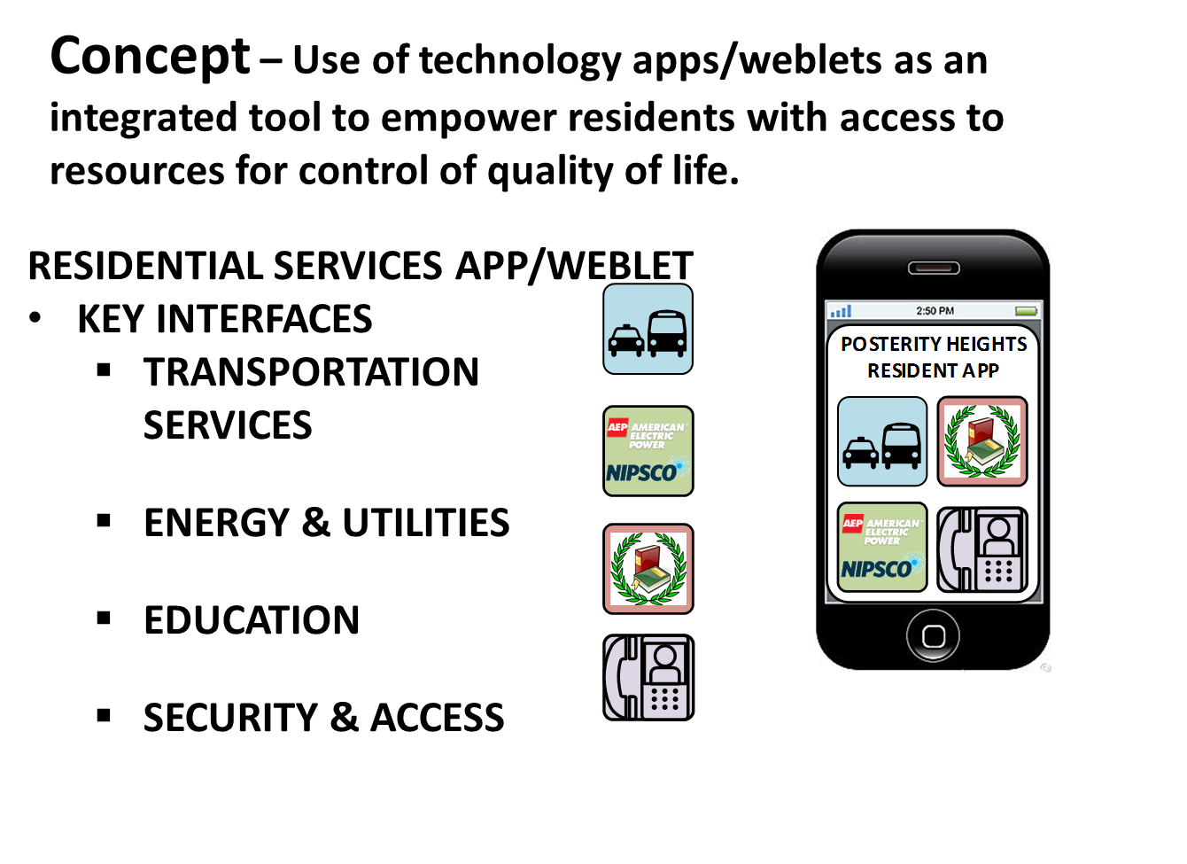

Status of the Project – Field implementation in 5 S&CC
S&CC at Overlook: Data collection started in Dec. 2017
Cloud Backend (Google Cloud)
API
Sensor
Sensor cloud
Cloud backend
Voice Interface
Query Table
Visual Interface
Local network
Unit 1
Unit 50
S&C technology integrated in the design of 4 new communities
Cloud
Database
Unit 20
Unit 40
200 S&C devices installed in 50 units
Smart Thermostat
WiFi-enabled Power meter
Cloud Integration

Slide 4
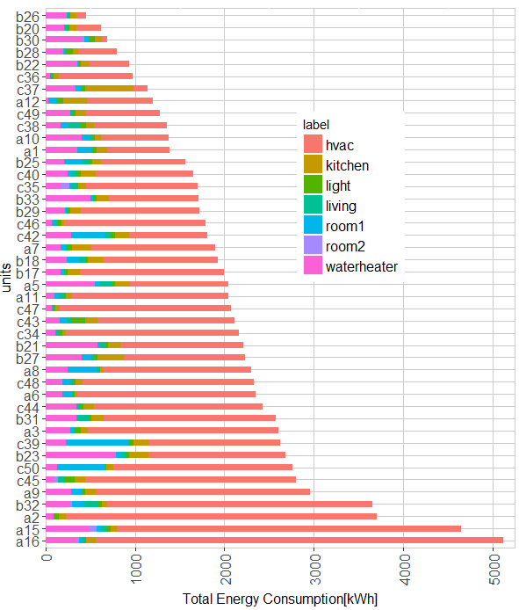
Status of the Project –Baseline Data
Data collection: Jan 03 – Feb 28, 2018
C50
75%
B23
C45
C34
50%
B23
B21
B33
C35
25%
C43
C49
B40
C39
A9
B27
B29
A12
C38
C47
C37
B20
B25
B26
A8
C46
B30
B28
A10
A5
A11
A3
C42
A1
B32
C48
B18
A7
A16
C44
A6
B31
A2
A15
Electricity Consumption [kWh]
Energy Distribution

Slide 5

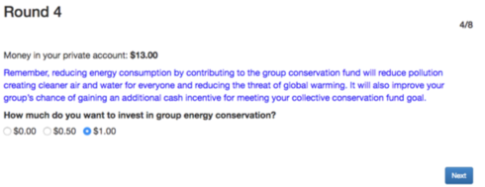
Status of the Project – Community-based Feedback
Experimental public goods game evaluating effect of environmental injunctive norms and descriptive norms on contributions to conservation goal.
Puzzle: how to build cooperation without sanctions.
Hypothesis: Adding injunctive norm message will increase contributions to collective energy goal.
Injunctive Norm message
Collective Energy Goal
Public Goods Game
(O-Tree framework; python-based)
GitHub Repo: https://github.com/SmartEnergyGame/

Slide 6
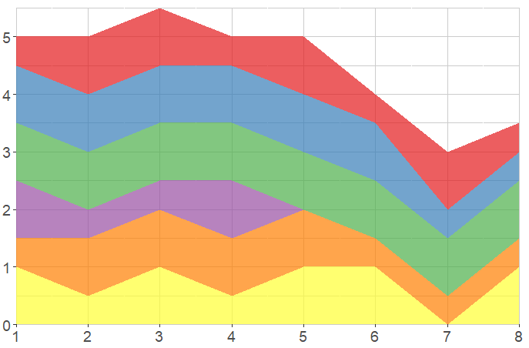
Status of the Project - Learning-based Feedback
Group contribution goal achieved round5
Player 6
Subjects contributed consistently toward collective energy goal with exposure to injunctive norm, no free riding.
Greatest contributions in early stages, prior to descriptive norm being established.
Incentive appears important, contributions decay after incentive goal met.
N.B. - Achievement of collective goal without sanctions
Player 5
Player 4
Contribution in Each Round [$]
Player 3
Player 2
Player 1
Round

Slide 7
Status of the Project – Learning-based Feedback
Physical
Symbolic
Psychometric Measures: Study 1 (N=299) Measured consumers’ knowledge, their motivation and values/attitudes towards energy-saving behaviors.
Procedural Knowledge and Symbolic Representation: Study 2 (N=204) Measured one component of participants’ procedural knowledge by asking them to describe plans to reach specified energy-saving goals.
Knowledge
Declarative
Procedural
$
%
kWh
Motivation
Values
Residential Energy Use Behaviors

Slide 8

Status of the Project – Learning-based Feedback
Scenario
Tables for six families in different states of the US showing their electricity consumption in the previous year.
Data of an average household in the same state.
Category | Energy [kWh]
 | Your Home | State Average
Cooling (Central A/C) | 6,813 | 4,542
Heating the Home | 2,461 | 1,641
Water Heating | 3,559 | 2,373
Refrigerator | 4,804 | 1,201
Other (Television, Lighting, Electronics, Washer/Dryer, etc.) | 10,374 | 6,916
Total kWh | 28,011 | 16,673
Results
Difficulty translating an overall energy-saving goal into a plan that specifies the usage of energy on the level of specific utilities.
  61% of action plans with error > 1% of the total used KWh.
  47% of action plans with error > 5%.
  30% of plans with error > 10%.
Two action plans to achieve the energy-saving goal (e.g. consume 15% less than last year).

Slide 9
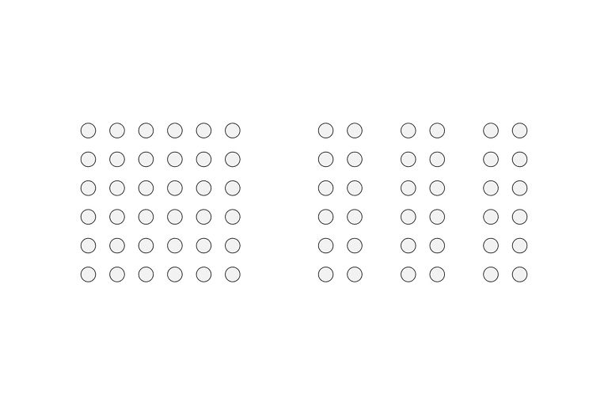

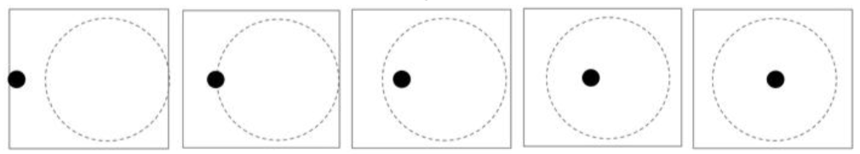
Status of the Project – Visual User-interactive System
    We believe that unifying visual structures can increase “perceived unity” of a energy housing community:
    Hypothesis 1: Proximity & enclosure positively affect perceived unity.
    Hypothesis 2: Skewedness moderates the effect of ”unifying visual” structure on perceived unity.
Ind. Variable for Visual Structures of Unity
              Skewedness of Data
Dep. Variables of Perceived Unity
              1) Proximity
              (member traits)
              1) Rapport – harmony between members
H2 (-)
H1 (+)
              2) Entitativity - perception of a group as pure entity (an entitative group)
              2) Enclosure (goal)
              3) Similarity – likeness to other members
              4) Centrality - belonging
    Control Variables (Cov.): Energy routines, Personality type, Graph literacy
    Controlled Perceptual Experiments on M-turk:
(I) Pre-Test
(II) Test and Visual Stimuli
(III) Exploration
(IV) Post-Test
Consent Form
Graph Literacy
IV
IV
IV
DV 1
DV 2
DV 3
Recall
One-shot Game
Scenario
Graph Tagging
Graph Comparison
Personality
Energy Behaviors
Housing
Demographics
Honor
code
Algorithm for visualizations (D3.js): https://xdanielsb.github.io/Energy/

Slide 10
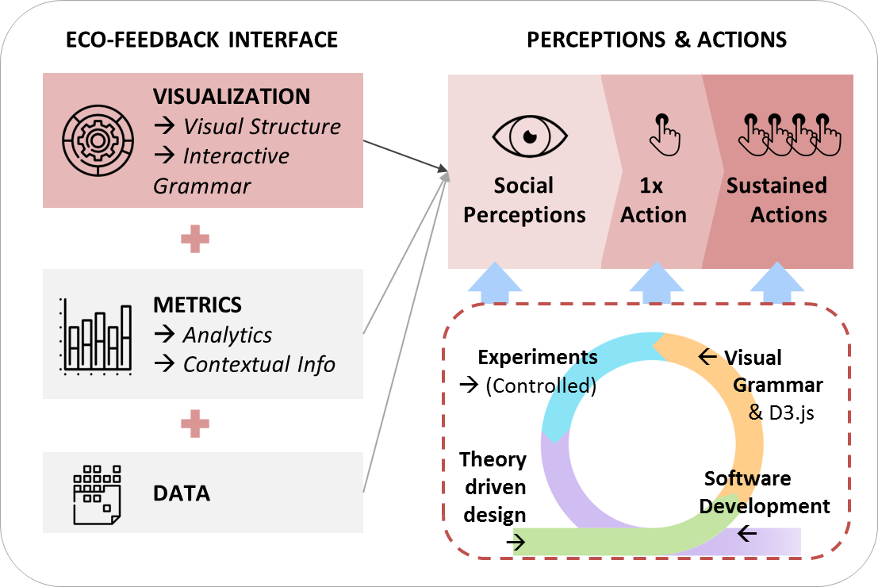
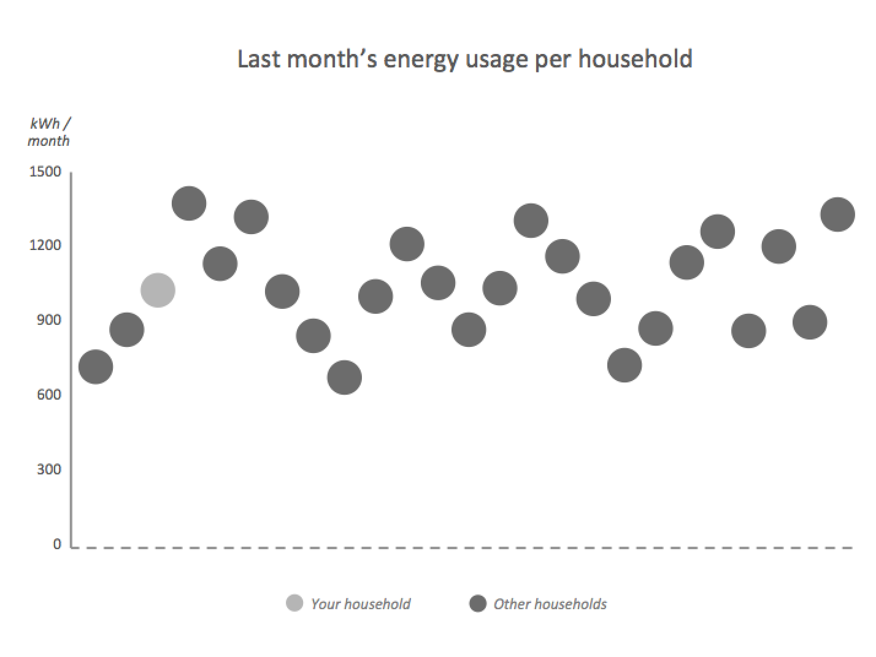
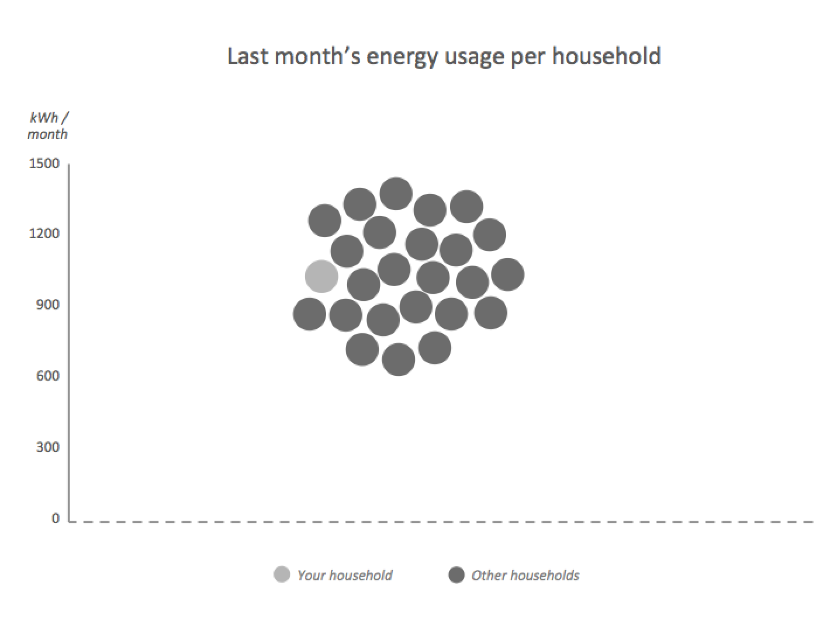
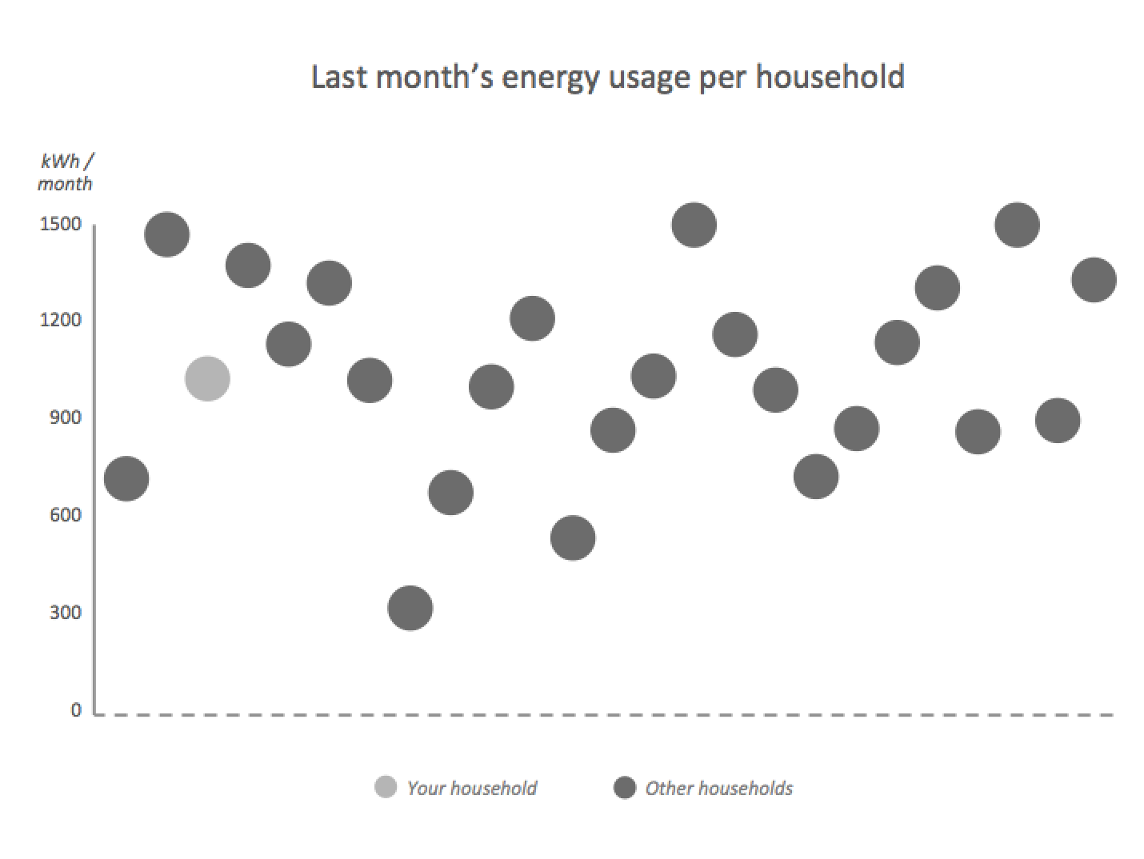
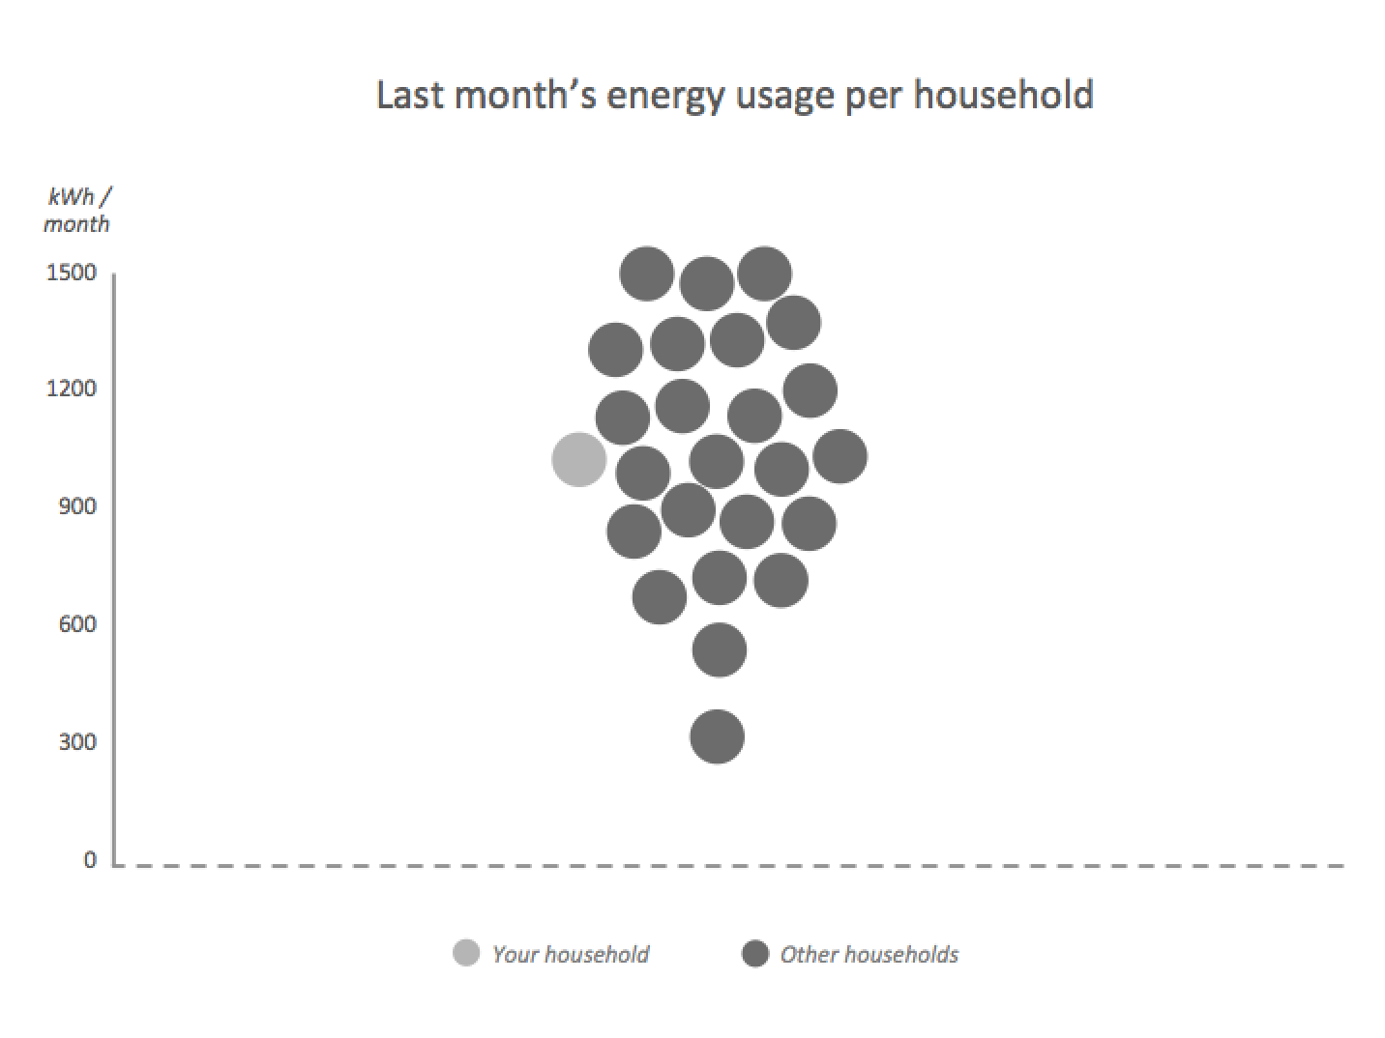
Status of the Project – Visual User-interactive System
EXCERPT OF RESULTS (2-WAY ANOVA)
Perceived Entitativity* (Est. Mar. Mean; 95% Conf. Intervals)
Perceived Rapport* (Est. Mar. Mean; 95% Conf. Intervals)
Perceived Similarity* (Est. Mar. Mean; 95% Conf. Intervals)
Control Group
Proximity Group
Visual Structure
2 by 2
Factorial Design
Balanced
n=47
n=45
Skewedness of Energy Data
Skewed
* Measured as 5-item scale semantic differential (1 very low, 5 very high)
n=43
n=44

Slide 11
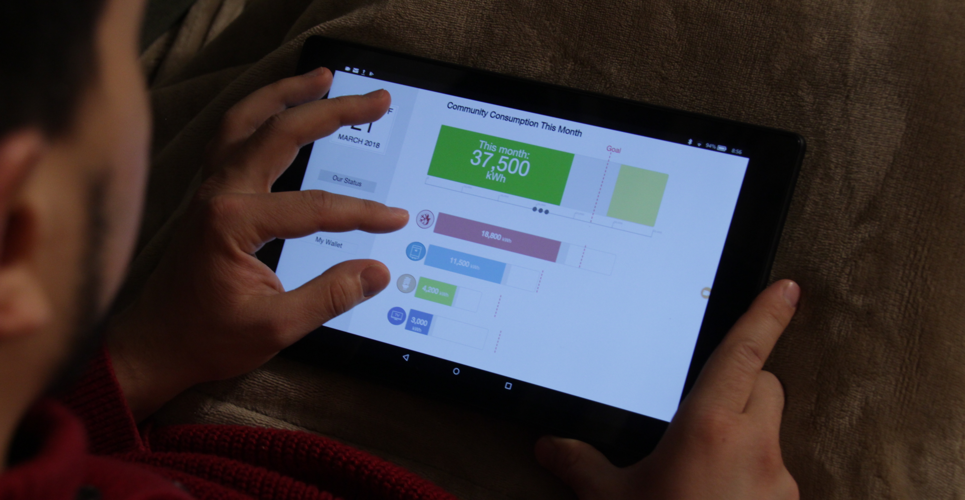
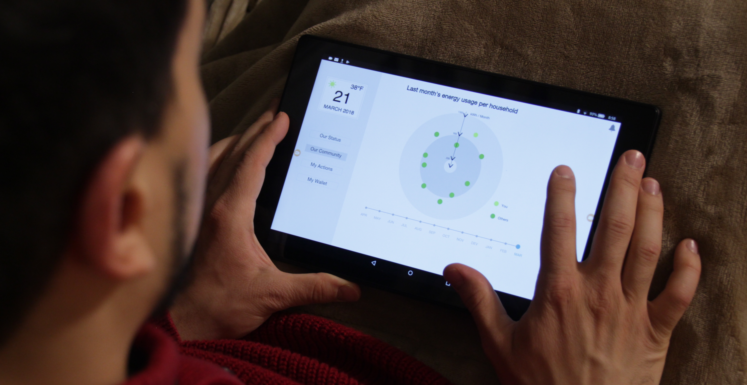
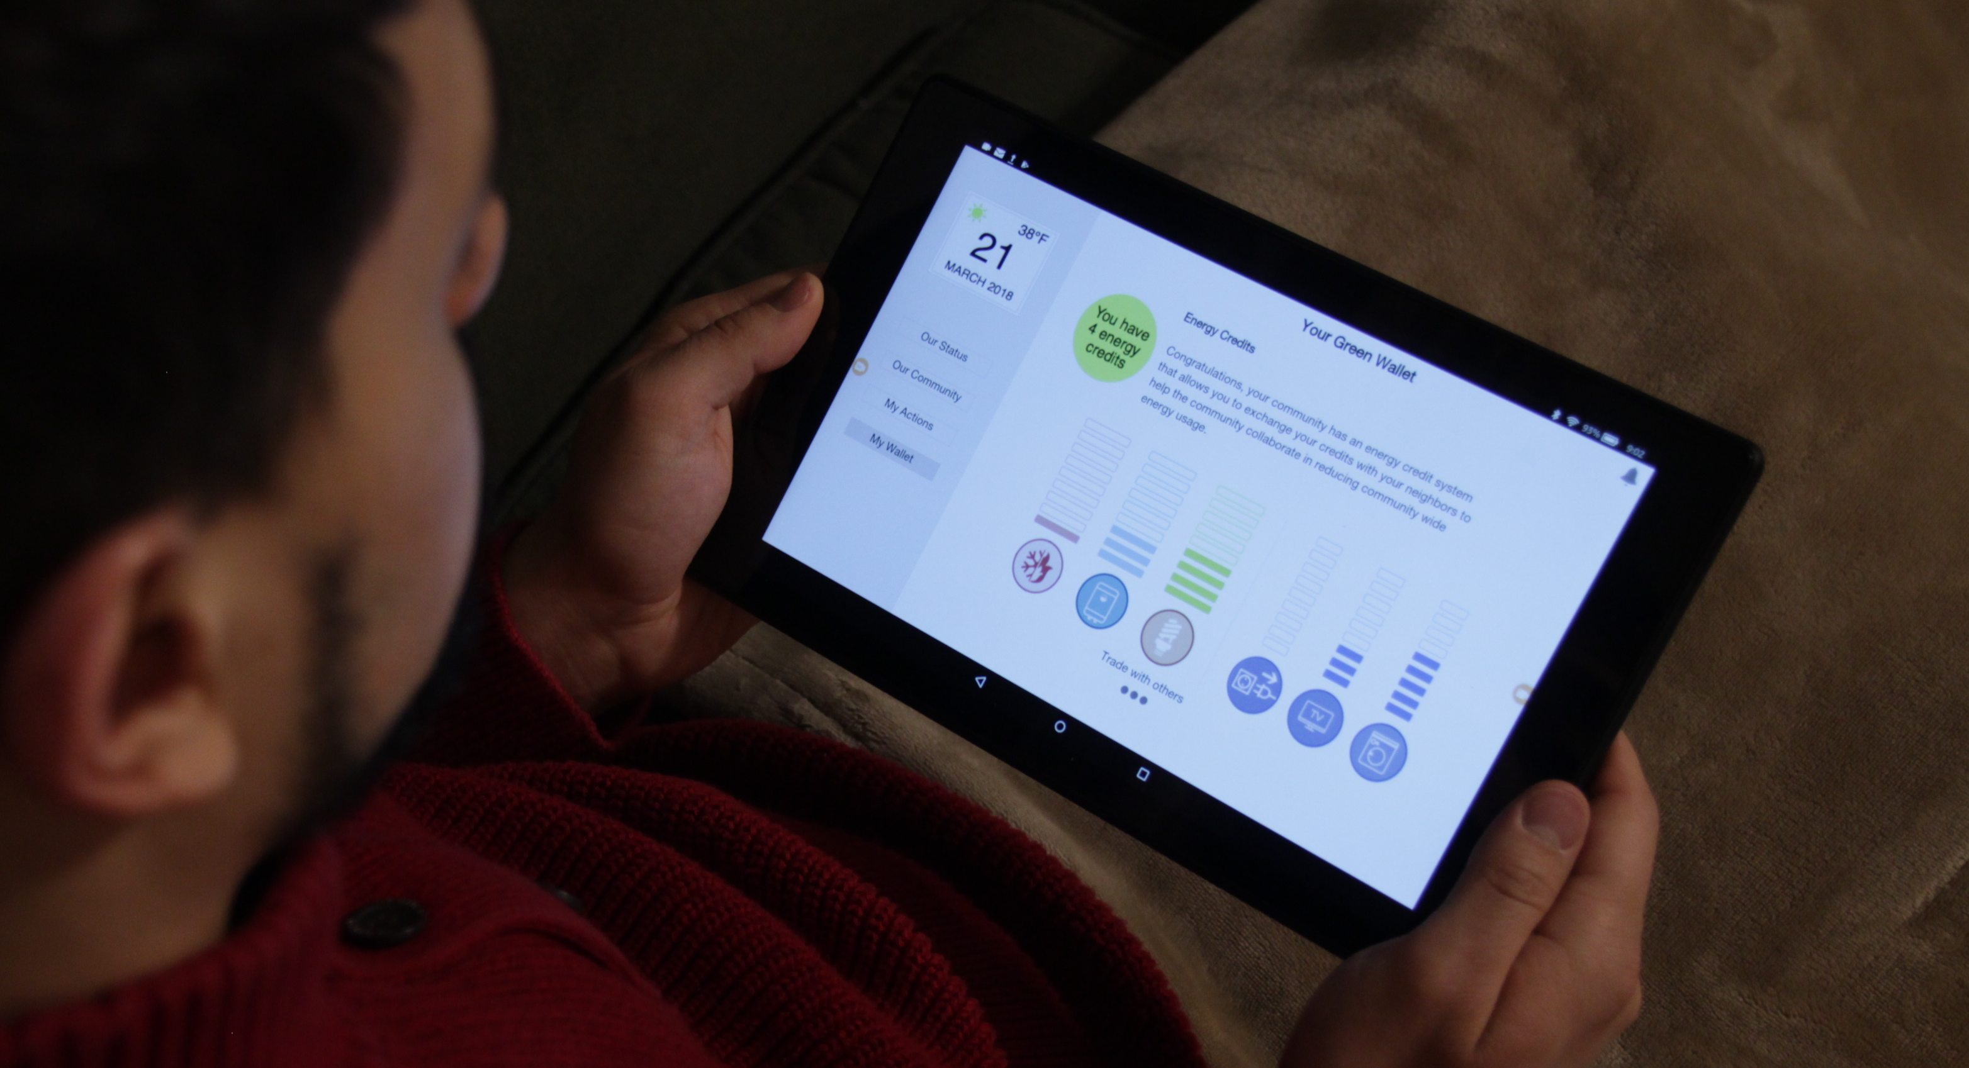
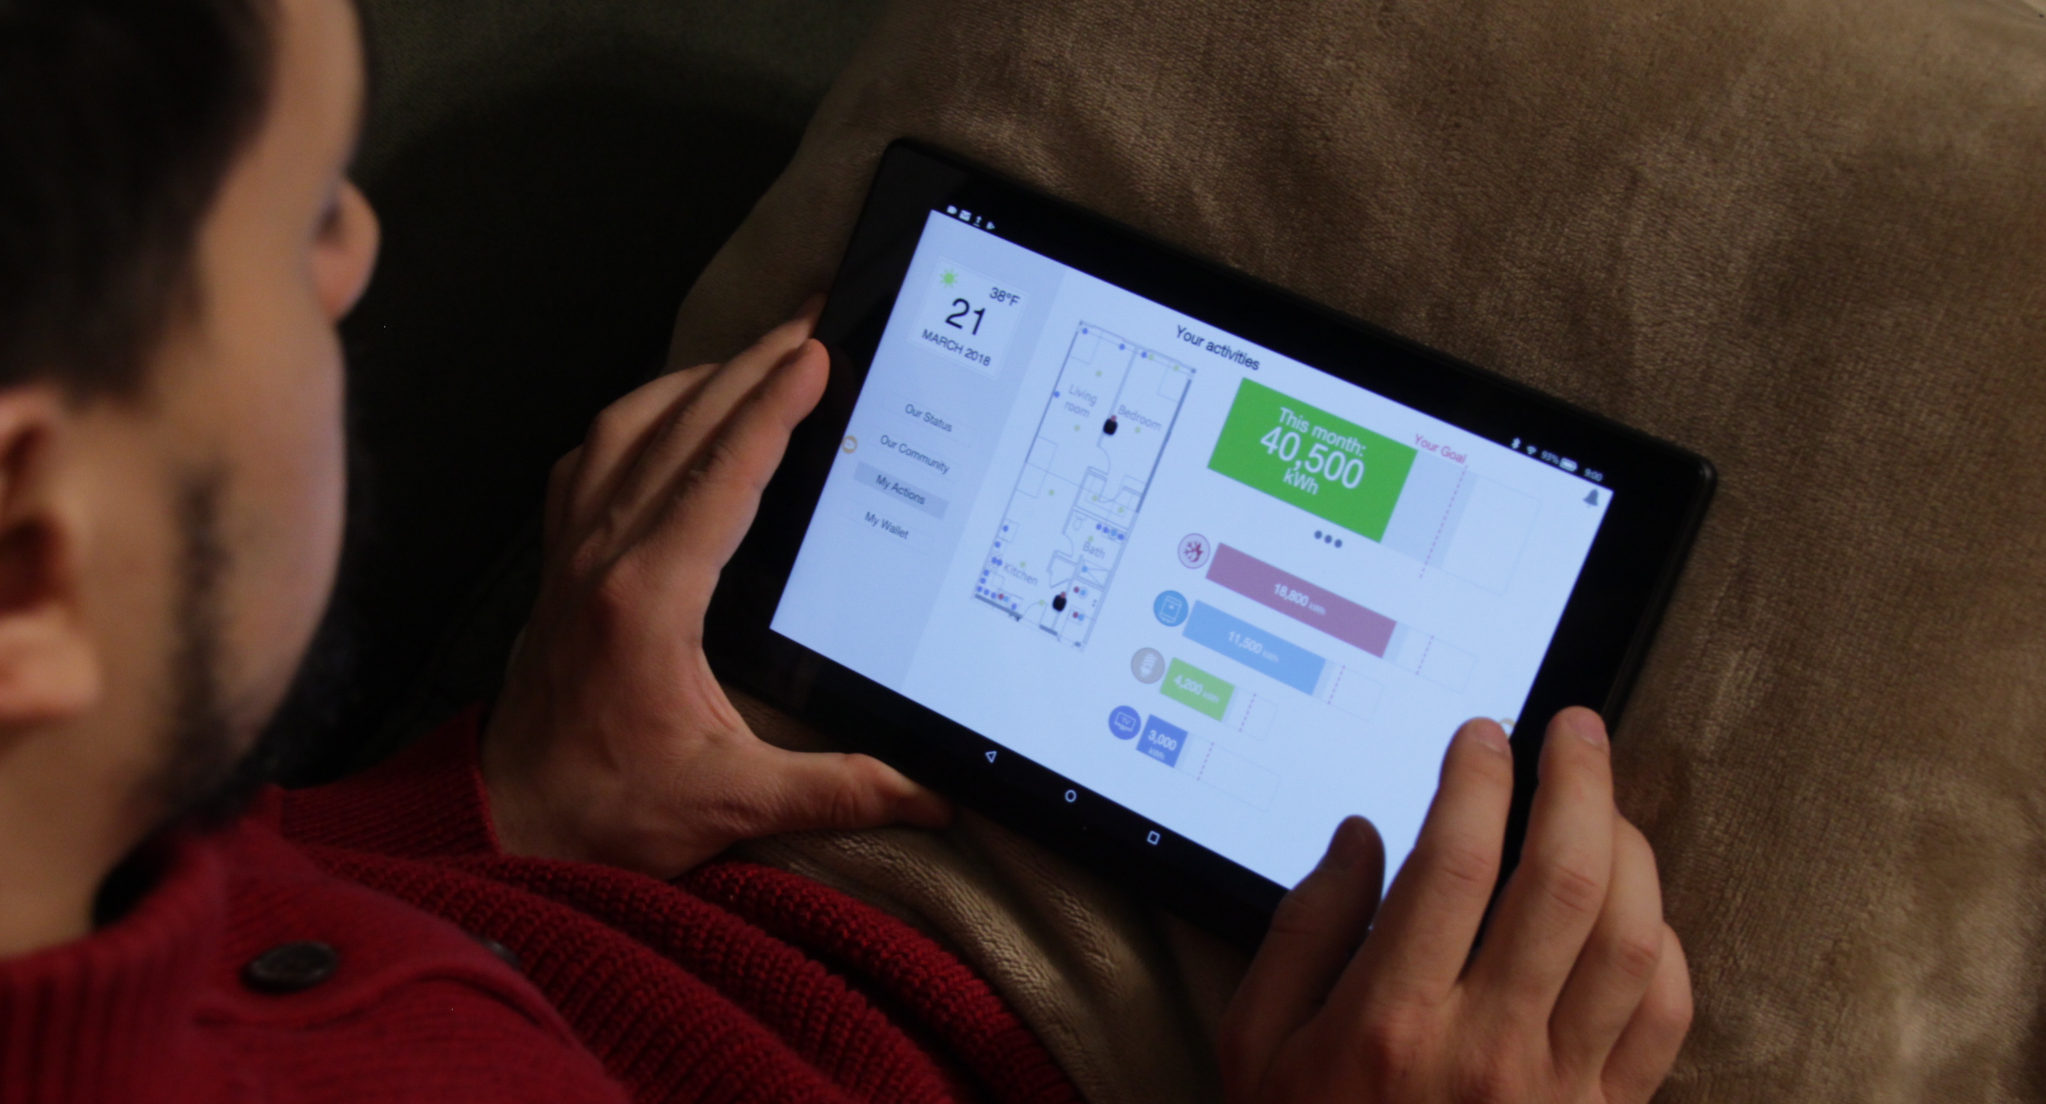
Status of the Project – Visual User-interactive System
4 Views of the First Demo Web Application
Our Status
(community aggregate)
Our Community
(household break down and history)
My Wallet
(gather energy tokens and exchange with others)
My Actions
(singe household and direct options to take action)
Demo App (developed for Amazon Tablet 10 inch): ​https://xdanielsb.github.io/EnergyMonitor
​

Slide 12








Status of the Project – Verbal User-interactive System
Preset interaction scenario
Your Service Processes Request
Advanced interaction scenario
Processor for Ontological Semantic Technology (syntax, morph, light common sense, etc)
NL e.g. English
Phon
Morph
Syntax
Lexicon
Ontology
Amazon Alexa Custom Skill (Energy saver)
BigQuery

Slide 13
What’s Next
d
d
Energy use behavior in 4 S&CC
Sociotechnical Modeling
S&C Technology
General principles of human behavior and response to feedback
Residents' declarative and procedural knowledge → presentation formats
Injunctive norms matched with resident’s values
Learning-based feedback mechanisms
Community-based feedback mechanisms
Bayesian multi-scale algorithms to discover energy use behavioral clusters.
Bayesian classification to predict the changes between pre- and post-treatment energy use behavior.
Game theoretic models to predict the response to community-based feedback mechanisms.
New interactive smart home devices
Resident verbal communication systems
Home energy monitor based on visual analytics for community-oriented conservation behaviors
Software tool for community energy management

