Slide 1
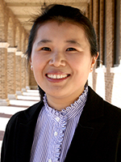
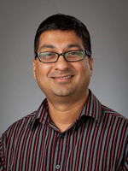
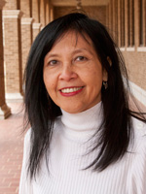
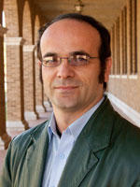
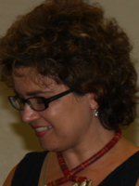
2018 NSF SMART AND CONNECTED COMMUNITIES PI MEETING
PG: SCC-Planning: Enhancing water resource management and infrastructure improvement through sensing, computation, and community engagement, NSF Award 1737634
Fang Jin
Computer Science
Venkatesh Uddameri
Civil Engineering
Rattikorn Hewett
Computer Science
Akbar Siami-Namin
Computer Science
Cristina Bradatan
Sociology
Texas Tech University
http://myweb.ttu.edu/fjin/projects/west-tx-water/
Notes:
BRIEFLY INTRODUCE YOURSELF AND YOUR INVESTIGATORS (10 sec slide)

Slide 2
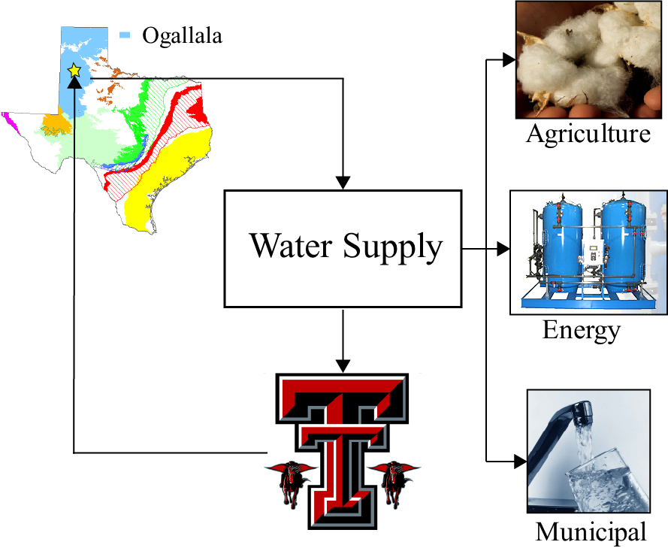
Project Aims
1. Improve Resilience of Rural Communities of Texas through improved water resources management
2. Work with rural communities to investigate
Their needs in improving water supply resilience
Dwindling Water Supplies
Poor Water quality
Aging infrastructure
3. Improve water use efficiencies across the sectors – evaluate challenges and barriers of adopting
Smart meters
Sensor technologies
Big data analytics
Notes:
A brief background: Please describe the problem you are addressing and why it is important (20sec slide)

Slide 3
Status of the Project
Established interdisciplinary socio-technical group at TTU to work on SCC
Several meetings, presentations to understand each other’s field
Derive common goals and interests to focus on water resources problems – integration of Social + Technical + Computational
Identified community leaders to engage with
Discussions with individual city managers, economic development councils
Council of Governments
Discussions with Non-profits and water industry personnel
Reconnaissance discussions on focus group facilitation with select community partners
Understanding data availability and needs
Tour of water treatment facilities
Final preparations for conducting focus groups
We will be conducting Focus Groups in April – May and Follow up with a workshop in July
Notes:
A brief background: Please describe the problem you are addressing and why it is important (20sec slide)

Slide 4
Planned Outcomes
1. Understanding needs and challenges faced by communities in improving water resiliency
Competing objectives faced by communities (can we tap synergies?)
Health care, education
How to improve information flow infrastructure in rural communities?
2. Data and information needs for better water planning at both short and long-term
Drought Preparedness
Tactical day-to-day water supply issues
Aging Infrastructure
Challenges and barriers to improvement
Use of Big Data, Sensor (Internet of Things) technologies
Smart meters to improve water efficiencies
Physics-Inspired Data Mining and Machine learning Paradigms
Development of Research Programs at Texas Tech to improve Rural Water Resilience in Arid and Semi-Arid Regions
Notes:
A brief background: Please describe the problem you are addressing and why it is important (20sec slide)

