Slide 1

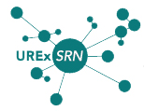




2018 NSF SMART AND CONNECTED COMMUNITIES PI MEETING
PG: Building Resilient Coastal Cities (RC2) through Smart and Connected Communities
NSF Award [#1737626]
Nancy Grimm (PI), Arizona State University; Tischa A. Muñoz-Erickson (Co-PI), USDA Forest Service, International Institute of Tropical Forestry; Tiffany Troxler (Co-PI), Florida International University; Claire Welty (Co-PI), University of Maryland, Baltimore County; Mathieu Feagan (Co-PI), Arizona State University; Pablo Méndez Lázaro, University of Puerto Rico, Medical Sciences; Clark Miller, Arizona State University; Timon McPhearson, The New School; David Iwaniec, Georgia State University; Daniel Sauter, The New School, Mikhail Chester, Arizona State University
Notes:
BRIEFLY INTRODUCE YOURSELF AND YOUR INVESTIGATORS (10 sec slide)

Slide 2
Project Aims
Notes:
A brief background: Please describe the problem you are addressing and why it is important (20sec slide) Describe the aims of this project and how you plan to address them in collaboration with your community partners and in a specified community.
As extreme events like Hurricanes Harvey, Irma, and Maria revealed, coastal infrastructure is ill-equipped to deal with the impacts of extreme weather-related events.
. City managers and mayors have begun making new investments in industry-based smart systems—such as sensors, data analytics, and communication technologies BUT
A new climate reality demands smart systems innovations that go beyond just the technologies of digital gadgets, data analytics, and quantification. Communities need smart systems that empower people by giving them access to robust visualization and SETS decision-support tools, that expand their capacity to envision future strategies over longer time horizons and facilitate sustainable and resilient transitions in an increasingly unpredictable future.
Integrated research concept: How can disciplinary- and domain-specific data about emerging risks and vulnerabilities be turned into integrated knowledge from a social-ecological-technological systems (SETS) perspective that communities can interact with and use in support of meaningful collaborations, networks, and anticipatory actions in their cities?
In this Planning Grant we aim to connect concepts and expertise from visualization and information technology, science and technology studies, engineering, and urban planning to develop a SETS Knowledge System that integrates a SETS Visualization Platform with the community and their knowledge, ideas, and networks (RC2 Hubs) through a hybrid interface (Innovation Space) in Miami, San Juan, and Baltimore.

Slide 3

Status of the Project and Planned Outcomes
INTERDISCIPLINARY TEAM FORMATION
COMMUNITY ENGAGEMENT
IMPLEMENTATION
Miami Innovation Lab
San Juan Innovation Lab
Baltimore Innovation Lab
feb
march- may
april - june
SETS Design Meetings (4)
Innovation Webinar
Miami Dialogues (3)
San Juan Dialogues (2)
Baltimore Dialogues
RC2 HUBS
2017
2018
2019…
NSF SCC PROPOSAL
ANALYSIS OF VISUALIZATION TOOLS
INITIAL DESIGN OF SETS VISUALIZATION PLATFORM
20 COMMUNITY PARTNERS ENGAGED
ENGINEERS AND VISUALIZATION EXPERTS JOIN SETS DESIGN TEAM
ASSESSMENT OF FLOOD RISK KNOWLEDGE SYSTEMS
~ 20 COMMUNITY PARTNERS EXPECTED
~15 COMMUNITY PARTNERS EXPECTED
REPORT
PUBLICATION
WEBSITE

Slide 4
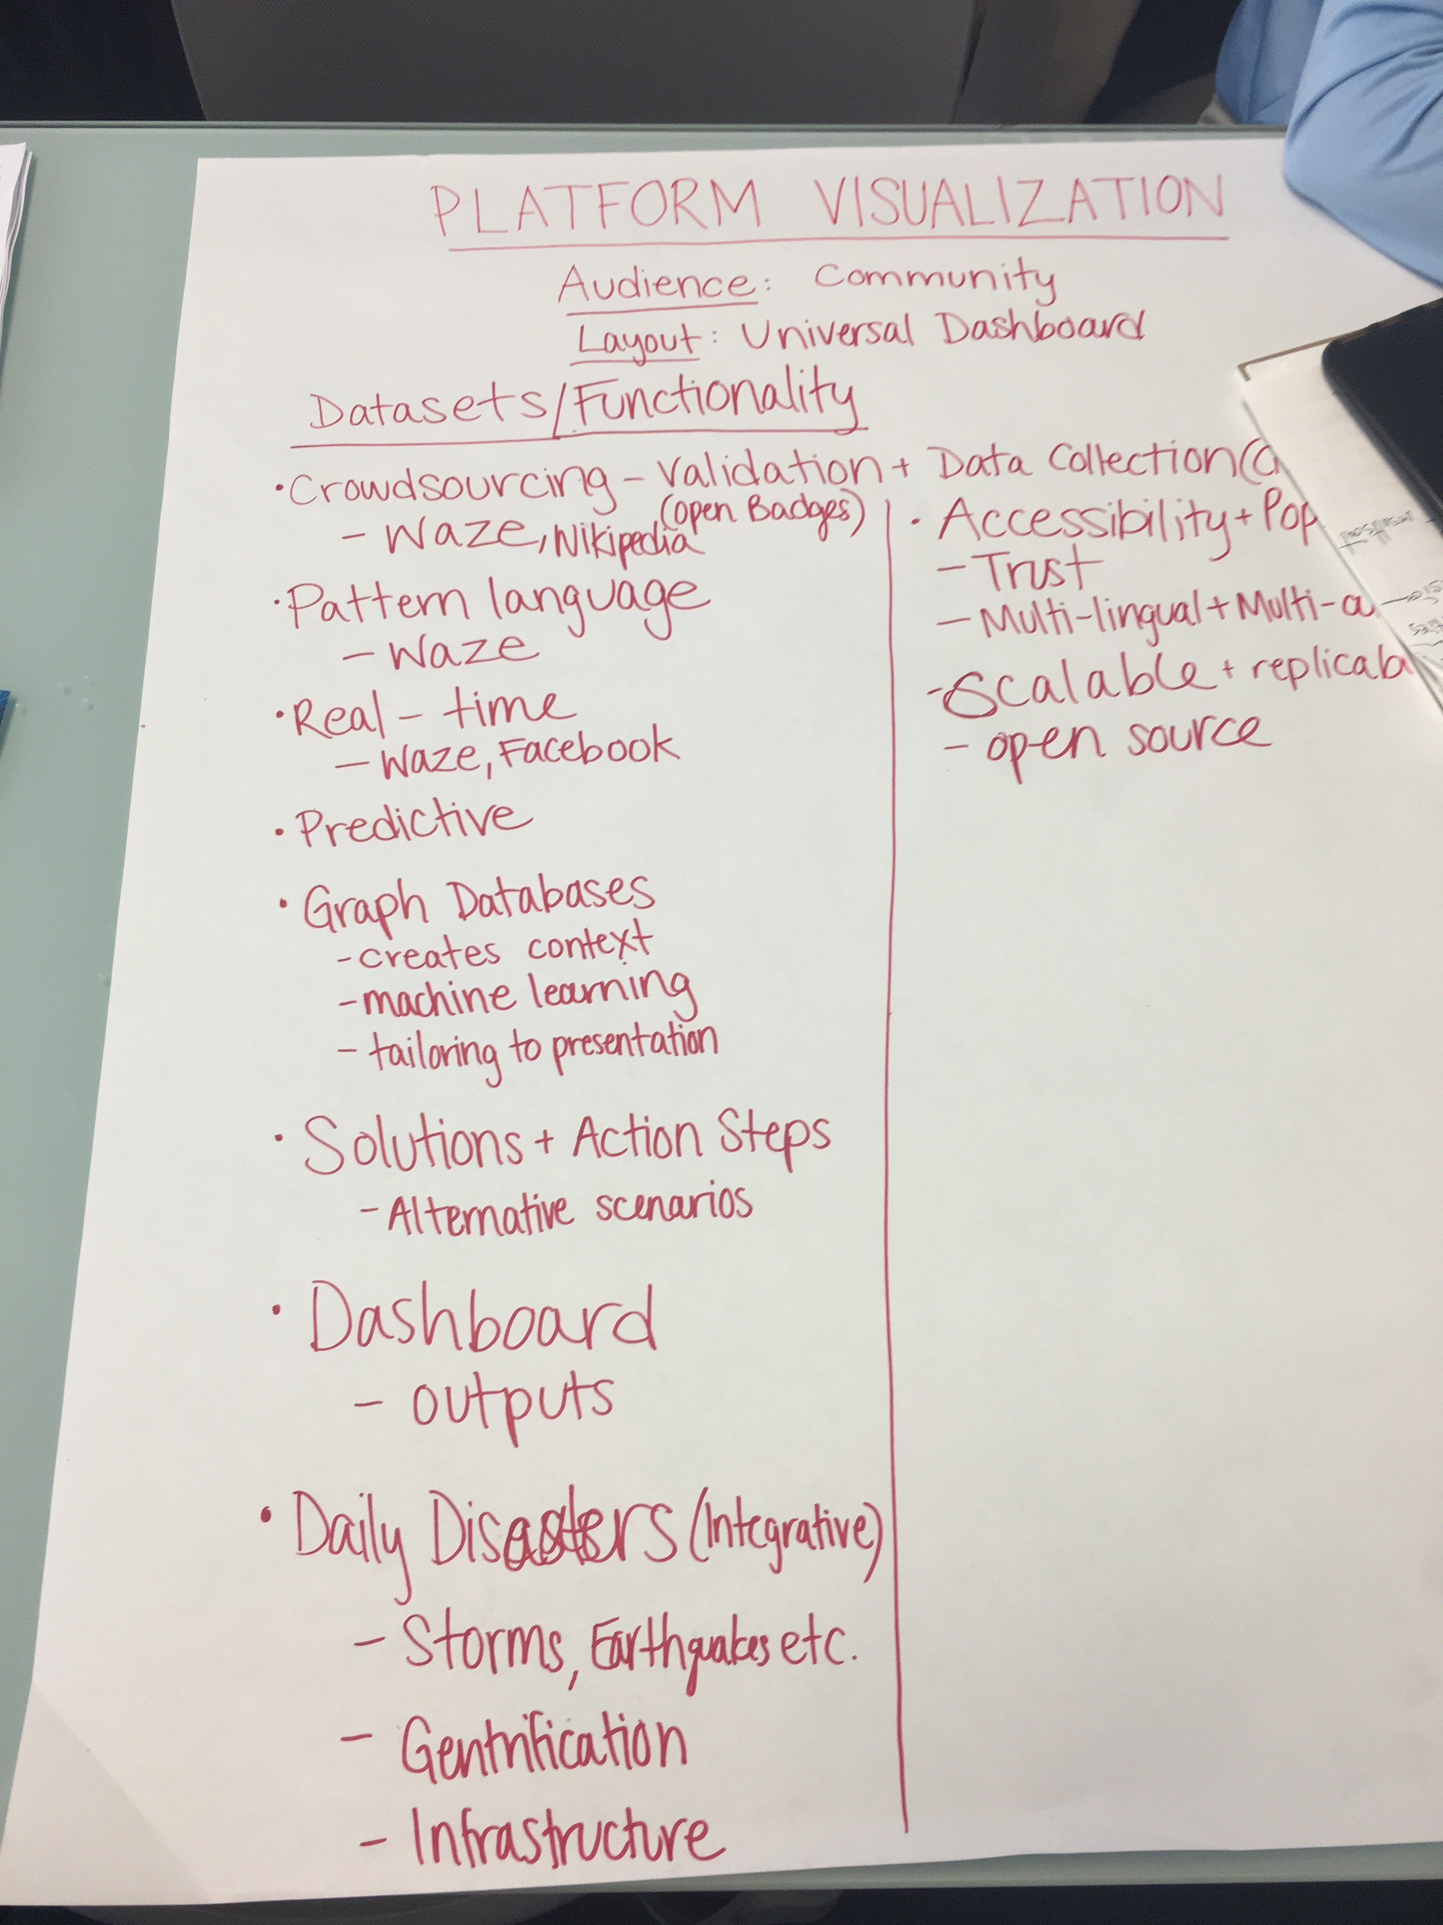
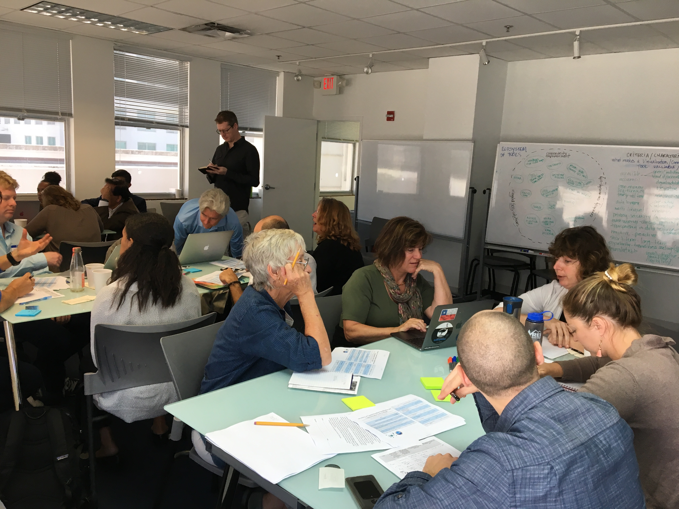
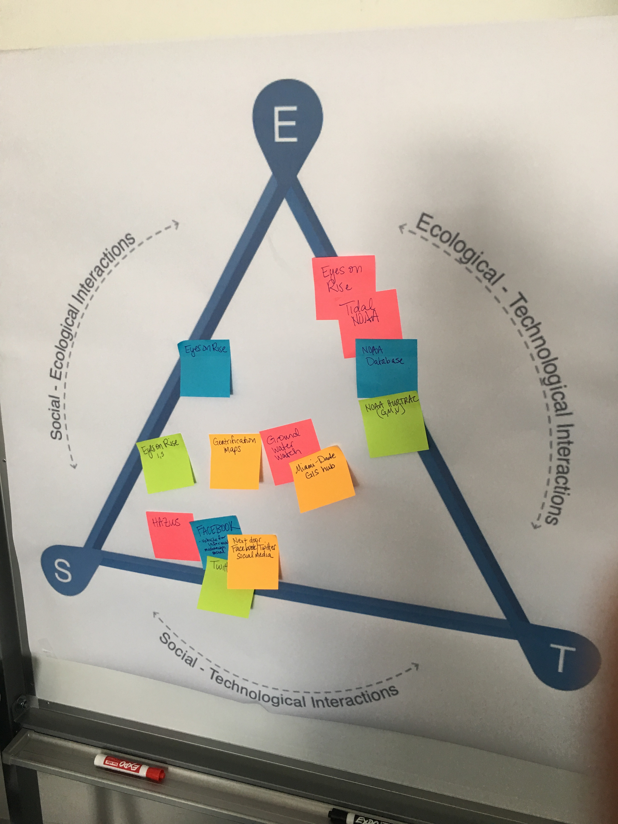
Miami Innovation Lab
March 1, 2018

