Slide 1
2018 NSF SMART AND CONNECTED COMMUNITIES PI MEETING
PG: Plan an Integrated Active Travel and Green Infrastructure System for Mental Wellbeing in Disadvantaged Communities through Crowdsourcing Technology, NSF Award #1737380
PI: Dr. Hongwei Dong¹; co-PIs: Dr. Ming Li² & Dr. Miguel Perez³
¹Department of Geography and City & Regional Planning
²Department of Computer Science
³Department of Public Health
California State University, Fresno
Notes:
BRIEFLY INTRODUCE YOURSELF AND YOUR INVESTIGATORS (10 sec slide)

Slide 2
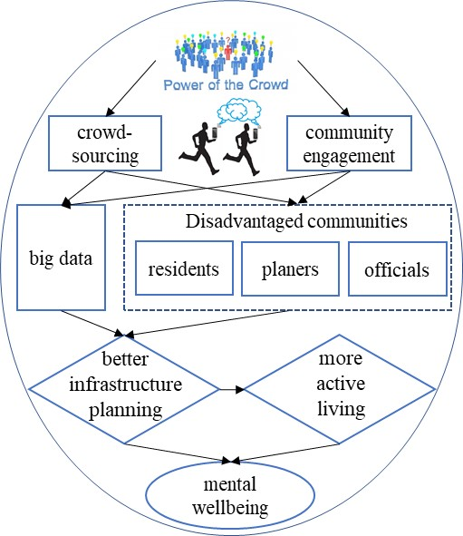
Project Aims
Goal: Planning an integrated transportation and green infrastructure system for mental wellbeing in disadvantaged communities via crowd-sourcing technology and community engagement.
Methods:
Crowd-sourcing via smartphone app
Qualitative: interviews with residents, planners and decision makers
Quantitative: using data from survey questionnaires
Notes:
A brief background: Please describe the problem you are addressing and why it is important (20sec slide)

Slide 3
Status of the Project
Pilot study:
Questionnaire survey is finished
Interviews are finished
Smart phone app to be tested in April
Community engagement:
Interactions with 150+ local residents
Interview 20 local planners, officials, and community organizers
A community workshop to be held in May
Research team building:
The current team has learned a lot experiences from this ongoing project
Have reached out to potential collaborators at Fresno State and UC Davis
Notes:
A brief background: Please describe the problem you are addressing and why it is important (20sec slide)

Slide 4
Planned Outcomes
Planned outcomes:
A better idea about how big data science can help to plan an integrated active travel and green infrastructure in disadvantaged communities for public health
A stronger interdisciplinary research team with expertise in urban planning, computer science, public health, psychology, and medicine.
Closer ties with local communities: residents, community organizers, urban planners, community organizers, and government/elected officials.
Deliverables:
A project report
Dissemination of research findings via publication and conference presentation
A preliminary proposal to NSF
Notes:
A brief background: Please describe the problem you are addressing and why it is important (20sec slide)

