Slide 1
2018 NSF SMART AND CONNECTED COMMUNITIES PI MEETING
PG: Community Energy: Technical and Social Challenges and Integrative Solutions, NSF Award ITR1737550
Research team: Jason Dedrick, Elizabeth Krietemeyer and Tarek Rakha, Syracuse University
Community partner: Pecan Street Institute, Austin, TX (represented by Rachel Jenkins, Senior Programs Manager)
Notes:
BRIEFLY INTRODUCE YOURSELF AND YOUR INVESTIGATORS (10 sec slide)

Slide 2
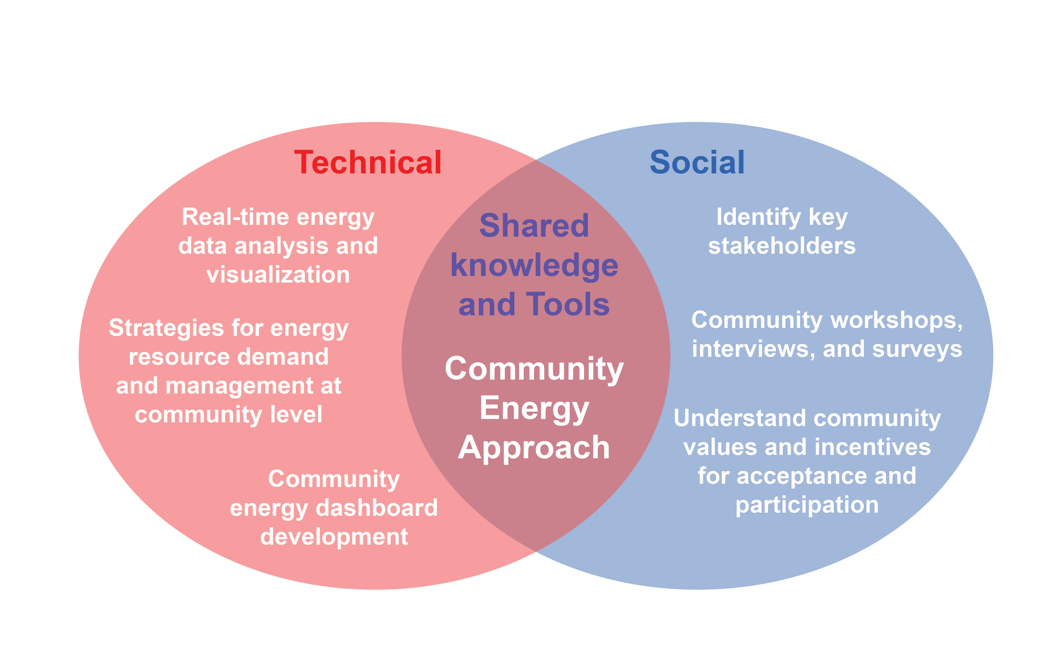
Project Aims: Community Energy Project in Austin, TX
Concept:
Community Energy is an innovative concept, integrating solar, storage and demand response at the community level.
Community Energy presents social challenges in communicating the value of the concept to residents and securing their participation.
Integrative Research:
Technical: developing a community energy management dashboard for residents to monitor individual and community energy activity.
Community Engagement: community workshops, a survey of residents, and interviews with community leaders.
Goals:
To understand the technical and social challenges presented by the Community Energy concept, and
To developtechnical and social solutions that are broadly applicable to communities around the U.S.
To prepare the groundwork for implementing a Community Energy project in the next stage
Notes:
B

Slide 4
Project Status
Completed initial interviews with community stakeholders and residents
Collected and visualized data on individual energy use from Pecan Street
Developing initial design for energy dashboard
Planning for community workshop in May, 2018

Slide 5
Planned Outcomes
Co-design (with community members) an energy dashboard to inform and empower community members on individual and community energy generation and use
Collect and analyze qualitative and quantitative data to understand perceptions and behaviors, and motivations and obstacles for participation in a Community Energy project
Disseminate results in academic outlets and to community members
Lay groundwork for implementation of a Community Energy project

