Slide 1
2018 NSF SMART AND CONNECTED COMMUNITIES PI MEETING
SCC-Planning: Smart and Connected Residential Water Quality Community, 1737514
Vinka Oyanedel-Craver, Civil and Environmental Engineering
Kunal Mankodiya, Electrical and Biomedical Engineering
Brian Krueger, Political Sciences
Colleen Redding, Behavioral Sciences
Notes:
BRIEFLY INTRODUCE YOURSELF AND YOUR INVESTIGATORS (10 sec slide)

Slide 2
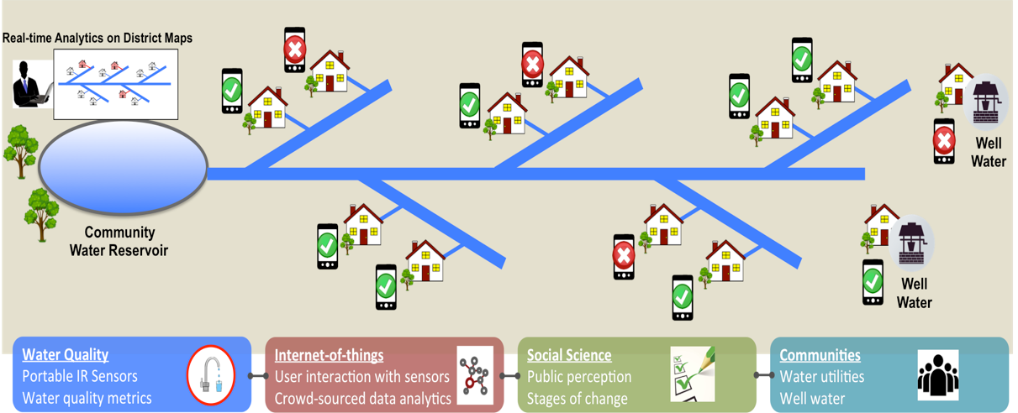
SCC-Planning: Smart and Connected Residential Water Quality Community
AIM:
Void in water quality information at the household level through the development of easy, inexpensive and internet-connected probes that could create a connected community of users and water utilities
Community Engagement:
Encourage communities to take a proactive role and participate in collecting crowdsourced data, which the community can act upon and will help authorities make informed decisions on residential water treatment.
Impact:
Planning workshop with different organizations, utilities and community members.
WaterHacks
Notes:
Building continuing support for the S&CC program and growing the S&CC community requires that we convey the essence and community engagement of S&CC-funded research to diverse stakeholders in a clear, concise, and visual way, quantifying impacts where possible. The summary should be understandable by the broader S&CC community– those who know S&CC, but aren’t in your specific domain.
Consider including your graphic on a separate slide if space is a concern. These slides may be used to promote the program both within and outside NSF. For project abstract, posters, and videos, please prepare one page for each.

Slide 3
Status of the Project
Water Sensors Selection: assessment precision, accuracy, usability, maintenance and cost
Internet of Things: Understanding the landscape of deployment for networked sensors in the community.
Community Survey: Survey drafted that investigates scope and perception of tap water problems, use of bottled alternatives, pros and cons of water testing/sensor use and data sharing, and social media technologies.
Notes:
A brief background: Please describe the problem you are addressing and why it is important (20sec slide)

Slide 4
Planned Outcomes
Cross-disciplinary
10 domains
Biomedical Eng.
Chemical Eng.
Civil & Environmental Eng
Computer Eng
Computer Science
Electrical Eng.
Environmental Sc.
Geology
Mechanical Eng.
MBA
42% participants were
women
Stakeholder Workshop.
Survey results presentation
Selection pilot location
Selection sensor
Selection data-sharing
Macky McCleary
RI Dept
Public Utilities & Carriers
Notes:
A brief background: Please describe the problem you are addressing and why it is important (20sec slide)

