Slide 1









2018 NSF SMART AND CONNECTED COMMUNITIES PI MEETING
PG: Building Capacity for Smart and Connected Management of Thermal Extremes,
NSF Award #1737617
Investigators:
Paul Coseo (PI), Arizona State University
Ariane Middel (Co-PI), Temple University
David Hondula (Co-PI), Arizona State University
Zoe Hamstead (Co-PI), University at Buffalo
Nicholas Rajkovich (Co-PI), University at Buffalo
Erie County
Josh Wilson
Dolores Funke
Gale Burstein
Eric Walker
National Weather Service
Paul Iniguez
Northern Arizona University
Ben Ruddell
Arizona State University
Anne Reichman
Lauren Withycombe Keeler
University at Buffalo
Zachary Schlader
Laura Quebral
Paul Ray
Bartholomew Roberts
Jessica Castner
Hanbin Wang
Community Partners & Experts:
City of Tempe
Braden Kay
Rosa Inchausti
Grace Kelly
City of Phoenix
Lysistrata Hall
Notes:
BRIEFLY INTRODUCE YOURSELF AND YOUR INVESTIGATORS (10 sec slide)

Slide 2
Project Aims
Planning
Architecture
Public Health
Computer Science
Climatology
Thermal sensing
Vulnerability analysis
Health outcome
modeling
Spatial landscape
analysis
Social & Technological Research
Measurement & analysis approaches
Management practices
Local government agencies
Mitigation &
adaptation planning
Land use strategies
Community capacity-
building
Social Services
Public health
Planning
Emergency response
Energy
Weather service
Smart & Connected Thermal Management
Notes:
A brief background: Please describe the problem you are addressing and why it is important (20sec slide)

Slide 3
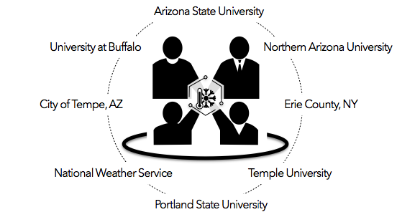
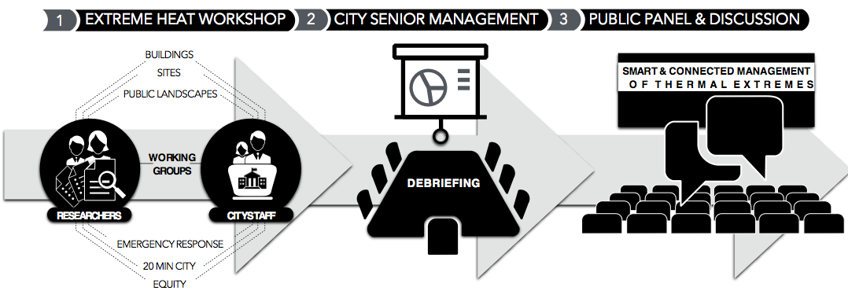
I.
I.
Status of the Project
II.
TEMPE FORUM
March 2-3
BUFFALO FORUM
June 29-30
PROJECT OUTCOMES
Notes:
A brief background: Please describe the problem you are addressing and why it is important (20sec slide)

Slide 4
I.
Planned Outcomes
II.
TEMPE FORUM
BUFFALO FORUM
III.
NATIONAL ASSESSMENT INSTRUMENT
FUTURE ACTVITIES FRAMEWORK
INTEGRATED ASSESSMENT
Notes:
A brief background: Please describe the problem you are addressing and why it is important (20sec slide)

