Slide 1
Smart and Connected Communities – Looking Forward
David Corman
March 15, 2018

Slide 2

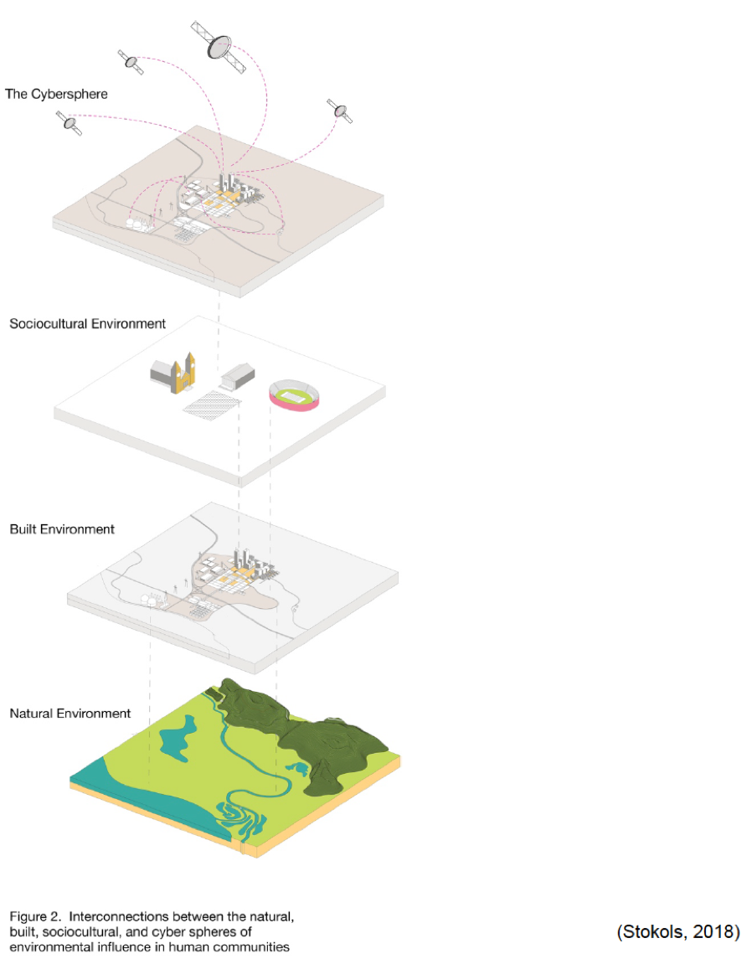
The Evolution of a Program
NSF supports fundamental, multidisciplinary research on the interactions between humans and the built environment within and among communities in all of the science and engineering domains supported by the Foundation’s directorates.
Cyber-physical systems (CPS) are engineered systems that are built from, and depend upon, the seamless integration of computation and physical components.
A Smart and Connected Community (S&CC) is a community that synergistically integrates information and communication technologies with the natural and built environments, including infrastructure, to improve the social, economic, and environmental well-being of those who live, work, or travel within it.

Slide 3
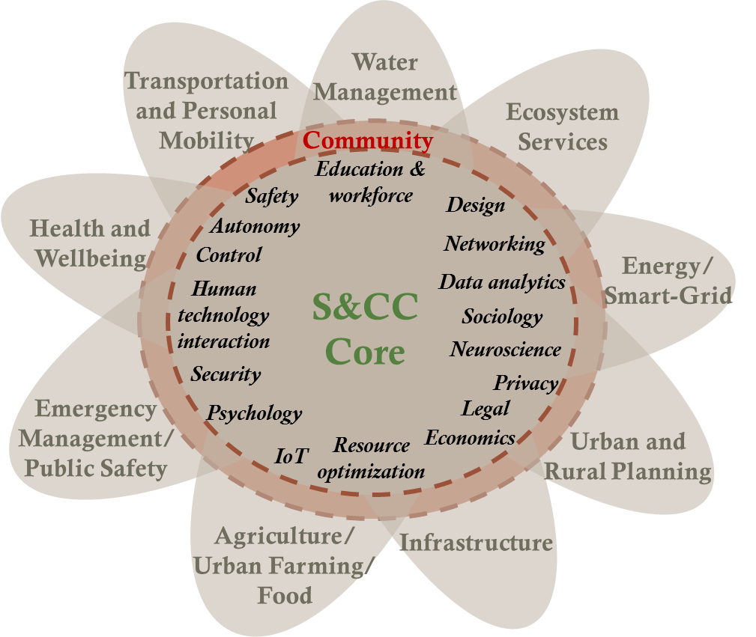
NSF CPS and S&CC Programs
Develops the core system science of complex cyber-physical systems and transitions the technologies into engineering practice.
  Integrative research that pairs advances in technological and social dimensions with meaningful community engagement.

Slide 4
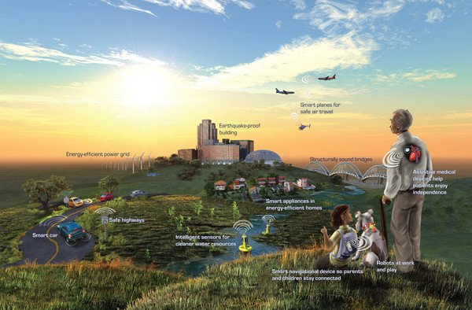
A Long-term Research and Education Agenda for Smart & Connected Communities
  The program aims to accelerate the creation of the scientific and engineering foundations that will enable smart and connected communities to bring about new levels of economic opportunity and growth, safety and security, health and wellness, and overall quality of life.
  Including research capacity building through growing an international inter- and multidisciplinary, multi-sector research and education community.
Notes:
The information on this slide is for IWG discussion, and will not appear in the FY2019 NITRD Supplement.

Slide 5
Smart & Connected Communities Program Conceptual Framework
Near- and Long-term Scientific and Community Impact
Community Engagement
Integrative Research
Integrated social and technological advances in fundamental science.
Interaction with individuals, institutions and organizations in communities.
Managing interdisciplinary and cross-sector collaborations & evaluating success.
Notes:
The information on this slide is for IWG discussion, and will not appear in the FY2019 NITRD Supplement.

Slide 6
Critical ‘Heilmeier’ Questions for
Smart & Connected Communities Proposals
What is the problem? Why is it hard?
What are the limits of current practice?
What's new in your approach?
Who cares?
What impact will success have?
What are the risks and the payoffs?
How much will it cost?
How long will it take?
How will success be measured?
S&CC Project Description
Outline specific social and technological research questions, hypotheses, and research gaps.
Explain the rationale and breadth of community engagement and how this engagement will be sustained through the duration of the award.
Describe management of the project and the proposed approach to data collection and evaluation.
Describe the vision of success for the proposal.
Notes:
The solicitation supports research and research
capacity-building activities that integrate multiple disciplinary and stakeholder perspectives and undertake meaningful community engagement.

Slide 7
2017 Smart & Connected Communities
Funding Portfolio
Notes:
The information on this slide is for IWG discussion, and will not appear in the FY2019 NITRD Supplement.

Slide 8
Looking Ahead
Lots of interest in the program from the research community
Substantial interest in S&CC from multiple agencies
S&CC 2018 review panels being formed
Eagerly anticipating results from first six months of program

