Slide 1
2018 NSF SMART AND CONNECTED COMMUNITIES PI MEETING
2018 NSF SMART AND CONNECTED COMMUNITIES PI MEETING
IRG Track 2: Resilient Water Systems:
Integrating Environmental Sensor Networks and
Real-Time Forecasting to Adaptively Manage Water Quality and Build Social Trust, NSF Award 1737424
Cayelan Carey, Renato Figueiredo, François Birgand, John Little, Madeline Schreiber, Michael Sorice, Quinn Thomas, Western Virginia Water Authority
SmartReservoir.org
Notes:
Hello, my name is Cayelan Carey and am excited to present with my colleague Renato Figueiredo on our new Track 2 project, which integrates ecosystem science, computer science, social science, and engineering to improve the resilience of drinking water systems for communities. To learn more about our project, I refer you to our website, SmartReservoir.Org

Slide 2
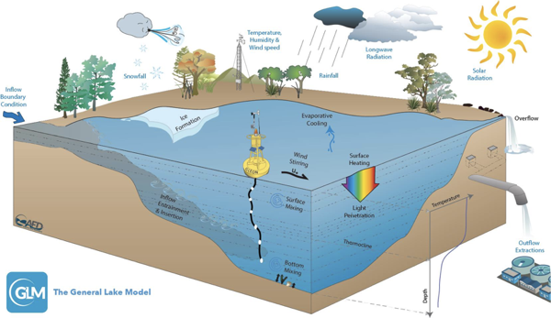
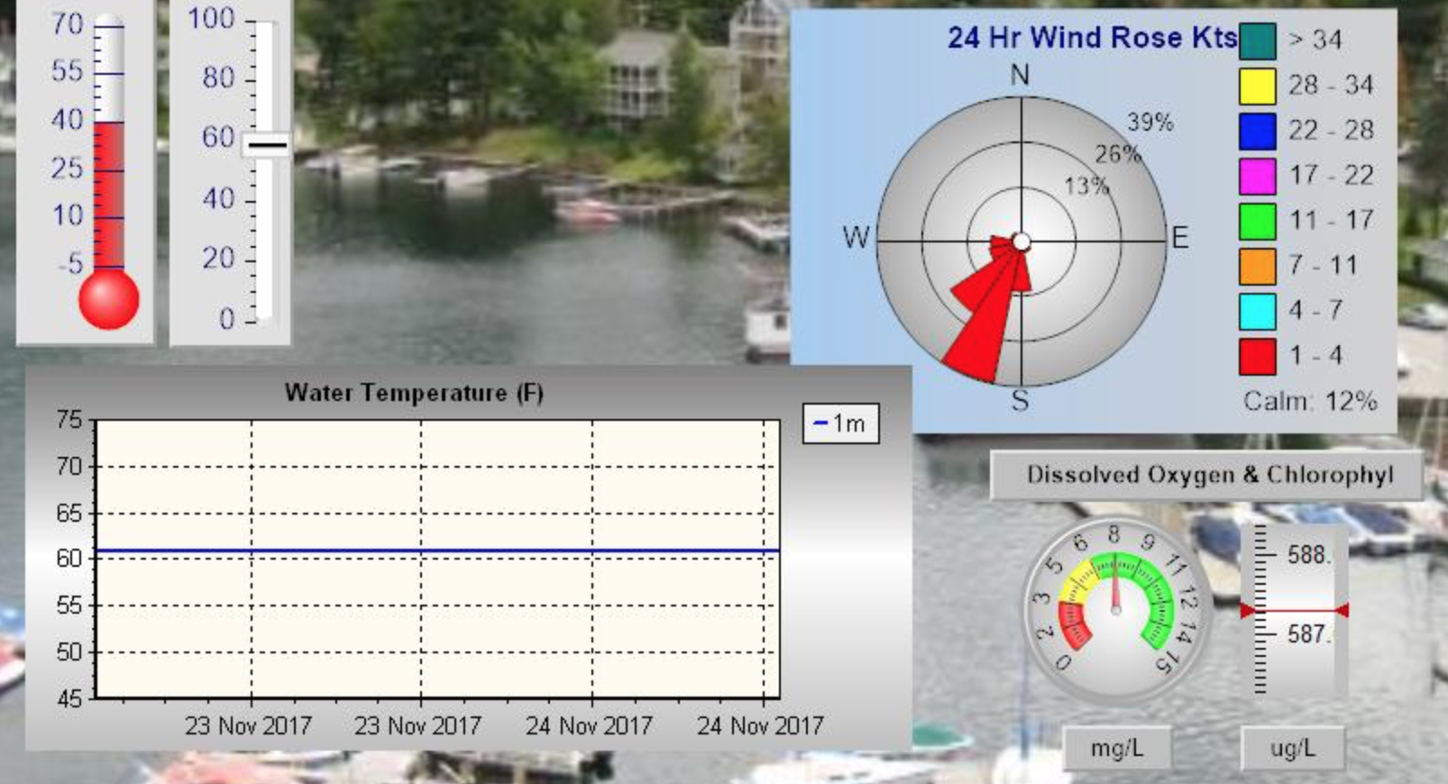
Sensored drinking water reservoir
Community system of water users
Building resilience in the water supply
Using forecasts to improve reservoir management and water quality
Educating the public on smart and connected technology
Evaluating how technology changes social trust in water utilities
Novel sensor technology
and secure data
transfer and processing
in the cloud
Creating real-time water quality forecasts for human-in-the-loop decision-making
Water quality model and forecasting system
Water utility management system
Notes:
Globally, the water quality of drinking supply lakes and reservoirs are threatened by land use change and climate change, resulting in toxic algal scums, odors, and contaminants. In response to this threat, our team is developing novel water chemistry sensors that are being deployed in a drinking water reservoir in Roanoke, Virginia. The data from the sensors are being transmitted wirelessly and securely through virtual private networks to drive ecosystem models that use model-data fusion techniques to create 10-day water quality forecasts, similar to weather forecasts. These forecasts are being co-developed with the water utility managers so that they can integrate this information into their workflows. Because our reservoirs have water quality engineering systems, we will study how the managers decide whether or not to use the forecasts to preemptively treat the reservoir to prevent adverse water quality events from occurring. This improved information will hopefully build resilience in the water supply, benefitting the overall community. We will then study how the public responds to increased information about their drinking water by embedding information on this smart & connected technology into their federally-mandated drinking water report every year and conducting public surveys. Our overall goal is to use this technology to build social trust between the public and the water utility.

Slide 3
Project Status
Kick-off meeting in August 2017 to launch project for January 2018 start
Water quality sensor and wireless sensor gateway development, testing, and deployment
Created model forecasting framework and code base
Hosted meetings with water utility to set up plan for manager interviews and surveys of Roanoke residents this year
Surface water temperature
30
20
Temperature (degrees C)
10
0
0
10
20
30
40
50
60
Time step (days)
Notes:
Our team held a kickoff meeting in August 2017 to organize project management and coordination for our official start date in January 2018.
Over the winter we have been working on sensor testing, with the first deployment of a sensor gateway that transmits environmental data to the cloud platform the first week of April.
In addition we have been developing the model-data fusion framework that we will use to generate the water quality forecasts.

Slide 4
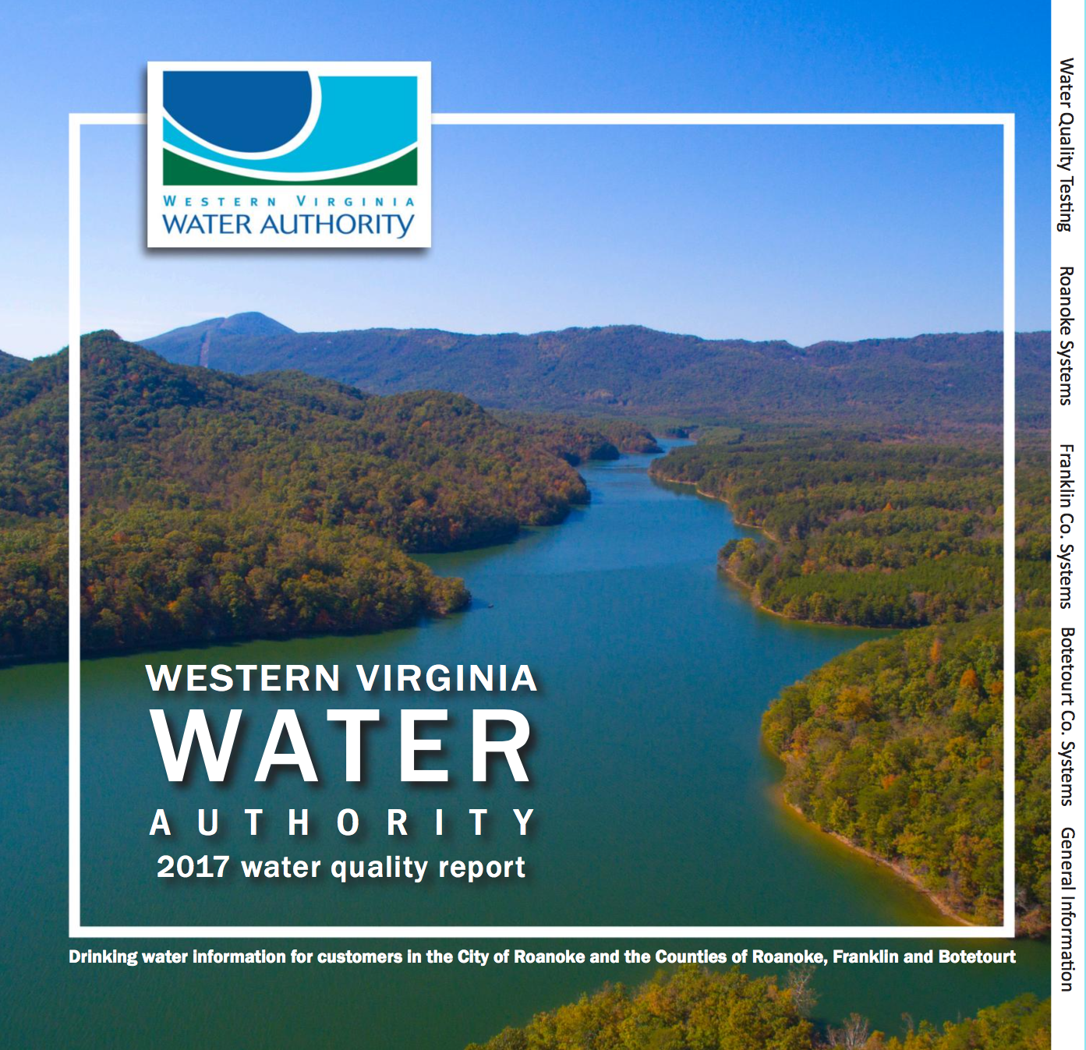
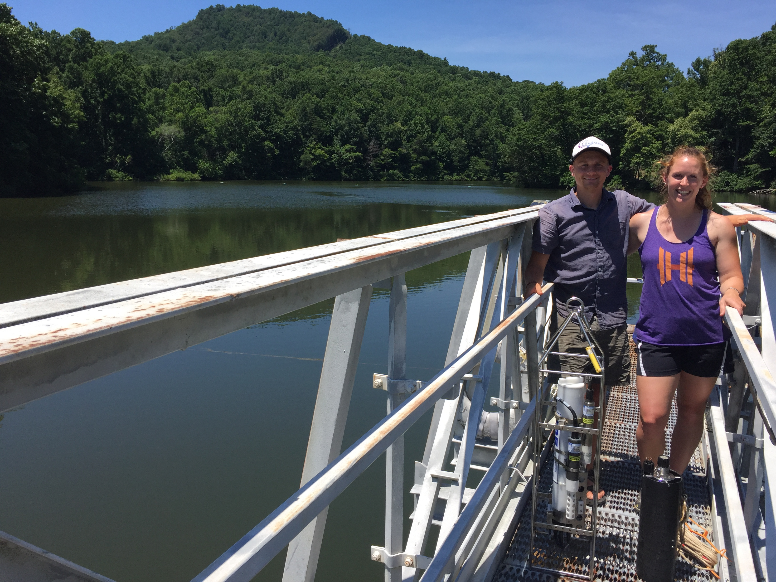
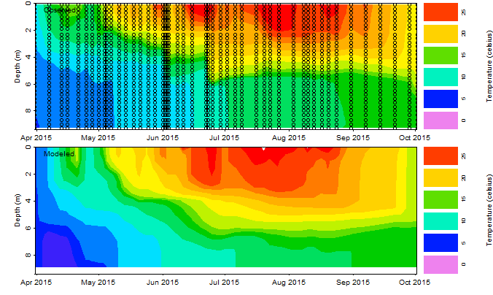
Next Steps
All-hands team project meeting
Water quality report survey of Roanoke residents
Deploy sensors and connect data wirelessly to run model in cloud platform
Calibrate reservoir simulation model and develop initial water quality forecasts
Develop first forecast visualizations for managers to study human-in-the-loop decision-making
Notes:
We will be hosting our all-hands project meeting in May 2018 to launch our first field season. Coincident with this workshop is our first survey of Roanoke residents this May, who will be receiving their water quality reports in April.
We will be deploying sensors throughout the spring and summer that will be providing important data streams for running our ecosystem model, which is currently undergoing calibration. Our goal is to have our preliminary first water quality forecasts by this summer. With the data for the forecasts in hand, the social scientists on our team will be embedded with the reservoir managers to study what visualizations are most effective for human-in-the-loop water quality decision-making.

