Slide 1
2018 NSF SMART AND CONNECTED COMMUNITIES PI MEETING
PG: Developing a Sensor-driven, Citizen Science Approach to Hazard Detection and Warning in Rural Communities, NSF Award #1737035
Ryan Brown (PI), Katie Whipkey (PM), Lisa Busch (Community Partner), Robert Lempert (co-PI)
RAND Corporation, Sitka Sound Science Center
www.rand.org, http://www.sitkascience.org/
Notes:
BRIEFLY INTRODUCE YOURSELF AND YOUR INVESTIGATORS (10 sec slide)

Slide 2
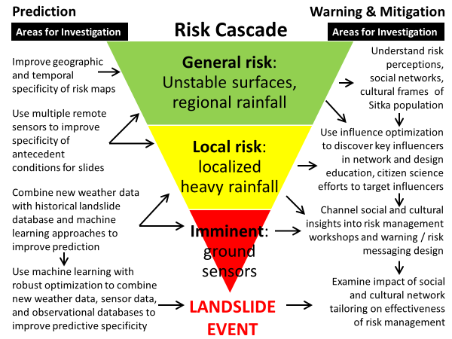
Project Aims
Problem: Landslides are destructive, hard to predict, and commonplace, especially in rural and remote communities with little existing infrastructure
Improve local landslide prediction using remote sensors in the context of citizen-science and community education.
Use social and data science to better understand how to leverage existing social networks and pathways for risk communication and risk sharing.
Employ robust decision-making methods to empower community to design data-driven landslide warning system and risk mitigation plan.
Notes:
A brief background: Please describe the problem you are addressing and why it is important (20sec slide)

Slide 3
Status of the Project
Developed a network of scientists, policy makers, and community stakeholders at universities and research organizations, federal, state, and local government agencies, and business organizations
Co-wrote follow-on proposal for 4-year, citizen-science landslide prediction, warning, and mitigation system
Notes:
A brief background: Please describe the problem you are addressing and why it is important (20sec slide)

Slide 4
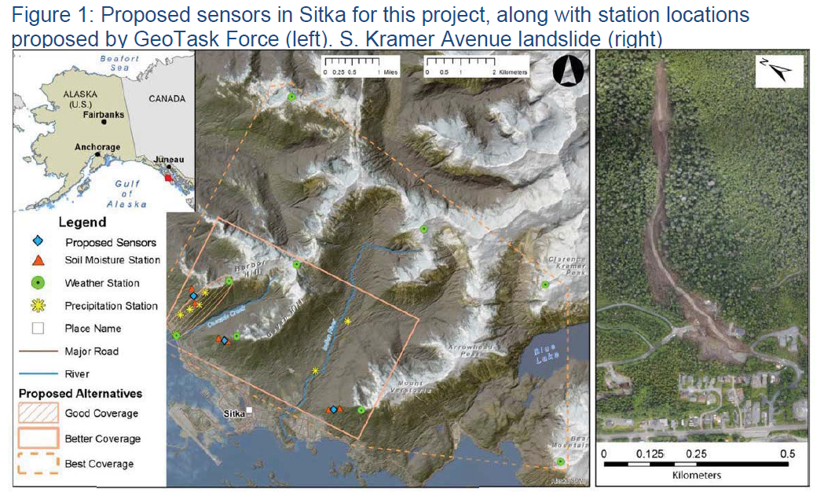
Planned Outcomes
Lasting collaborative network of scientific & research organizations; federal/state/local agencies; and local stakeholders, businesses; and citizens
Increased community awareness, mobilization, and connectedness to address landslide and other natural hazard risk
4-year follow-on proposal to NSF S&CC (submitted)
Improved predictive geoscience of shallow landslides
Social science of risk perception and communication for small, isolated communities
Influence maximization and robust optimization for landslide warning and risk management
Overall goal is to develop a networked landslide prediction, warning, and mitigation system built on citizen participation and supported by inexpensive remote sensors that can be applied in other remote, isolated areas with limited existing infrastructure
Notes:
A brief background: Please describe the problem you are addressing and why it is important (20sec slide)

