Slide 1
2018 NSF SMART AND CONNECTED COMMUNITIES PI MEETING
IRG Track 2: SMART & CONNECTED KIDS FOR SUSTAINABLE ENERGY COMMUNITIES #1737565
HILARY BOUDET (OREGON STATE UNIVERSITY) RAM RAJAGOPAL (STANFORD UNIVERSITY), MAHNOOSH ALIZADEH (UNIVERSITY OF CALIFORNIA, SANTA BARBARA)
COMMUNITY PARTNERS: RACHEL DIFRANCO (CITY OF FREMONT), JEAN FAHY (GIRL SCOUTS OF NORTHERN CALIFORNIA), OHLONE COMMUNITY COLLEGE
GLEE.STANFORD.EDU (FOR NOW!)
Notes:
BRIEFLY INTRODUCE YOURSELF AND YOUR INVESTIGATORS (10 sec slide)

Slide 2
Project Aims
In Fremont, CA, using smart-meter data from household energy use, and community-engaged intervention strategies from behavioral sciences, to influence energy management in families (working with Girl Scout troops and high-school students).
Based on the collected smart-meter data, engaging youth in lifestyle-drive interventions to make customers more energy-aware when making energy consumption choices.
Notes:
A brief background: Please describe the problem you are addressing and why it is important (20sec slide)

Slide 3
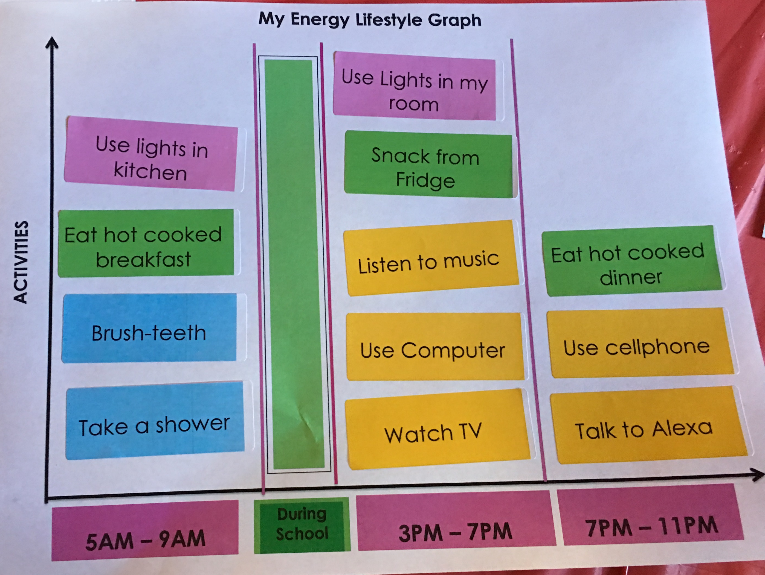
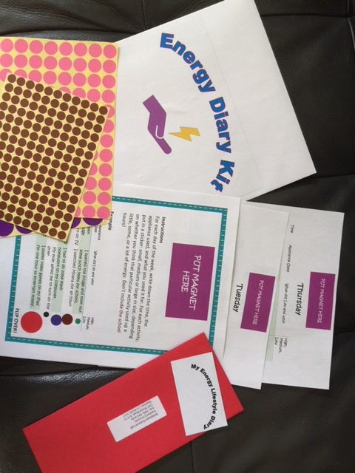
Status of the Project
Science - Formative activities and piloting
Focus on peak shaving/shifting
Focus groups with local children to better understand household energy lifestyles (to date N=20)
New “my energy lifestyle” curriculum (prototype test N=90)
New data collection strategies (e.g., prototyping diaries, focus groups, and eventually mobile apps)
Community Engagement
Piloting curriculum at events in Fremont: World Thinking Day (N=175 Girl Scouts), Fremont Earth Day Celebration, and with Girl Scout’s “Discover Together” afterschool programs in 2 Title 1 elementary schools (N=40), one local troop (n=20), and with 4th graders in science class (N=90)
Capacity Building
Postdoc (specialist in CHI) identified to join team in August 2018
Two master’s students at OSU
Four undergraduates and two hourly research associates at Stanford
Partnering with Society of Women Engineers at Stanford for STEM-based event on campus with Girl Scouts
Notes:
A brief background: Please describe the problem you are addressing and why it is important (20sec slide)

Slide 4
Next Steps
Online surveys in Fremont to better understand household appliances, use, norms, & peak use
Developing “Designing your sustainable life” 5 part workshop design thinking series with Ohlone Community College students
Create lifestyle-based mobile/tablet application for shaving peak demand based on energy services/practices (cleanliness, comfort, entertainment)
Some Learnings
During peak, over half report:
-using a computer
-getting a snack
-watching TV
I feel tired when I get home from school, so I want to go in a long shower.
-Local Girl Scout
Notes:
A brief background: Please describe the problem you are addressing and why it is important (20sec slide)

