Slide 1
Cities & universities:
Science as a civic partnership

Slide 2
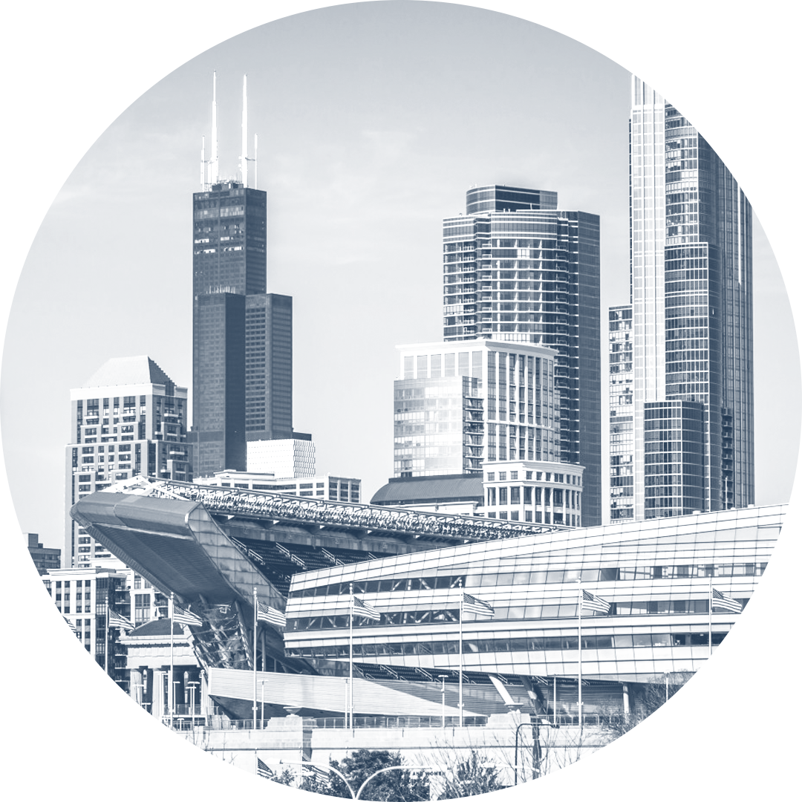
Cities face increasingly acute challenges & complex situations for solving those challenges – collaboration is key to develop sustainable solutions
CHALLENGES ARE MULTI-DIMENSIONAL
Climate change leads to flooding, heat waves, & other emergencies
Traffic congestion leads to air pollution, increased travel time, & accidents
Economic development creates jobs but also increases waste, further stresses infrastructure & can displace vulnerable populations
MULTIPLE PLAYERSMUST BE INVOLVED TO ESIGN AND DEPLOY A SUCCESSFUL SOLUTION
Residents
Anchor Institutes
Government
Tourists
Businesses
CHALLENGES EVOLVE & IMPACT DIFFERENT PARTS OF CITIES DIFFERENTLY
Neighborhoods
Business Districts
Industrial Zones
Green Spaces

Slide 3
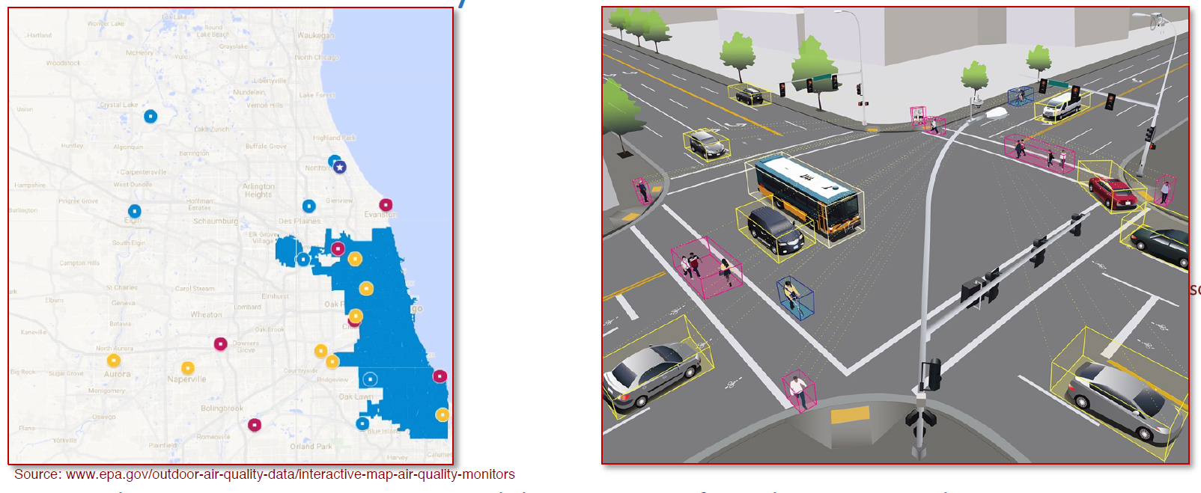
The need for more data and functionality to inform urban solutions is bring cities and universities together
Notes:
Sparse data example: air quality data – EPA collection sites around Chicago
New functionality needed example – computer vision capabilities to better understand interactions in intersections (near misses) and create safer streets

Slide 4
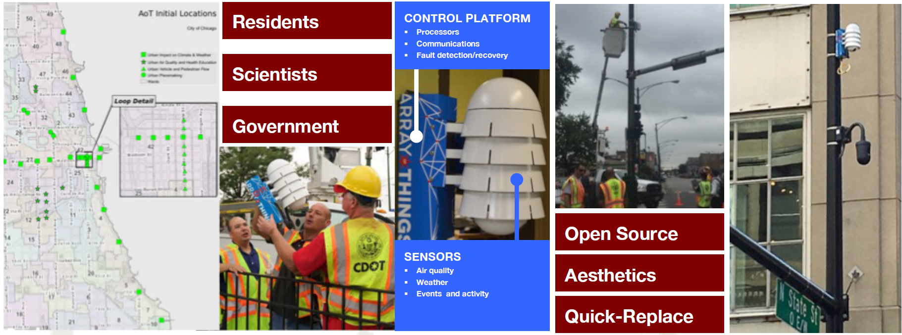
The Array of Things: science as a civic partnership

Slide 5
A program designed to meet many needs

Slide 7
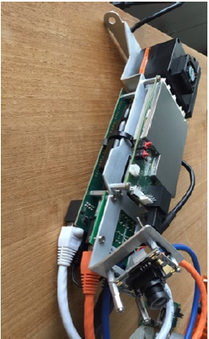
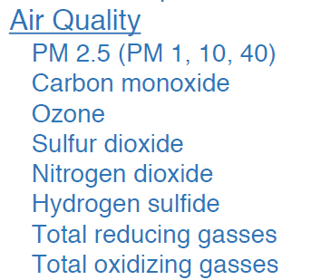
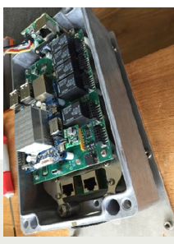
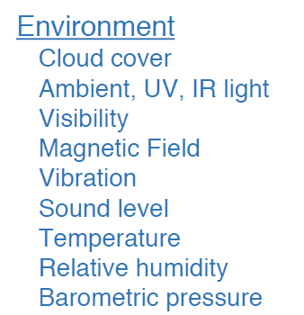
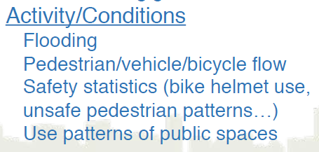
Targeting data sets defined to meet many needs

Slide 8
Design is influences & optimized by those responsible for installation

Slide 9
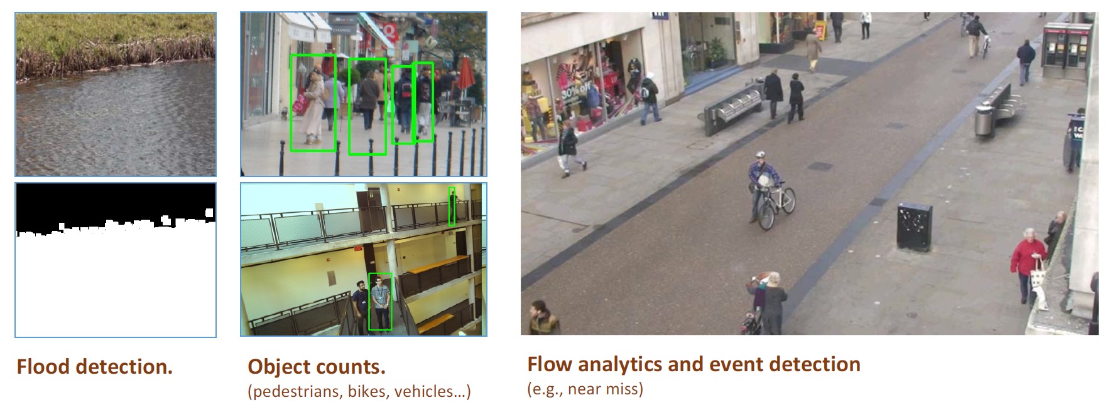
Computer vision at the edge for performance & privacy

Slide 10
City-draft, culturally sensitive governance model

Slide 11
Engaging people drives acceptance, uptake & partnership

Slide 12
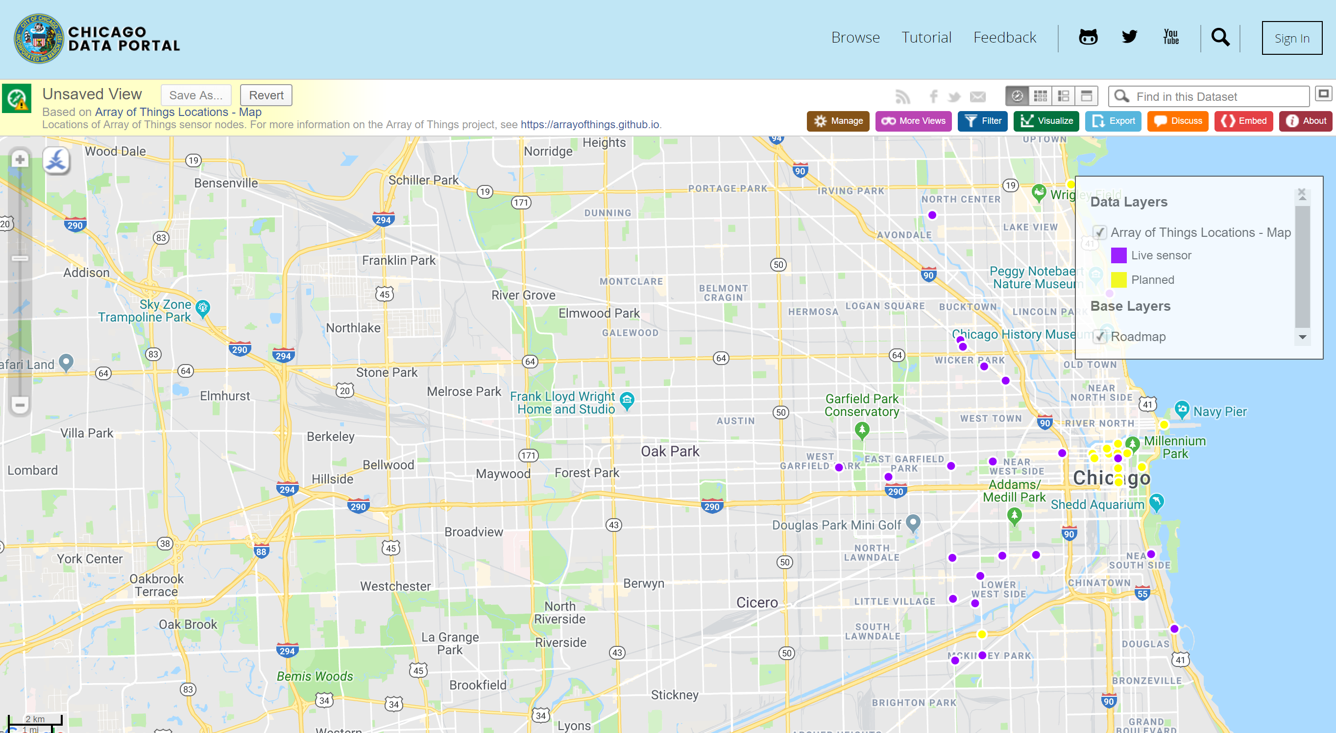
Current Chicago node locations

Slide 13
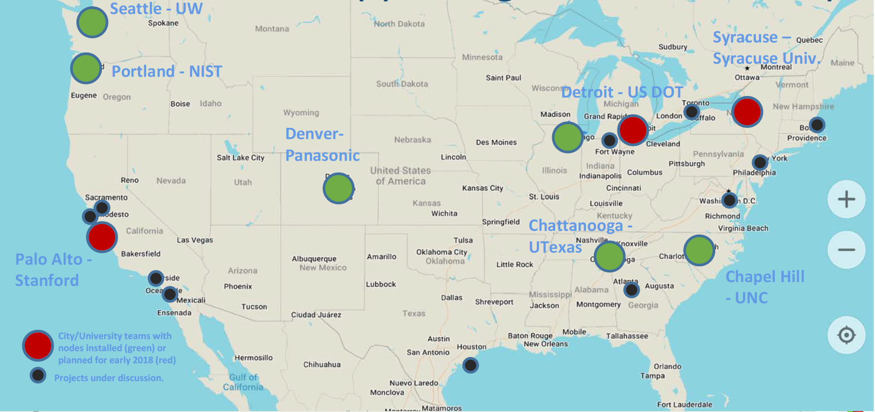
University Partnerships across the country

Slide 14
Thank you
Brenna M. Berman | march 26, 2018

