Slide 1


2018 NSF SMART AND CONNECTED COMMUNITIES PI MEETING
RCN: MainStreet21, NSF Award GA11275
PI Ila Berman, co PI Karen Rheuban, Donna Cheng, Cai Qian, RCN Director Mona El Khafif, Advisor Tho Nguyen, IEN Tanya Denckla
UVA University of Virginia
www.mainstreet21.virginia.edu [under construction]
Notes:
BRIEFLY INTRODUCE YOURSELF AND YOUR INVESTIGATORS (10 sec slide)

Slide 2
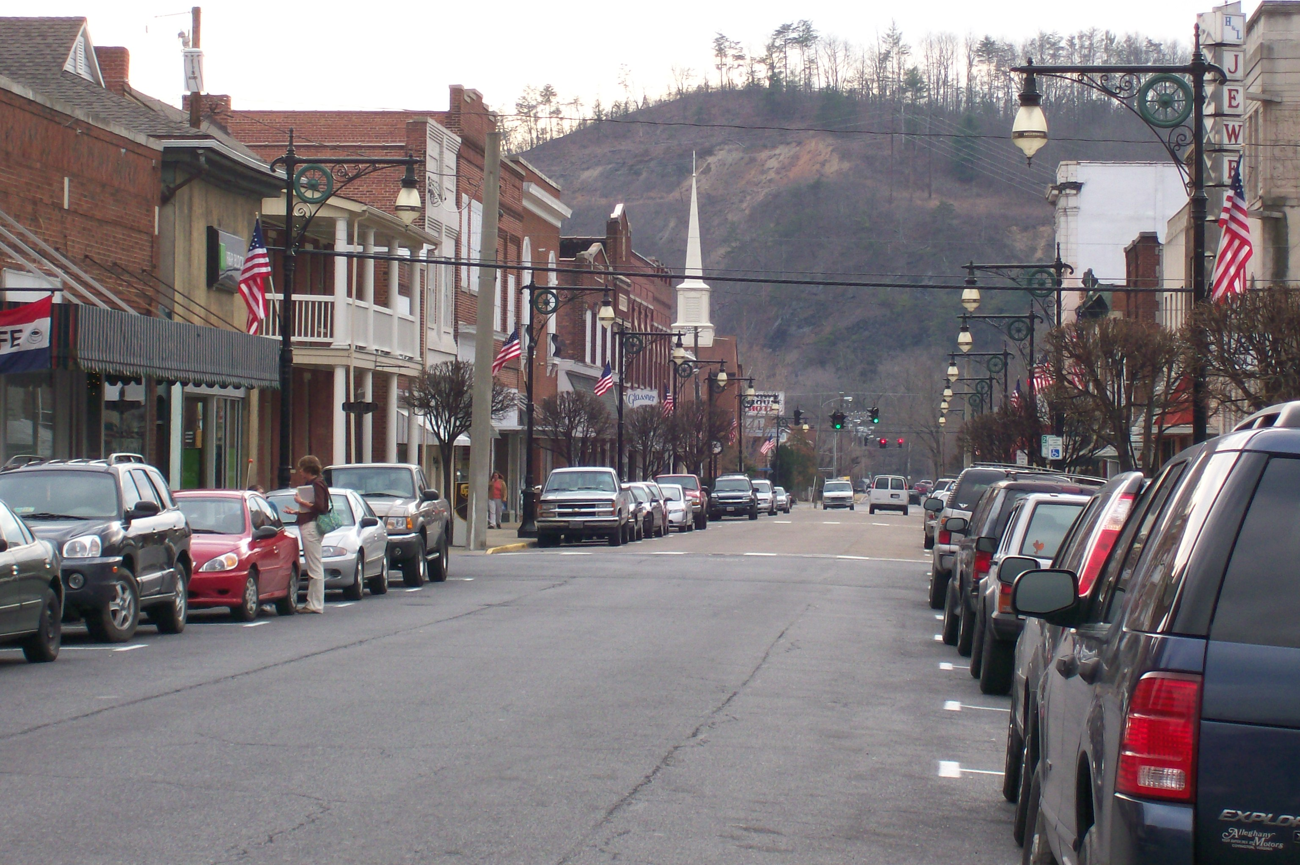
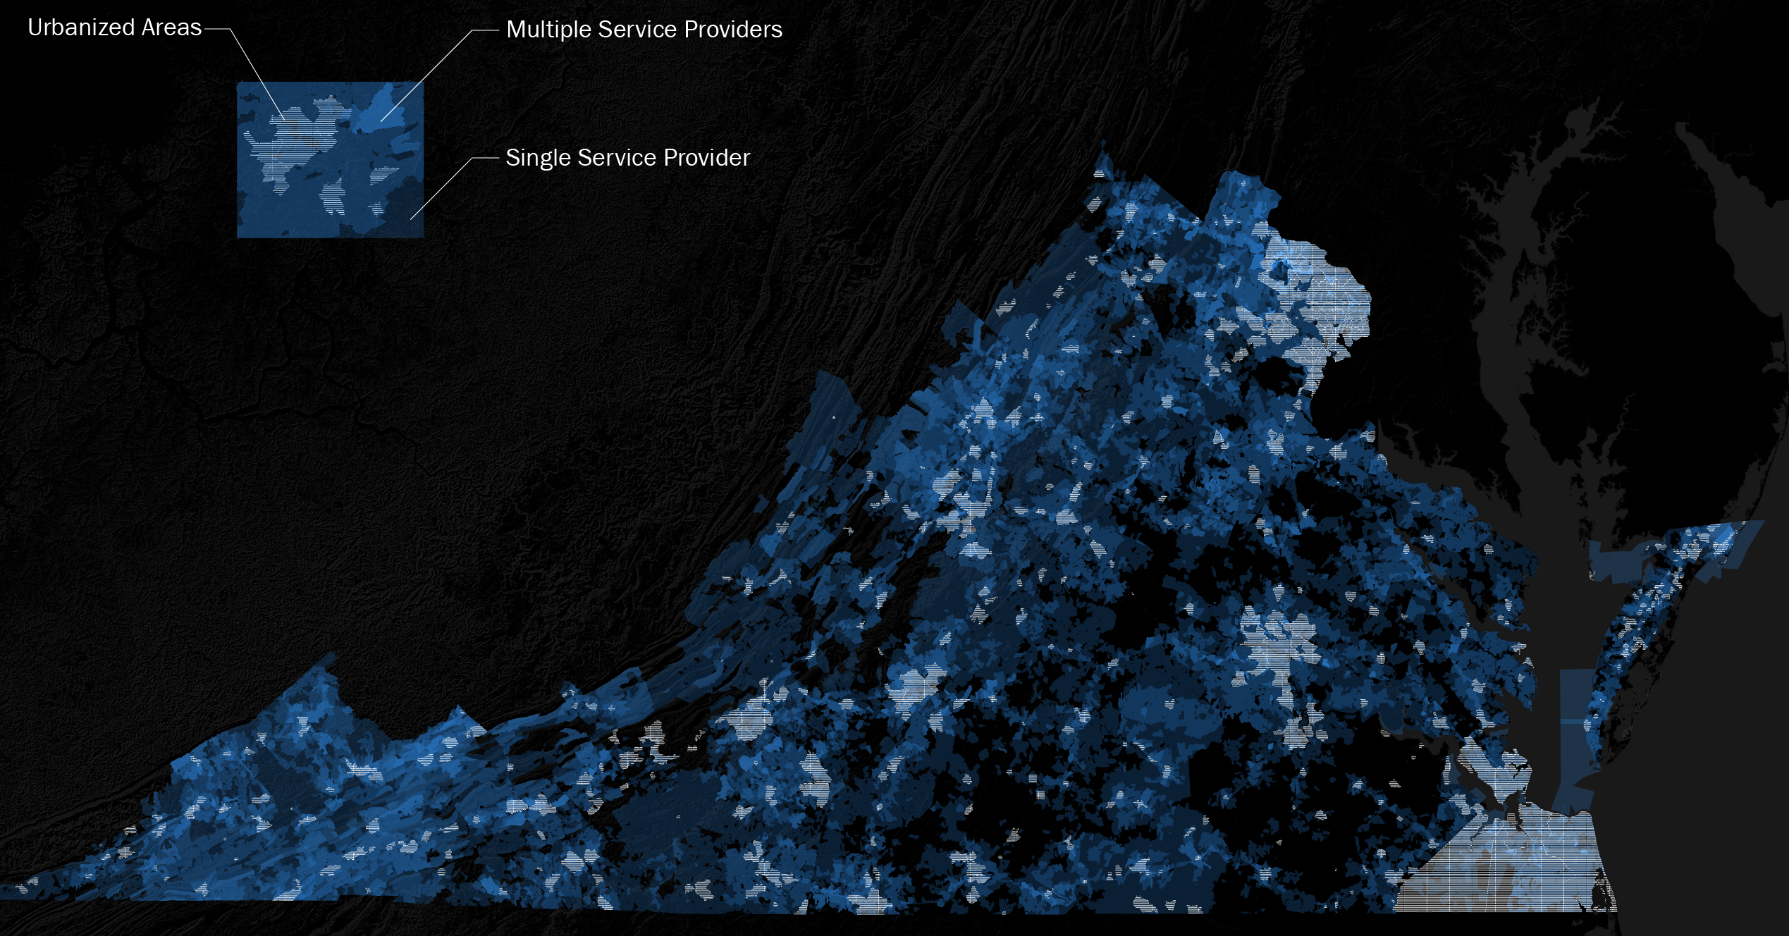
Project Aims VA MainStreet21
NSF18_Smart and Connected Communities PI Meeting
Network
Exchange
Support
Pipelines
Establishment of Partner Network and Communities in the Commonwealth of Virginia
SCC Project support: evaluate proposed projects and activities, pipeline support from concept to implementation
Community Engagement: Annual partner workshop and community workshop
SCC Project support: evaluate proposed projects and activities, pipeline support
Education and training: web portal, visiting lectures, student involvement
MainStreet 21 Playbook: Publication best practice and pipeline strategies
Figure: [left] Downtown Covington, VA Main Street, steady decline since 1960 from 11,062 to 5518 residents, [right] VA Broadband Coverage
Dr. Mona El Khafif I University of Virginia
Notes:
A brief background: Please describe the problem you are addressing and why it is important (20sec slide)

Slide 3
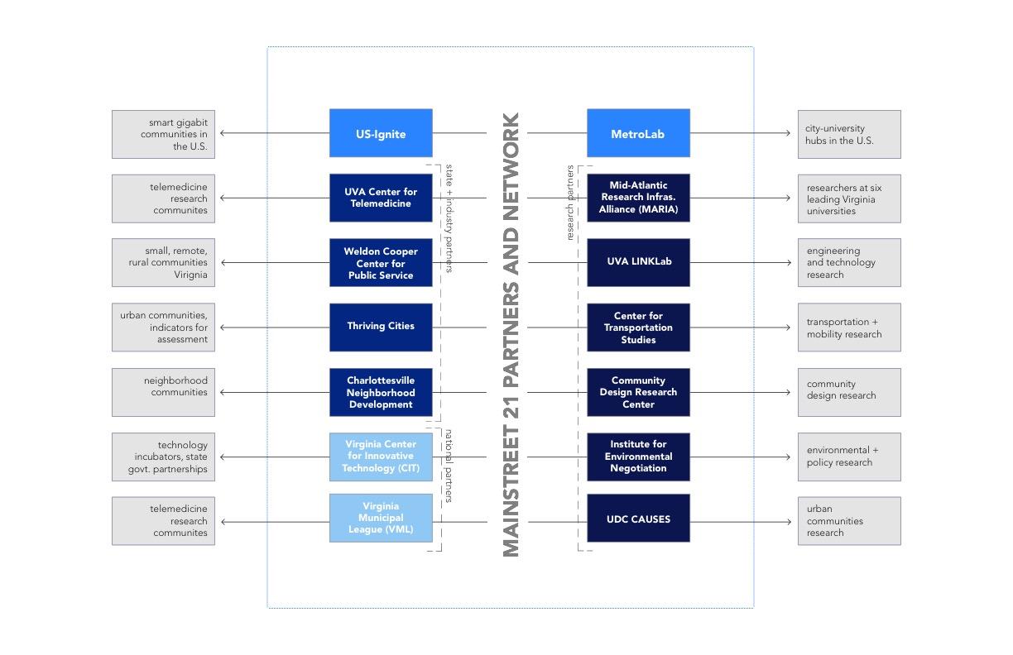
RCN Network
NSF18_Smart and Connected Communities PI Meeting
Figure: MainStreet21 RCN partners: (blue) national partners, (light blue) state and industry partners, (middle blue) community partners, (dark blue) research partners
Dr. Mona El Khafif I University of Virginia
Notes:
A brief background: Please describe the problem you are addressing and why it is important (20sec slide)

Slide 4
NSF18_Smart and Connected Communities PI Meeting
Status of Project
Establishment of core Team with monthly Meetings
Co-hosted national Workshop to develop Research Agenda for SCC in September, CRC 17 Workshop https://cps-vo.org/group/crc17
Development of Network Website and Tool
Development of Pipeline Matrix
Production of State-wide Cartographic Data Base
Establishment of first Community Partnerships to introduce Community Engagement Tools
Dr. Mona El Khafif I University of Virginia
Notes:
A brief background: Please describe the problem you are addressing and why it is important (20sec slide)

Slide 5
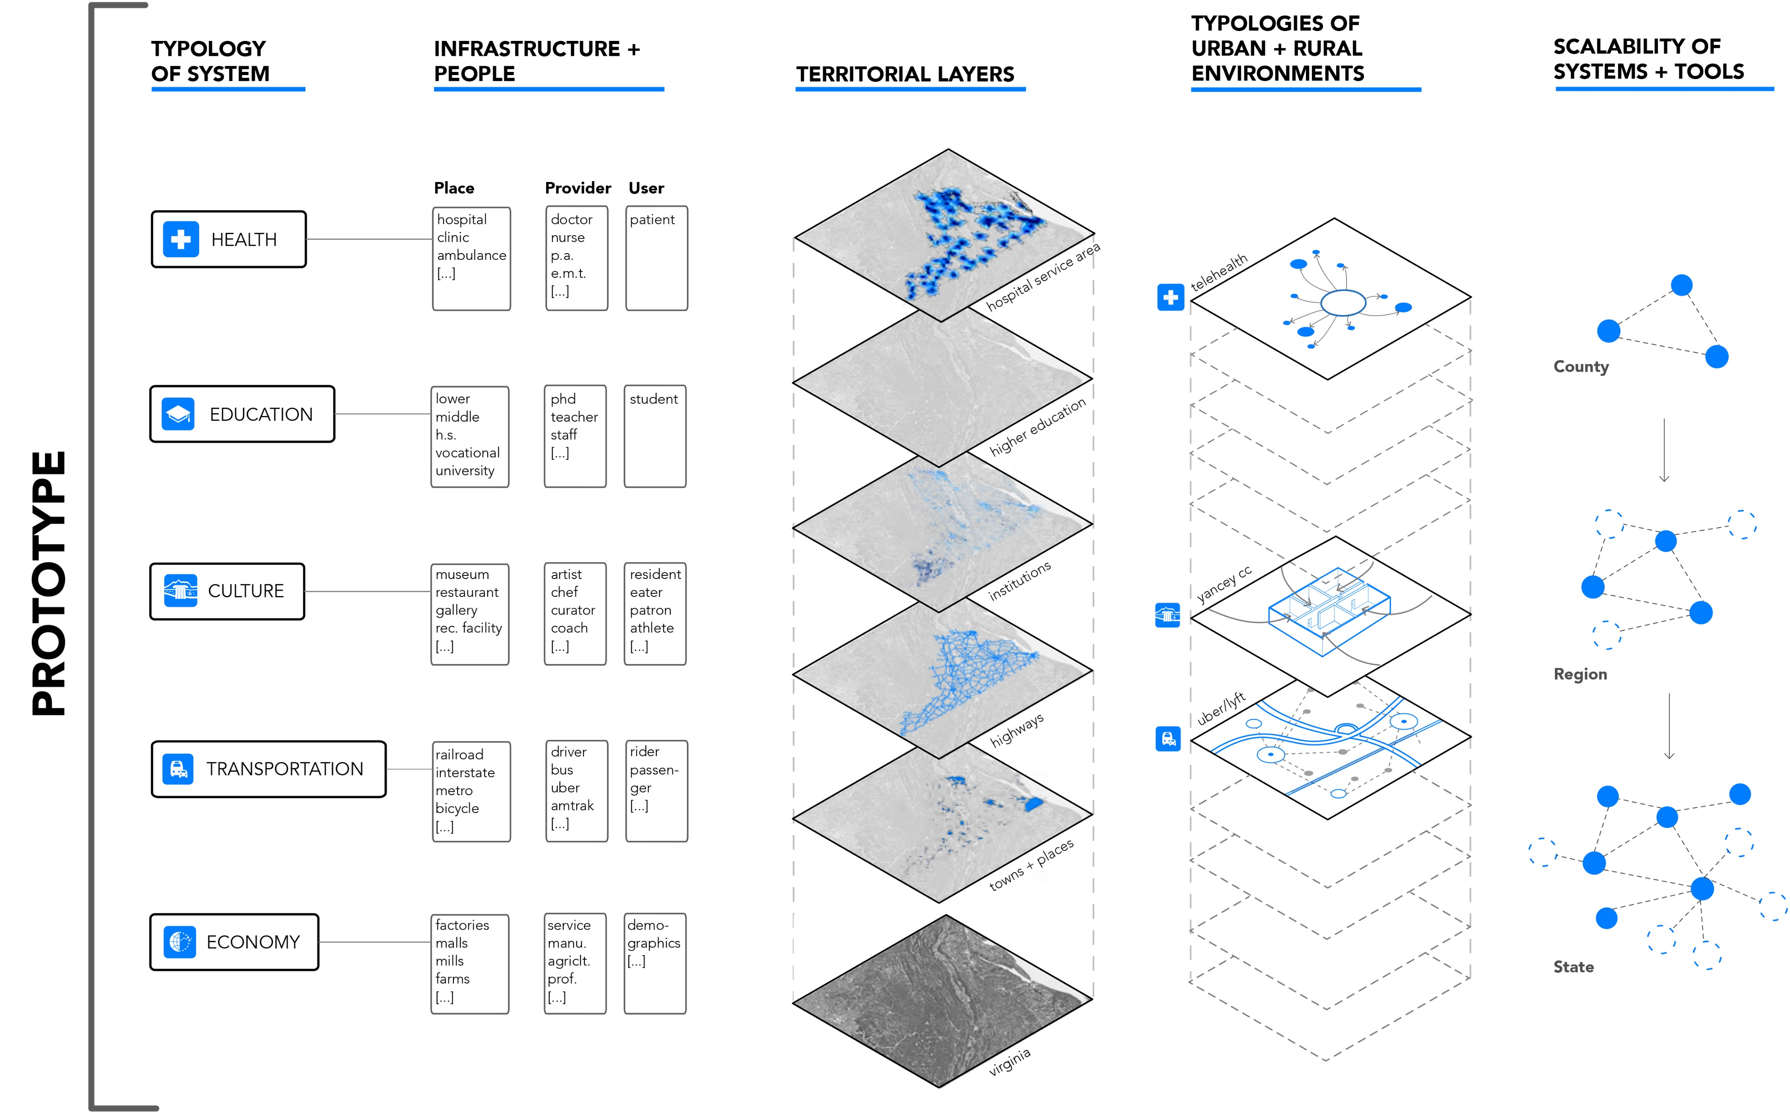
Prototypes and Model for Replication
NSF18_Smart and Connected Communities PI Meeting
Figure: RCN Pipeline Matrix
Dr. Mona El Khafif I University of Virginia
Notes:
A brief background: Please describe the problem you are addressing and why it is important (20sec slide)

Slide 6
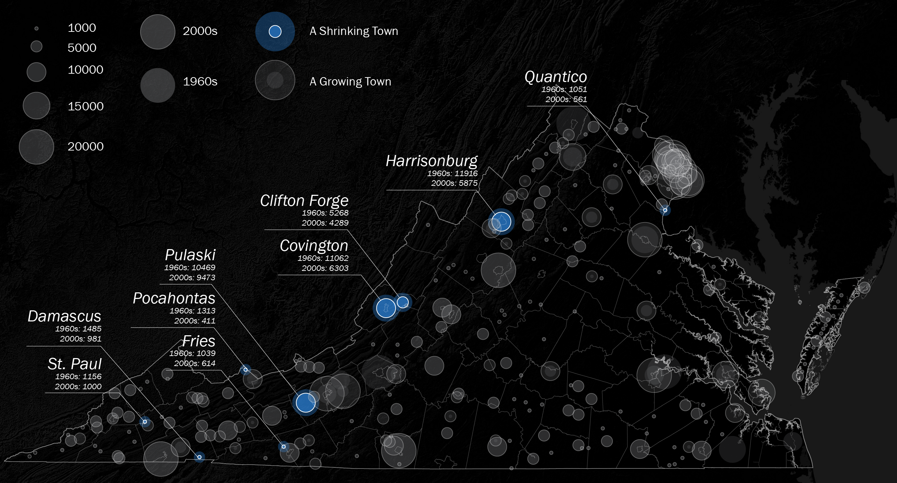
VA Cartographies
NSF18_Smart and Connected Communities PI Meeting
Figure: Virginia Population Data per city, town, place 2000 to 1960
Dr. Mona El Khafif I University of Virginia
Notes:
A brief background: Please describe the problem you are addressing and why it is important (20sec slide)

Slide 7
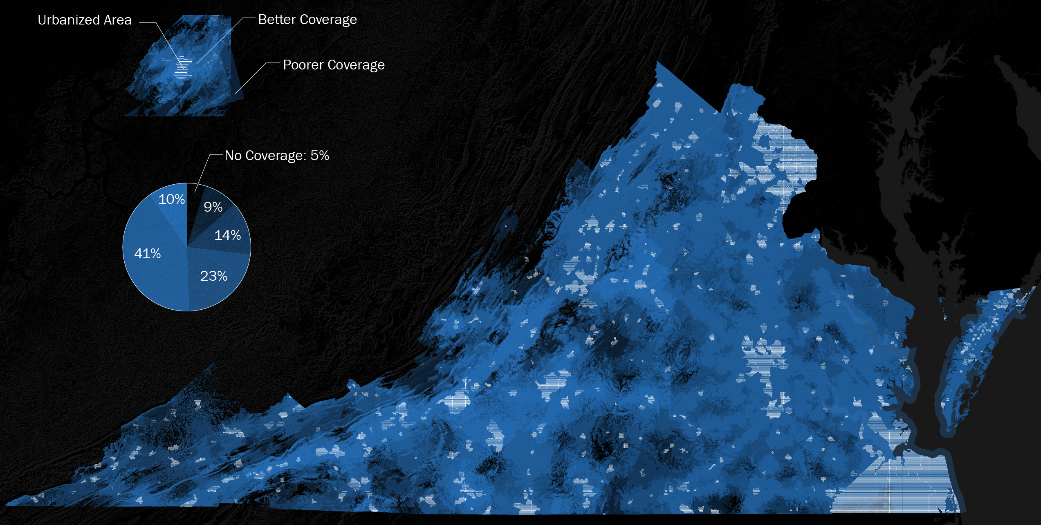
NSF18_Smart and Connected Communities PI Meeting
VA Cartographies
Figure: Virginia Cellphone Coverage, 2018
Dr. Mona El Khafif I University of Virginia
Notes:
A brief background: Please describe the problem you are addressing and why it is important (20sec slide)

Slide 8
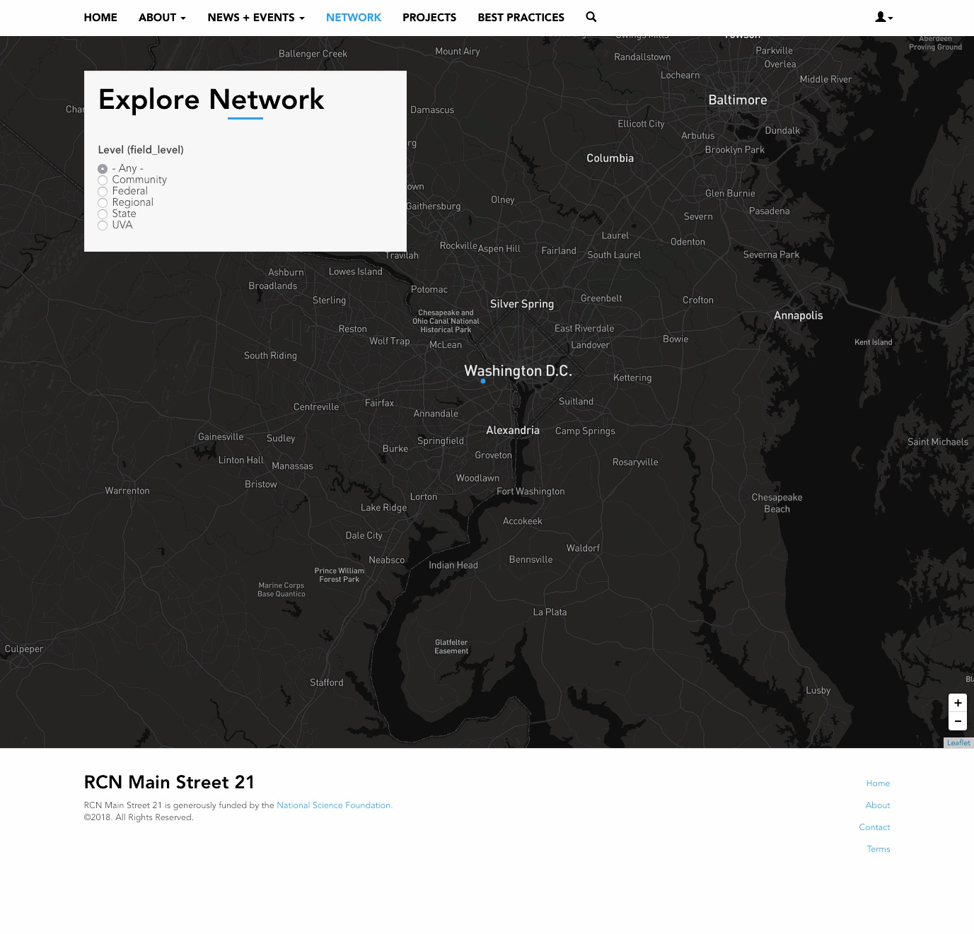
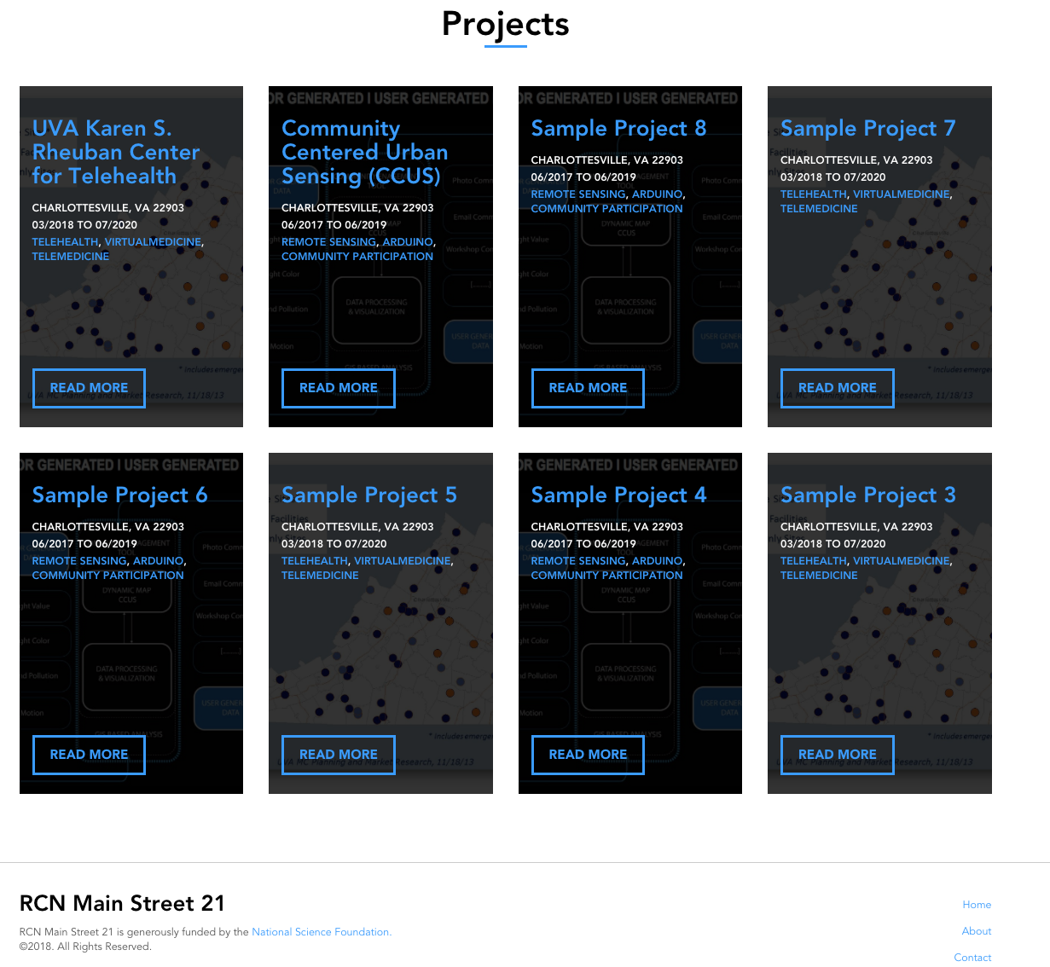
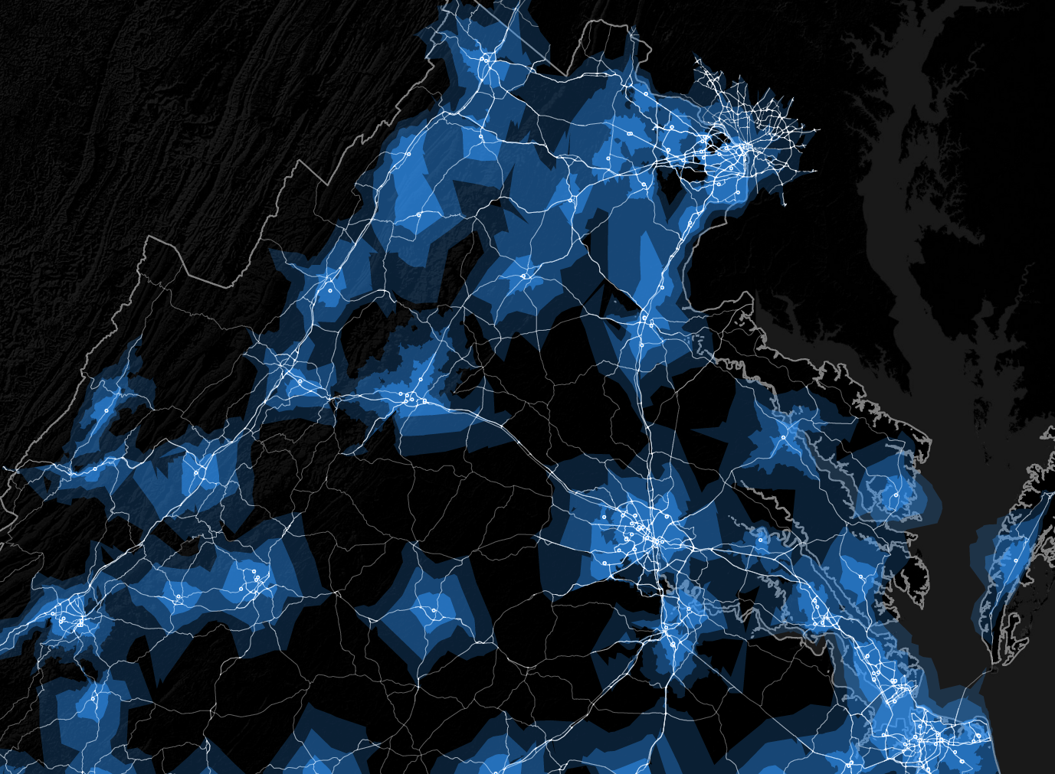
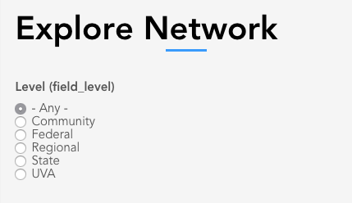
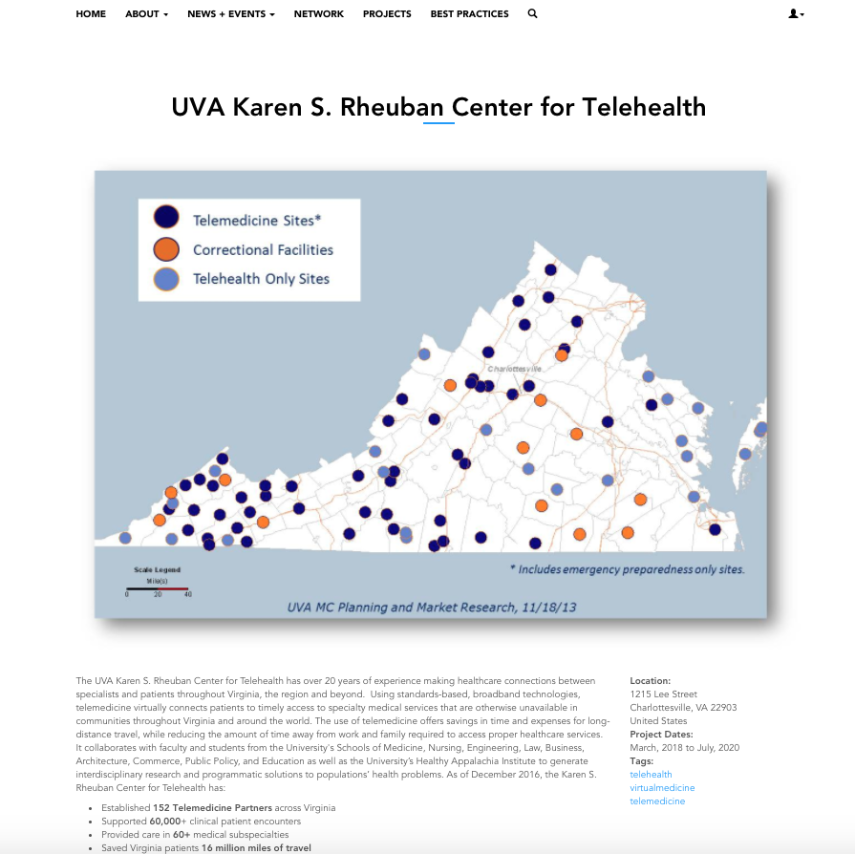
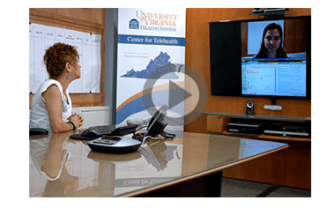
NSF18_Smart and Connected Communities PI Meeting
RCN Website Tool
Website as a Networking and Publication Tool. www.mainstreet21.virginia.edu
Dr. Mona El Khafif I University of Virginia
Notes:
A brief background: Please describe the problem you are addressing and why it is important (20sec slide)

Slide 9
NSF18_Smart and Connected Communities PI Meeting
Timeline 2018
Year 1 Outreach and Network Phase 1
April 9th TomTom Hometown Submit Reach-out Campaign, Charlottesville
April 17th Website and Tool Launch
April 18th first RCN Workshop with Partners
May Establishment of existing Partner Network
June Pipeline Support and call for Submissions
July Database development best Practice
July 21st Planning Districts Meeting, Roanoke
September first Workshop with Partners and Communities
December Playbook 2018
Contact
Mona El Khafif me9gn@virginia.edu
Tho Nguyen thn2c@virginia.edu
Dr. Mona El Khafif I University of Virginia
Notes:
A brief background: Please describe the problem you are addressing and why it is important (20sec slide)

