Slide 1
2018 NSF SMART AND CONNECTED COMMUNITIES PI MEETING
PG: S&CC Planning: Smart & Connected Rural Communities, NSF Award # 1737592
Cajetan M. Akujuobi, Pamela Obiomon, Farrah Cambrice, Noel M. Estwick, Jerrel Moore, City of Prairie View (CPV) & CPV’s Mayor David Allen
Prairie View A&M University
http://www.pvamu.edu/cybersecurity/smart-connected-rural-community/
Notes:
BRIEFLY INTRODUCE YOURSELF AND YOUR INVESTIGATORS (10 sec slide)

Slide 2
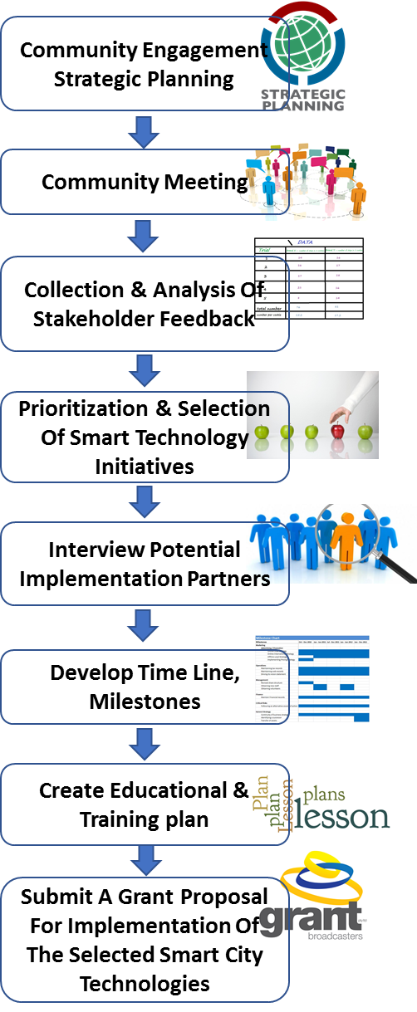
Project Aims
The primary goal of the Smart and Connected Rural Community planning grant is to explore how technology can be used to enhance the lives of rural residents.
The City of Prairie View (CPV) is selected for this planning project for its distinctive rural nature. Rural Community's unique Challenges are Low Income, Aging population, and Aging Infrastructures.
To improve the quality of life, our researchers must assess the needs and desires of Prairie View Community (PVC) residents and tailor smart tools to meet those needs.
Since last year our team has been working closely with the Mayor, CPV residents and local government and engaging all the stockholders to asses the need of smart solutions.
Notes:
A brief background: Please describe the problem you are addressing and why it is important (20sec slide)

Slide 3
Status of the Project
Community Engagement:
The team has worked collaboratively to create a brief survey instrument that could be used to assess Prairie View City residents’ views on technology and some of their concerns regarding the implementation of SMART technologies.
Facilitated three community meetings with the citizens of Prairie View City.
The three meetings took place on February 13th, 15th and 20th at City Hall’s Chamber.
Administered brief community survey and then gathered qualitative feedback in an open forum on how technology should be implemented in the City of Prairie View.
SCC Team has completed Demographic Assessment, Assessment of Crime and Safety, Assessment of Health Services, and Assessment of Technology.
Assessment of Health Services
Survey Items | N | Mean | Median | Std. Deviation
I am satisfied with emergency and medical services available in the city of Prairie View. | 19 | 1.95 | 2.00 | 1.026
I am satisfied with the healthcare facilities available in the city of Prairie View. | 20 | 1.70 | 1.50 | .865
I am satisfied with the pharmacy services available in the city of Prairie View. | 20 | 1.75 | 1.50 | 1.020
I am satisfied with the mental healthcare/psychological services available in the city of Prairie View. | 20 | 1.75 | 1.00 | .910
Notes:
A brief background: Please describe the problem you are addressing and why it is important (20sec slide)

Slide 4
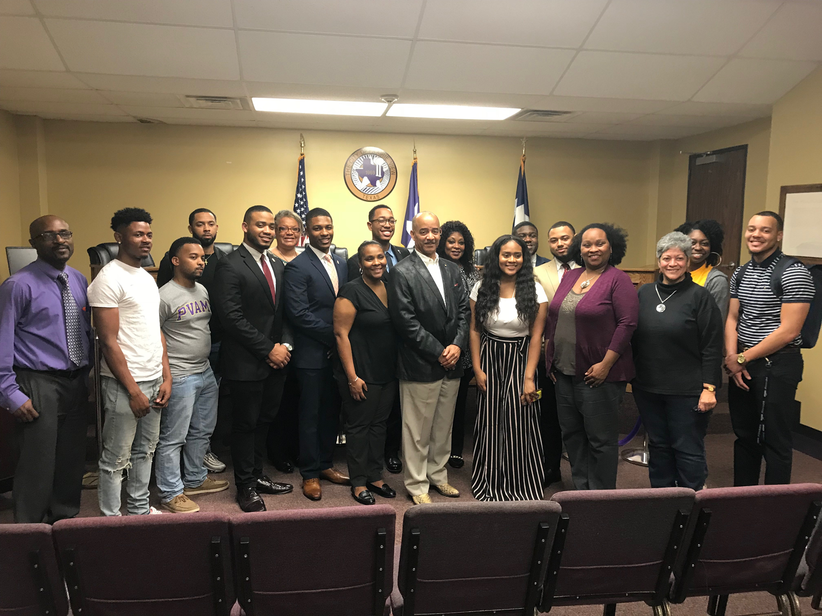
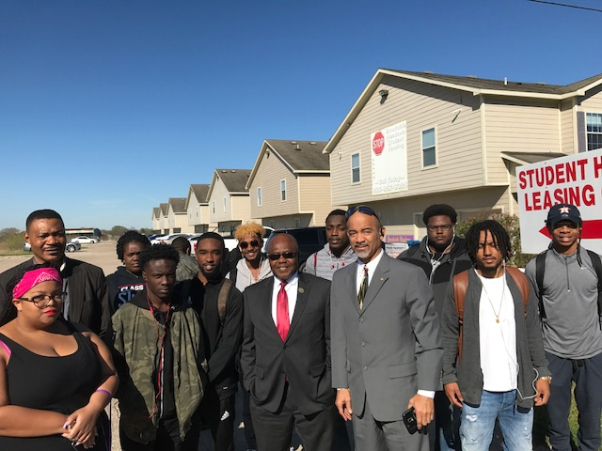
Planned Outcomes
Understand the need of Smart & Connected Rural Communities
Dissemination of knowledge to scientific community and stake holders via publication and presentation
Develop educational and training plan
Submit a grant proposal to NSF for the implementation of the selected smart technologies for the Smart & Connected Rural Communities.
Notes:
A brief background: Please describe the problem you are addressing and why it is important (20sec slide)

